Slide 2
Objectives Overview
Describe career opportunities available in various segments of the computer industry
Discuss functions of jobs available in an IT department
Distinguish between trade schools and colleges
Differentiate among various computer-related majors for college students
Identify ways to stay current with changing technology after graduation
See Page 783
for Detailed Objectives

Slide 3
Objectives Overview
List the benefits of certification for employers, employees, and vendors
Identify ways to prepare for certification
List the general areas of IT certification
Name some specific IT certifications in various certification areas
See Page 783
for Detailed Objectives

Slide 4
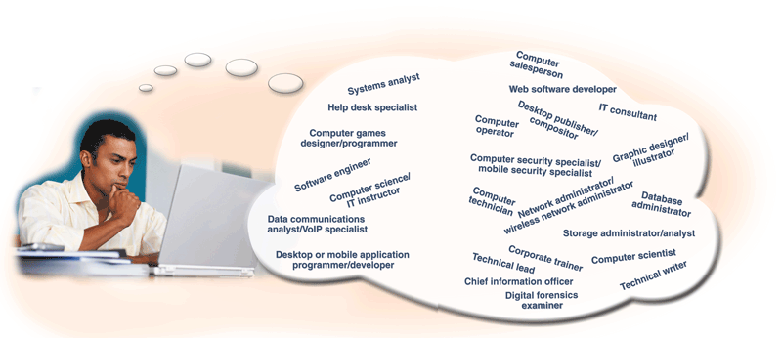
The Computer Industry
A demand for computer professionals continues to grow
  IT is predicted to be the fastest growing industry for the next 10 years
Pages 784 – 785
Figure 15-1

Slide 5
Careers in the Computer Industry
Job opportunities in the computer industry generally are available in one or more of these areas:
General business and government organizations and their IT departments
Computer equipment field
Computer software field
Computer service and repair field
Computer sales
Computer education and training field
IT consulting
Page 786

Slide 6
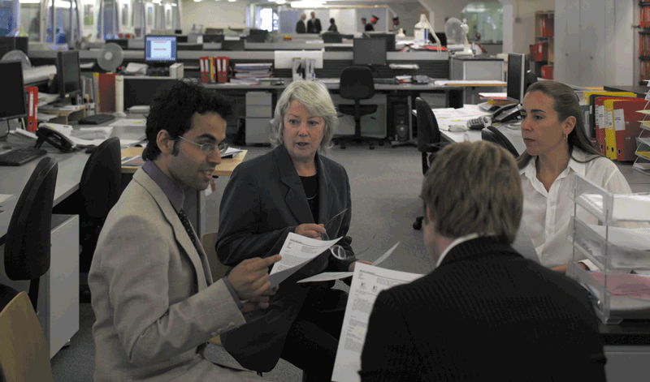
Careers in the Computer Industry
Employees in the IT department work together as a team to meet the information requirements of the organization
Employees also are responsible for keeping all the computer operations and networks running
Pages 786 – 787
Figure 15-2

Slide 7
Careers in the Computer Industry
Jobs in the IT department typically are divided into six main areas
Management
System development and programming
Technical services
Operations
Training
Security
Click to view Web Link,
click Chapter 15, Click Web
Link from left navigation,
then click Computer Career Salaries below Chapter 15
Page 787

Slide 8
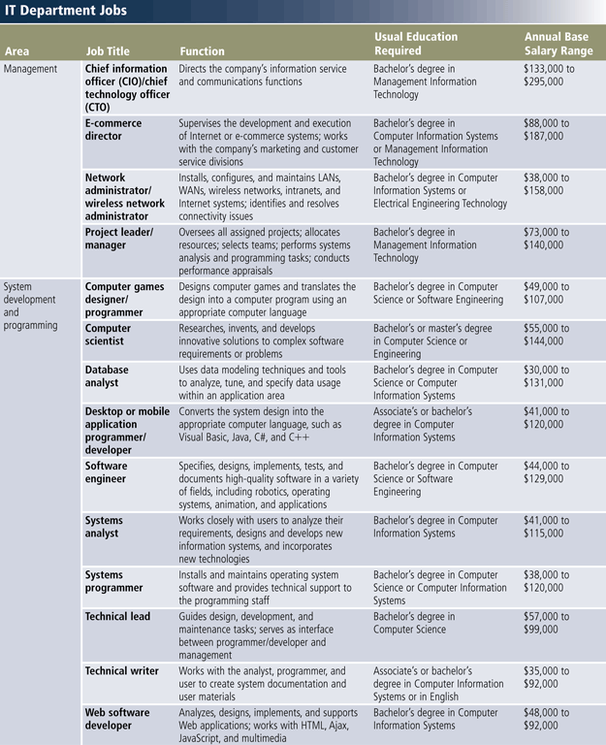
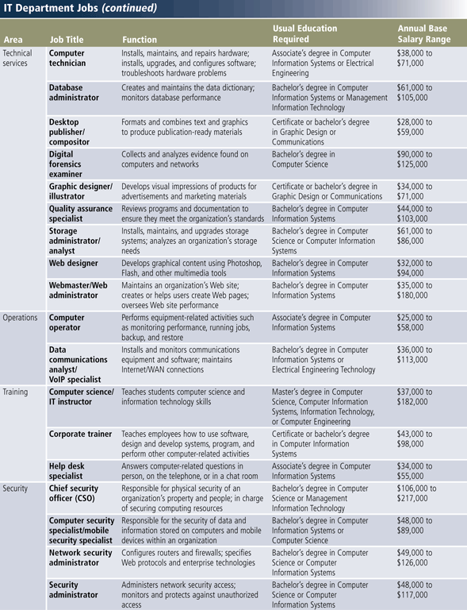
Careers in the Computer Industry
Pages 788 – 789
Figure 15-3

Slide 9

Careers in the Computer Industry
The computer equipment field consists of manufacturers and distributors of computers and computer-related hardware
Careers in this field are available with companies that design, manufacture, and produce computers and devices
Page 790
Figure 15-4

Slide 10
Careers in the Computer Industry
The computer software field consists of companies that develop, manufacture, and support a wide range of software
Job titles might include:
Project leader
Project manager
Desktop or mobile application programmer/developer
Technical lead
Software engineer
Computer scientist
Pages 790 - 791

Slide 11
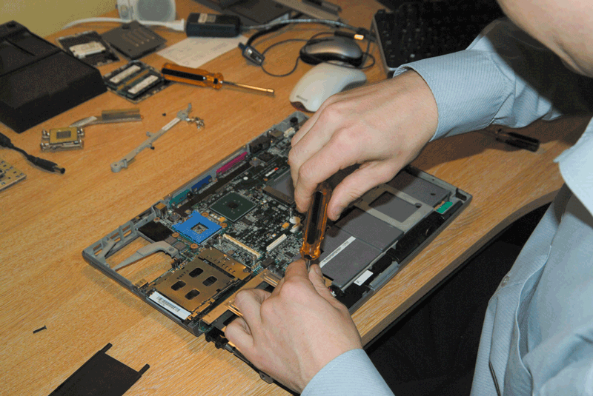
Careers in the Computer Industry
The computer service and repair field provides:
  Preventive maintenance
  Component installation
  Repair services
Requires a knowledge of electronics
Page 791
Figure 15-5

Slide 12
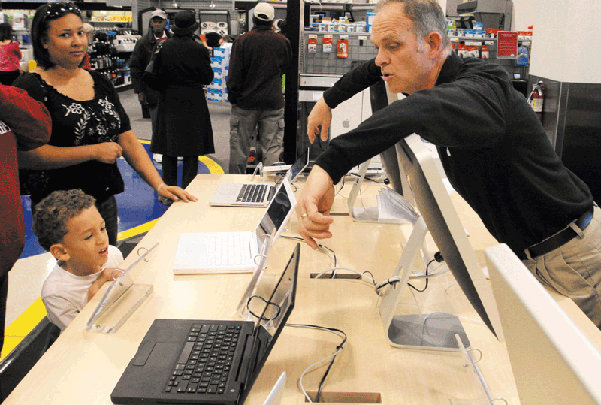
Careers in the Computer Industry
Computer salespeople must possess a general understanding of computers and a specific knowledge of the products they are selling
  Some work for computer
  equipment and software
  manufacturers, and
  others work for retailers
Page 792
Figure 15-6

Slide 13

Careers in the Computer Industry
Corporate trainers teach employees how to use software, design and develop systems, write programs, and perform other computer-related activities
Page 793
Figure 15-7

Slide 14
Careers in the Computer Industry
An IT consultant provides computer services to his or her clients
Page 793

Slide 15
Preparing for a Career in the Computer Industry
A trade school typically offers programs in:
Programming
Web design and development
Graphics design
Hardware maintenance
Networking
Personal computer support
Security
Click to view Web Link,
click Chapter 15, Click Web
Link from left navigation,
then click Trade Schools
below Chapter 15
Page 794

Slide 16
Preparing for a Career in the Computer Industry
If you attend a two-year college, check for an articulation agreement with a four-year university
Three broad disciplines produce the greatest number of entry-level employees
Computer Information Systems
Computer Science
Computer Engineering
Page 794

Slide 17
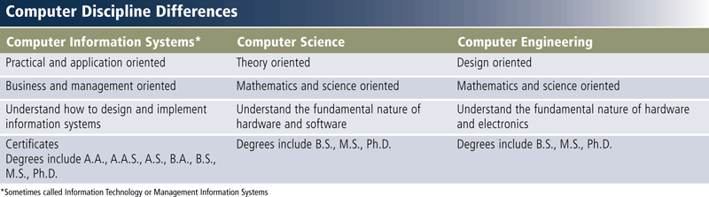
Preparing for a Career in the Computer Industry
Page 795
Figure 15-8

Slide 18
Preparing for a Career in the Computer Industry
Computer information systems
Programming
Computer Science
Artificial intelligence
Computer Engineering
Application and systems programming
Operating systems
Systems analysis and design
Databases
Networking
Web development
Data communications
Data and file structures
Operating systems
Application and systems programming
Systems analysis and design
Data and file structures
Networks
Operating systems
Click to view Web Link,
click Chapter 15, Click Web
Link from left navigation,
then click Computer Degrees
below Chapter 15
Page 795

Slide 19
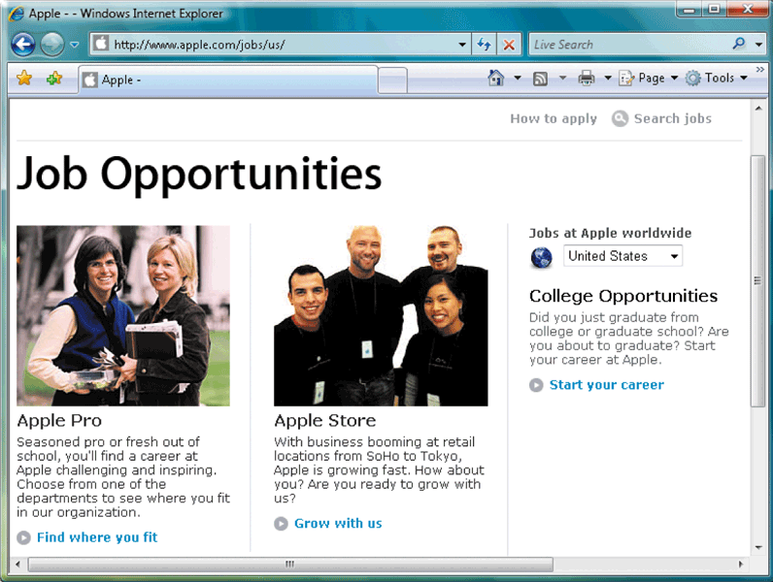
Preparing for a Career in the Computer Industry
Many companies list their job openings, internship opportunities, and career opportunities on their Web sites
Job seekers can create a video resume
Page 796
Figure 15-9

Slide 20
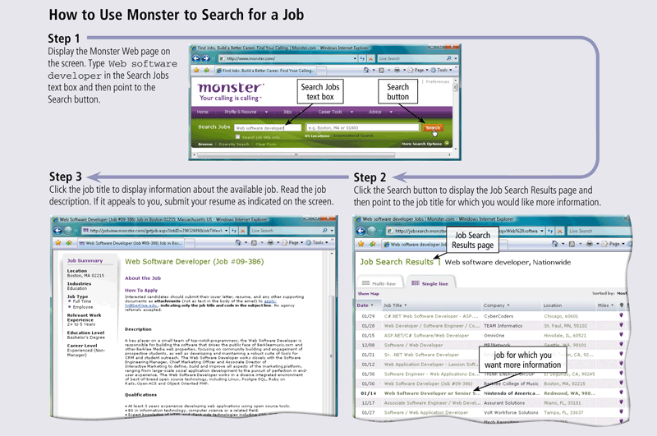
Preparing for a Career in the Computer Industry
Page 796
Figure 15-10

Slide 21
Preparing for a Career in the Computer Industry
It is important to keep up to date on industry trends and technologies and to develop new skills
Professional organizations and personal networks
Professional growth and continuing education
Computer publications
Certification
Page 797

Slide 22
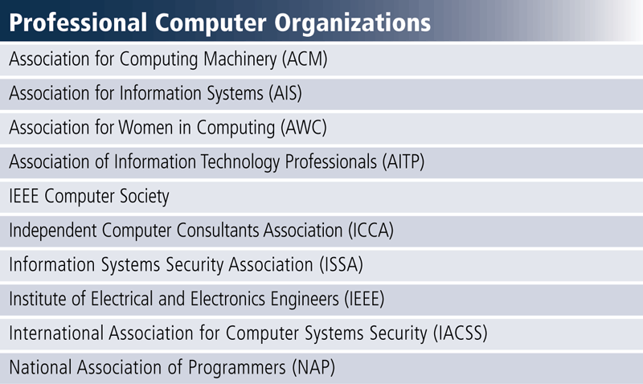
Preparing for a Career in the Computer Industry
Computer professionals with common interests and a desire to extend their proficiency form computer-related professional organizations
Click to view Web Link,
click Chapter 15, Click Web
Link from left navigation,
then click Professional Computer Organizations
below Chapter 15
Page 797
Figure 15-11

Slide 23
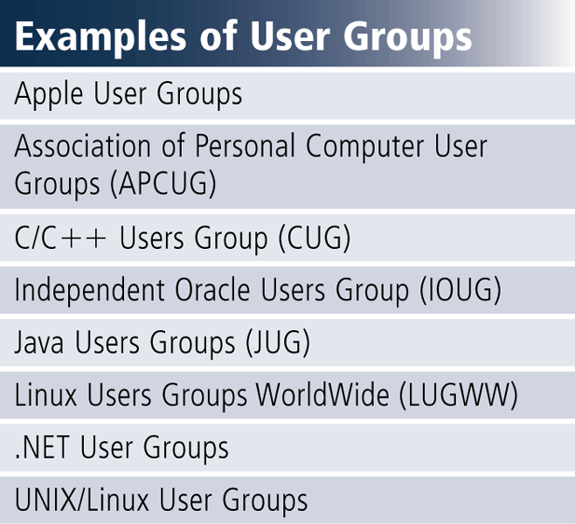
Preparing for a Career in the Computer Industry
A user group is a collection of people with common computer equipment or software interests
Can be an effective and rewarding way to learn about and continue career development
Page 798
Figure 15-12

Slide 24
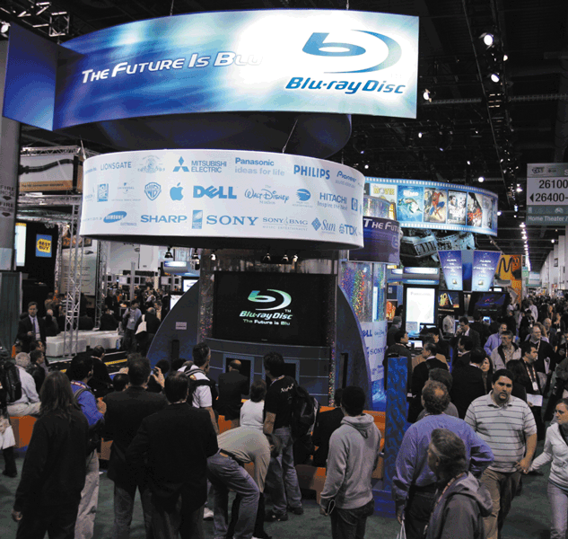
Preparing for a Career in the Computer Industry
Conferences, conventions, and trade shows are a great way to stay aware of new products and services
  International Consumer
  Electronics Show (CES)
Page 798
Figure 15-13

Slide 25
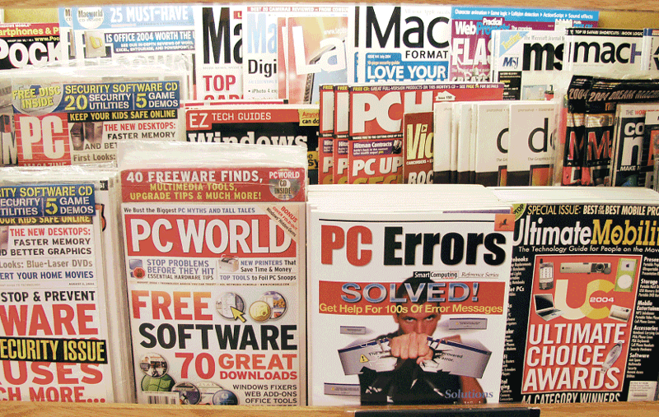
Preparing for a Career in the Computer Industry
Hundreds of computer industry publications are available
  Computerworld
  InfoWorld
  PC Magazine
  PC World
Click to view Web Link,
click Chapter 15, Click Web
Link from left navigation,
then click Professional Computer Publications
below Chapter 15
Page 799
Figure 15-14

Slide 26
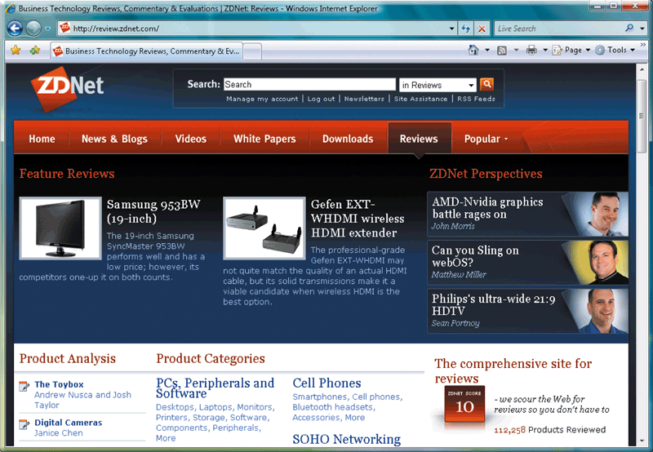
Preparing for a Career in the Computer Industry
Web sites discuss or share opinions, analysis, reviews, or news about technology
  Slashdot
  The Register
  AnandTech
  Tom’s Hardware Guide
Page 799
Figure 15-15

Slide 27
Certification
Certification is the process of verifying the technical knowledge of an individual who has demonstrated competence in a particular area
Computer certifications are available in these areas:
Application software
Operating systems
Programming
Hardware
Networking
Digital forensics
Security
The Internet
Database systems
Click to view Web Link,
click Chapter 15, Click Web
Link from left navigation,
then click Computer Certifications below
Chapter 15
Page 800

Slide 28
Certification
IT certifications can:
Enhance employees’ careers
Increase professional standing
Increase employee salaries
Pages 800 - 801

Slide 29
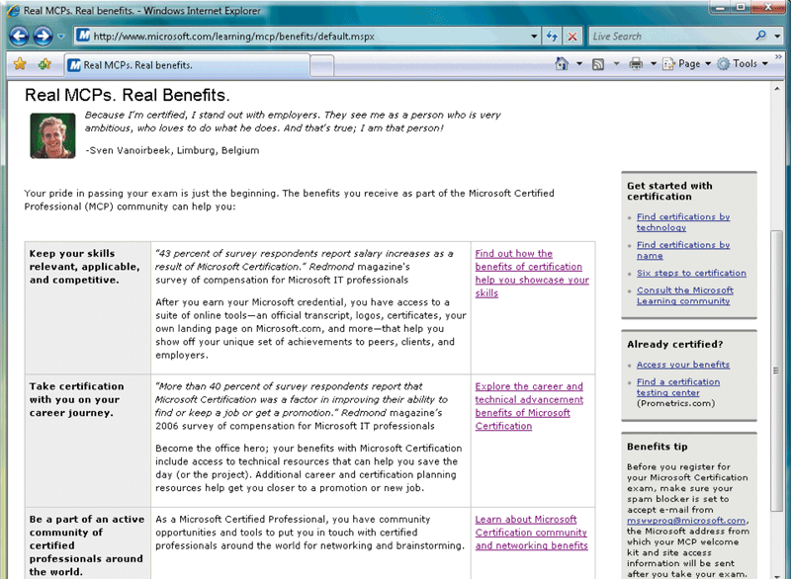
Certification
Vendor-sponsored certifications offer many special benefits as incentives
Professional organizations also offer certifications
Click to view Web Link,
click Chapter 15, Click Web
Link from left navigation,
then click Institute for Certification of Computing Professionals below
Chapter 15
Page 801
Figure 15-17

Slide 30
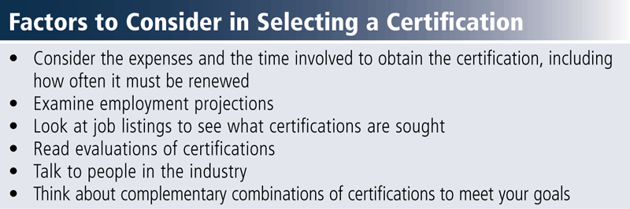
Certification
Selecting a certification requires careful thought and research
Page 802
Figure 15-18

Slide 31
Certification
Certification training options are available to suit every learning style
Self-study
Online training classes
Instructor-led training
Web resources
Requires high motivation
Least expensive
Students set their own pace
Can be one-third the price of instructor-led programs
Typically span from several days to several months
Some sponsors hold their own sessions
May include detailed course objectives, training guides, sample test questions, chat rooms, and discussion groups
Page 802

Slide 32
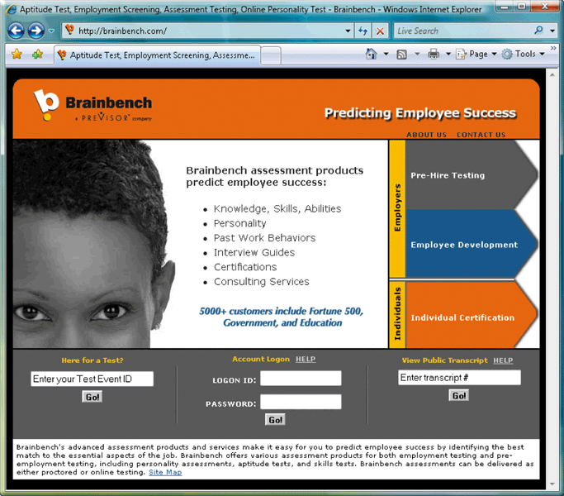
Certification
Certifications are typically taken on a computer at a testing center
With computerized adaptive testing (CAT), the tests analyze a person’s responses while taking the test
Page 803
Figure 15-19

Slide 33
A Guide to Certification
Application Software Certifications
Microsoft Certified Application Specialist (MCAS)
Microsoft Certified Application Professional (MCAP)
Microsoft Certified Desktop Support Technician (MCDST)
Adobe Certified Associate
Adobe Certified Expert (ACE)
Adobe Certified Instructor (ACI)
IBM Certified Professional for Lotus Software
Click to view Web Link,
click Chapter 15, Click Web
Link from left navigation,
then click Microsoft Certified Application Specialist
below Chapter 15
Page 804
Figure 15-20

Slide 34
A Guide to Certification
Operating System Certifications
IBM Certified Specialist
Microsoft Certified Technology Specialist (MCTS)
Novell Certified Linux Professional (CLP)
Red Hat Certified Engineer (RHCE)
Red Hat Certified Technician (RHCT)
Sun Certified System Administrator (SCSA)
Page 804
Figure 15-21

Slide 35
A Guide to Certification
Programmer/Developer Certifications
Certified Software Development Associate (CSDA)
Certified Software Development Professional (CSDP)
ISB Certified Solution Developer
Microsoft Certified Professional Developer (MCPD)
Sun Certified Enterprise Architect (SCEA)
Sun Certified Java Developer (SCJD)
Sun Certified Java Programmer (SCJP)
Sun Certified Mobile Application Developer (SCMAD)
Page 805
Figure 15-22

Slide 36
A Guide to Certification
Hardware Certifications
A+
IBM eServer Certified Specialist
NACSE Hardware Technician
Page 805
Figure 15-23

Slide 37
A Guide to Certification
Networking Certifications
Novell Certified Administrator (NCA)
Novell Certified Engineer (NCE)
Cisco Certified Network Associate (CCNA)
Cisco Certified Network Professional (CCNP)
Cisco Certified Internetwork Expert (CCIE)
Microsoft Certified Systems Administrator (MCSA)
Network+
Sun Certified Network Administrator (SCNA)
Click to view Web Link,
click Chapter 15, Click Web
Link from left navigation,
then click Network+
below Chapter 15
Page 806
Figure 15-24

Slide 38
A Guide to Certification
Digital Forensics Certifications
Certified Computer Examiner (CCE)
Certified Electronic Evidence Collection Specialist (CEECS)
Certified Forensic Computer Examiner (CFCE)
Certified Information Forensics Investigator (CIFI)
Page 806
Figure 15-25

Slide 39
A Guide to Certification
Security Certifications
Certified Information Systems Security Professional (CISSP)
Security Certified Network Architect (SCNA)
Security Certified Network Professional (SCNP)
Security Certified Network Specialist (SCNS)
Systems Security Certified Practitioner (SSCP)
Page 807
Figure 15-26

Slide 40
A Guide to Certification
Internet Certifications
Certified Internet Webmaster (CIW)
Certified Web Professional (CWP)
Page 807
Figure 15-27

Slide 41
A Guide to Certification
Database System Certifications
IBM Certified Solutions Expert – DB2
IBM Certified Solutions Expert – Informix
Microsoft Certified IT Professional (MCITP)
Oracle Certified Professional (OCP)
Sybase Certified Professional
Pages 807 - 808
Figure 15-28

Slide 42
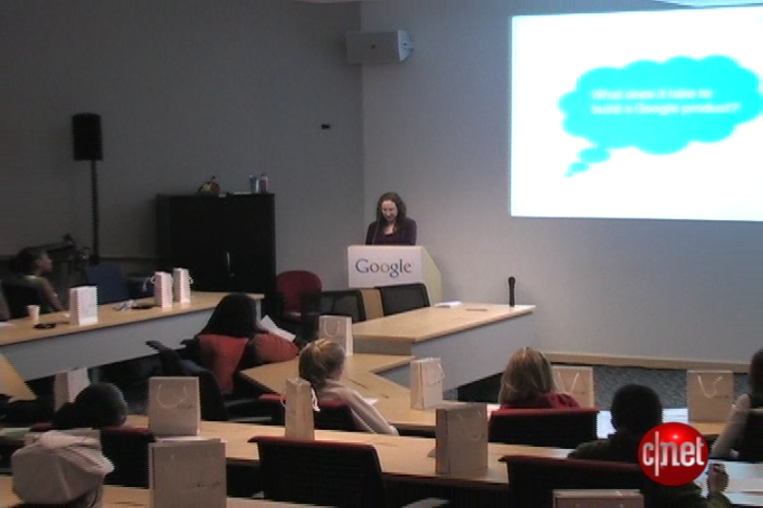
Video: Girls Tour the Googleplex
CLICK TO START

Slide 43
Summary
Strong demand for computer and IT professionals
Variety of available computer-related careers
Computer education at trade schools, computer-related majors at colleges and universities, job searches, career development planning, professional organizations, and professional growth
Certification preparation, examinations, and resources
Specific certifications
Page 808

Slide 44
Chapter 15 Complete

