Slide 2
Objectives Overview
Discuss the special information requirements of an enterprise-sized corporation
Identify information systems and software used in the functional units of an enterprise
Describe and list general purpose and integrated information systems used throughout an enterprise
Describe and list types of technologies used throughout an enterprise
Describe virtualization, cloud computing, and grid computing
See Page 719
for Detailed Objectives

Slide 3
Objectives Overview
Discuss the computer hardware needs and solutions for an enterprise
Discuss high availability, scalability, and interoperability
Determine why computer backup is important and how it is accomplished
Discuss the steps in a disaster recovery plan
See Page 719
for Detailed Objectives

Slide 4
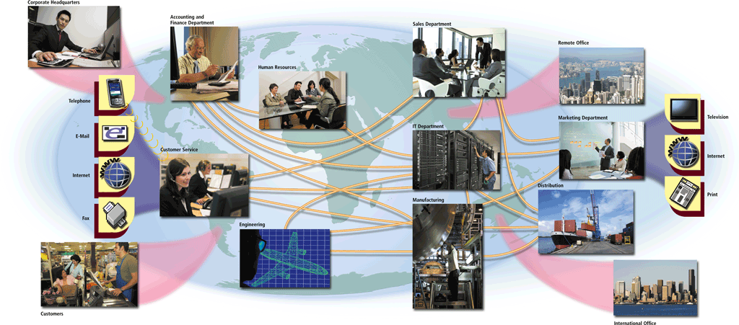
What Is Enterprise Computing?
Enterprise computing involves the use of computers in networks, such as LANs and WANs, or a series of interconnected networks that encompass a variety of different operating systems, protocols, and network architectures
Pages 720 – 721
Figure 14-1

Slide 5
What Is Enterprise Computing?
Types of enterprises include:
Retail
Manufacturing
Service
Wholesale
Government
Educational
Transportation
Page 722

Slide 6
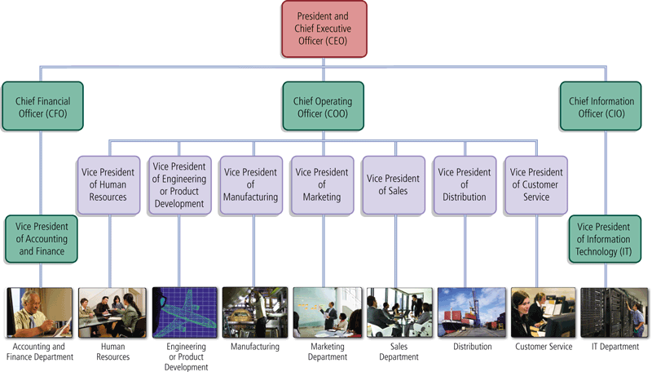
What Is Enterprise Computing?
Most traditional enterprises are organized in a hierarchical manner
Pages 722 – 723
Figure 14-2

Slide 7
What Is Enterprise Computing?
In an enterprise, users typically fall into one of four categories:
Executive Management
Middle Management
Operational Management
Nonmanagement Employees
Page 724
Figure 14-3

Slide 8
What Is Enterprise Computing?
Enterprise information is the information gathered in the ongoing operations of an enterprise-sized organization
  Business intelligence
  Business process management
  Business process automation
Click to view Web Link,
click Chapter 14, Click Web
Link from left navigation,
then click Business Process Management below Chapter 14
Pages 725 - 726

Slide 9
What Is Enterprise Computing?
Managers coordinate resources by performing four activities
Planning
Organizing
Leading
Controlling
Page 725
Figure 14-4

Slide 10
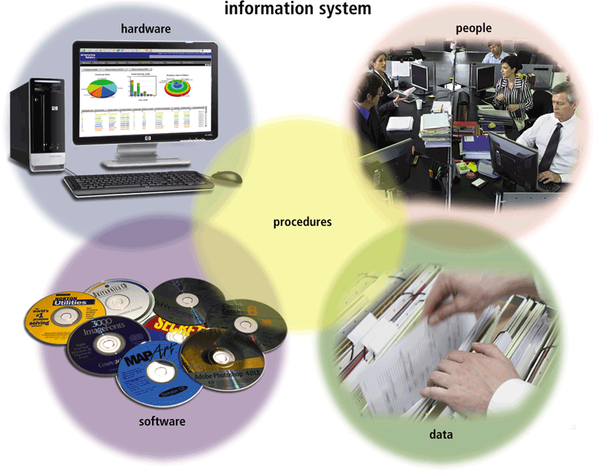
Information Systems in the Enterprise
An information system is a set of hardware, software, data, people, and procedures that work together to produce information
Page 726
Figure 14-5

Slide 11
Information Systems in the Enterprise
Functional units within an enterprise might include:
Enterprise
Accounting and Finance
Human Resources
Engineering or Product Development
Manufacturing
Marketing
Sales
Distribution
Customer Service
Information Technology
Page 727

Slide 12
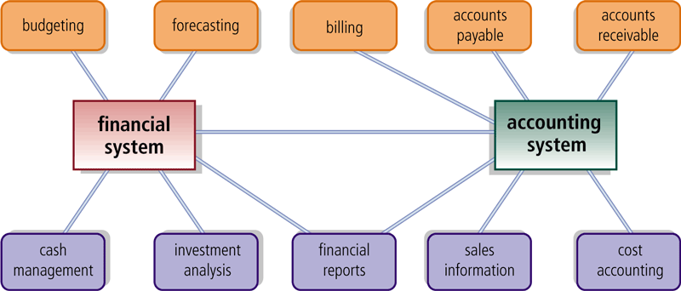
Information Systems in the Enterprise
Accounting software manages everyday transactions
Billing software helps the company reconcile purchases with customer payments
Financial software helps managers budget, forecast, and analyze
Pages 726 – 728
Figure 14-7

Slide 13
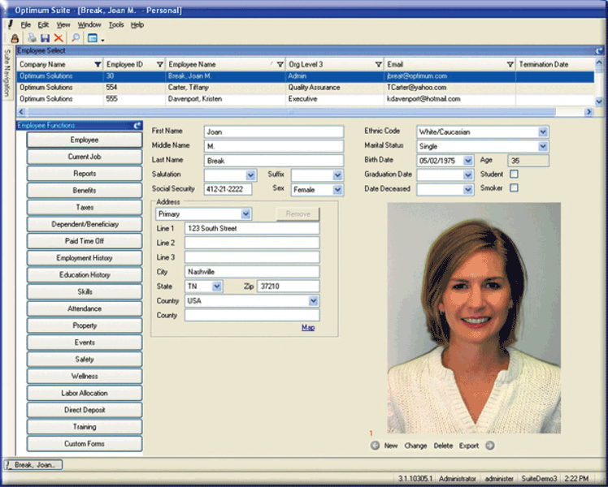
Information Systems in the Enterprise
A human resources information system (HRIS) manages one or more human resources functions
Employee relationship management systems manage communication between employees and the business
Click to view Web Link,
click Chapter 14, Click Web
Link from left navigation,
then click ERM
below Chapter 14
Page 728
Figure 14-8

Slide 14
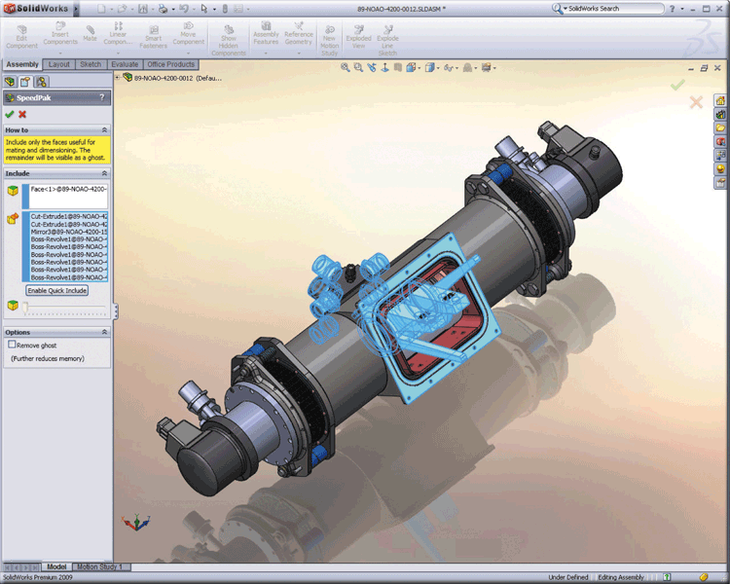
Information Systems in the Enterprise
Computer-aided design (CAD) uses a computer and special software to aid in engineering, drafting, and design
Computer-aided engineering (CAE) uses computers to test product designs
Pages 728 – 729
Figure 14-9

Slide 15
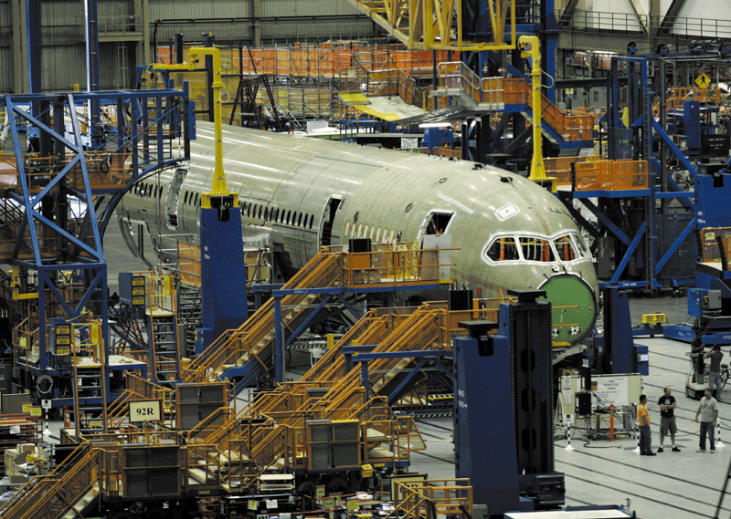
Information Systems in the Enterprise
Computer-aided manufacturing (CAM) is the use of computers to control production equipment
Computer-integrated manufacturing (CIM) uses computers to integrate the many different operations of the manufacturing process
Page 729
Figure 14-10

Slide 16
Information Systems in the Enterprise
Material Requirements Planning (MRP) uses software to help monitor and control processes related to production
Manufacturing Resource Planning II (MRP II) is an extension of MRP and also includes software that helps in scheduling
Click to view Web Link,
click Chapter 14, Click Web
Link from left navigation,
then click MRP II
below Chapter 14
Pages 729 - 730

Slide 17
Information Systems in the Enterprise
A quality control system helps an organization maintain or improve the quality of its products or services
A marketing information system serves as a central repository for the tasks of a marketing department
Page 730

Slide 18
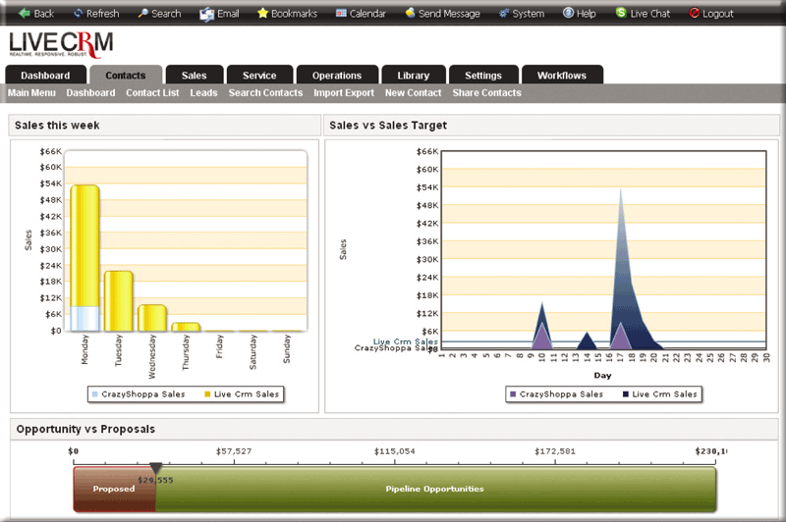
Information Systems in the Enterprise
Sales force automation (SFA) software equips traveling salespeople with the electronic tools they need to be more productive
Click to view Web Link,
click Chapter 14, Click Web
Link from left navigation,
then click SFA
below Chapter 14
Pages 730 – 731
Figure 14-12

Slide 19
Information Systems in the Enterprise
Distribution systems perform the following functions:
Provide forecasting for inventory control
Manage and track shipping of products
Provide information and analysis on inventory in a warehouse
Page 731

Slide 20
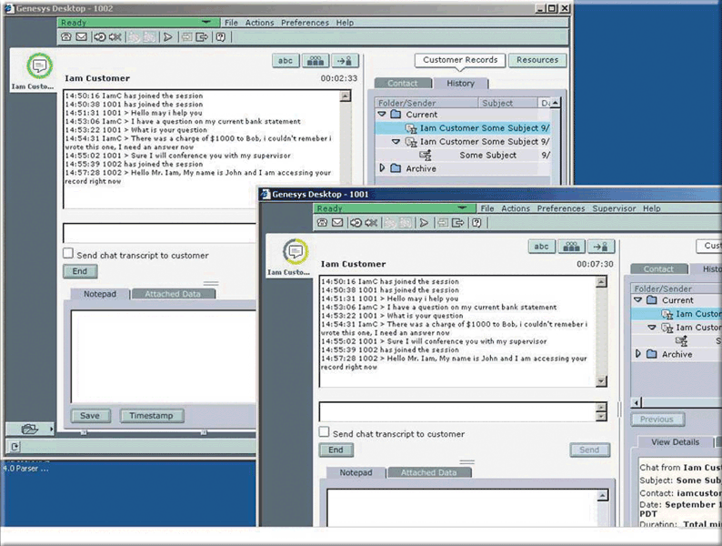
Information Systems in the Enterprise
Customer interaction management (CIM) software manages the day-to-day interactions with customers
Page 731
Figure 14-13

Slide 21
Information Systems in the Enterprise
The information technology (IT) department makes technology decisions for the enterprise
  Whether to build or buy new information systems
  When a computer or information system has outlived its useful life
Web site management programs collect data designed to help organizations make informed decisions regarding their Web presence
Click to view Web Link,
click Chapter 14, Click Web
Link from left navigation,
then click IT Departments
below Chapter 14
Page 732

Slide 22
Information Systems in the Enterprise
General purpose information systems generally fall into one of five categories
Office Information System
Transaction Processing System
Management Information System
Decision Support System
Expert System
Page 732

Slide 23
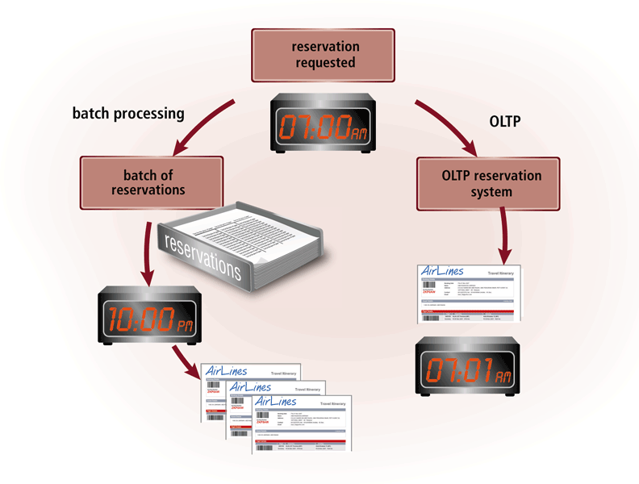
Information Systems in the Enterprise
Batch processing vs. online transaction processing
Page 733
Figure 14-14

Slide 24
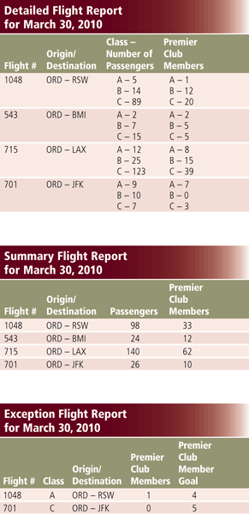
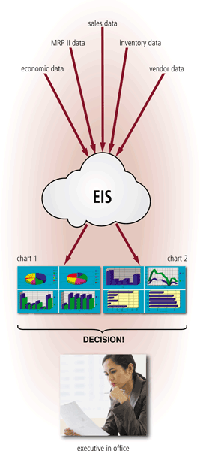
Information Systems in the Enterprise
Management Information System
Decision Support System
Pages 734 – 725
Figures 14-15 – 14-16

Slide 25
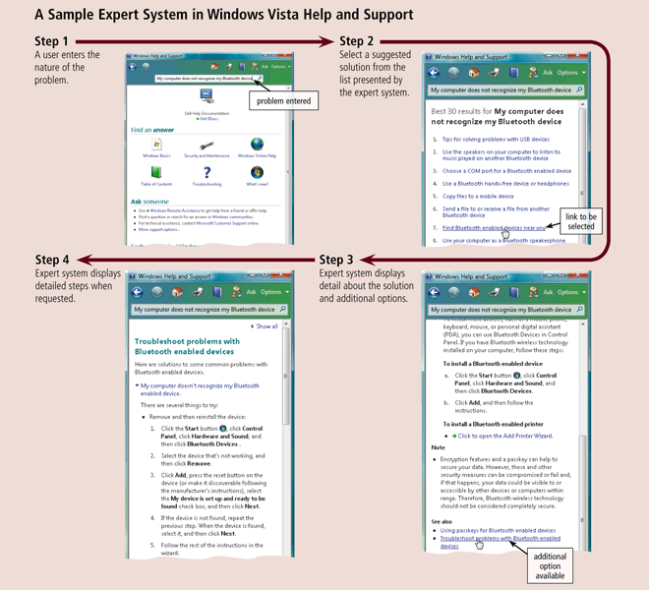
Information Systems in the Enterprise
Page 736
Figure 14-17

Slide 26
Information Systems in the Enterprise
Integrated Information Systems
Customer relationship management manages information about customers, interactions with customers, past purchases, and interests
Enterprise resource planning provides centralized, integrated software to help manage and coordinate ongoing activities
Content management systems are information systems that combine databases, software, and procedures
Pages 737 - 739

Slide 27
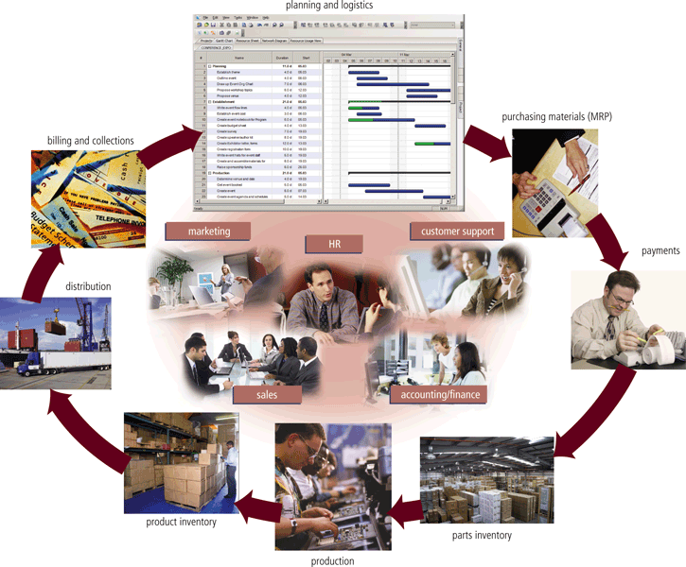
Information Systems in the Enterprise
Click to view Web Link,
click Chapter 14, Click Web
Link from left navigation,
then click ERP
below Chapter 14
Page 738
Figure 14-18

Slide 28
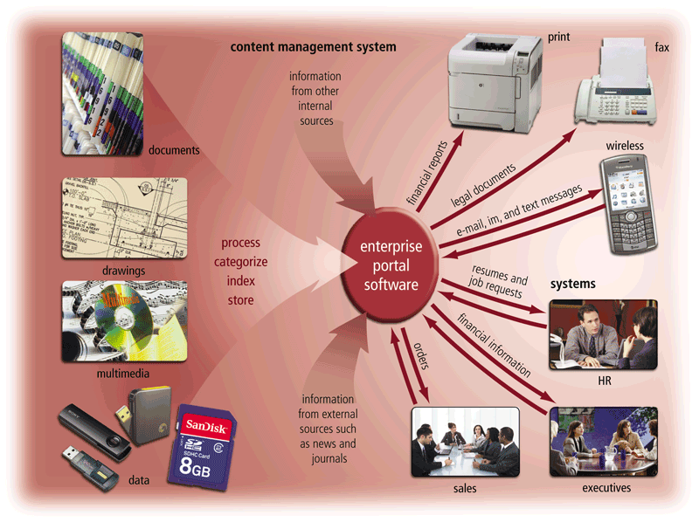
Information Systems in the Enterprise
Page 739
Figure 14-19

Slide 29
Enterprise-Wide Technologies and Methodologies
Some technologies used in enterprises include:
Portals
Data warehouses
Electronic data interchange
Extranets
Web services
Document management systems
Workflow
Virtual private networks
Click to view Web Link,
click Chapter 14, Click Web
Link from left navigation,
then click Data Centers
below Chapter 14
Page 740

Slide 30
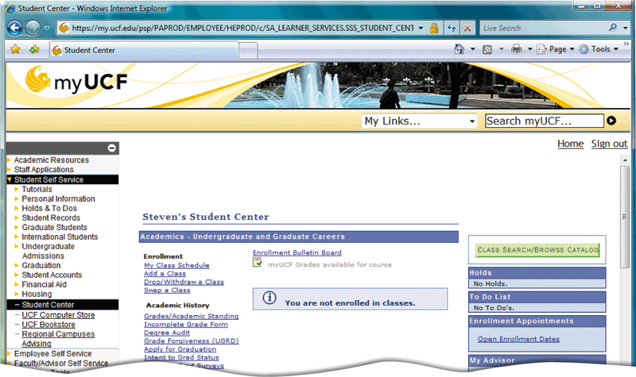
Enterprise-Wide Technologies and Methodologies
A portal is a collection of links, content, and services presented on a Web page that are interesting for a particular job function
Pages 740 – 741
Figure 14-20

Slide 31
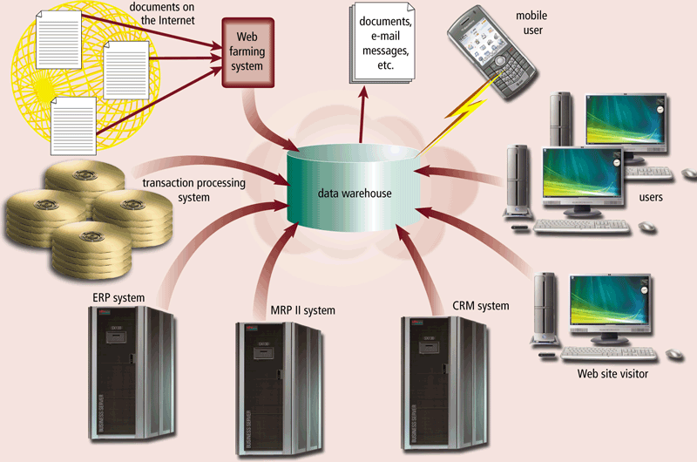
Enterprise-Wide Technologies and Methodologies
A data warehouse is a huge database that stores and manages the data required to analyze historical and current transactions
Page 741
Figure 14-21

Slide 32
Enterprise-Wide Technologies and Methodologies
EDI is a set of standards that controls the transfer of business data and information among computers within and among enterprises
An extranet is the portion of a company’s network that allows customers or suppliers of a company to access parts of an enterprise’s intranet
Page 742

Slide 33
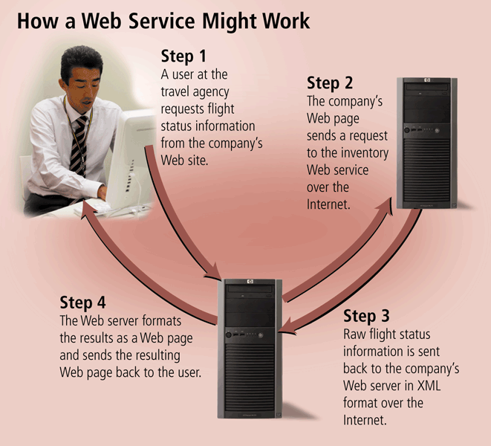
Enterprise-Wide Technologies and Methodologies
Web services allow businesses to create products and B2B interactions over the Internet
Click to view Web Link,
click Chapter 14, Click Web
Link from left navigation,
then click Web Services
below Chapter 14
Pages 742 – 743
Figure 14-22

Slide 34
Enterprise-Wide Technologies and Methodologies
In a service-oriented architecture, information systems provide services to other information systems in a well-defined manner over a network
A document management system (DMS) allows for storage and management of a company’s documents
  Stored in a repository
Page 743

Slide 35
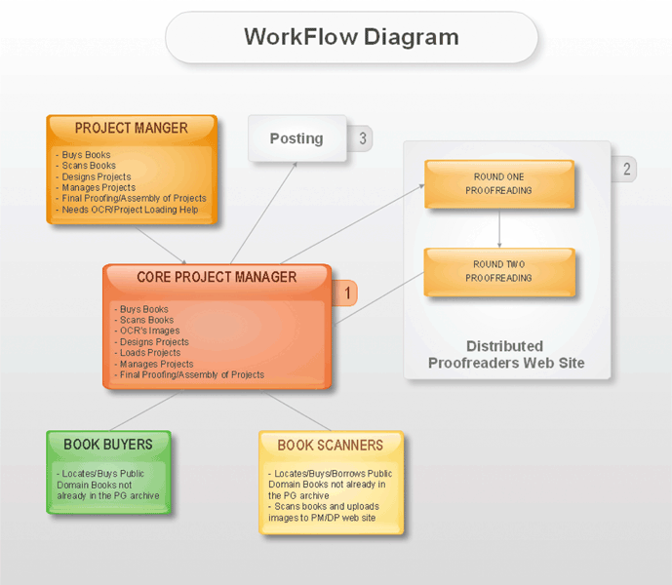
Enterprise-Wide Technologies and Methodologies
A workflow is a defined process that identifies the specific set of steps involved in completing a particular project or business process
  Workflow application
Page 744
Figure 14-23

Slide 36
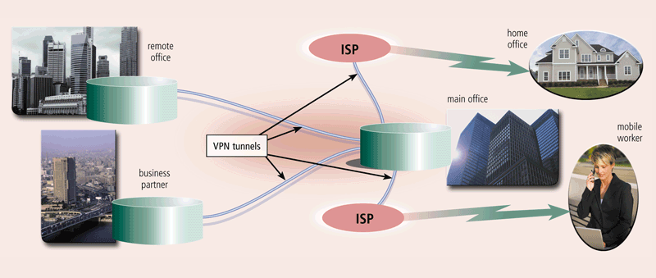
Enterprise-Wide Technologies and Methodologies
A virtual private network (VPN) provides mobile users, vendors, and customers with a secure connection to the company network server
Pages 744 – 745
Figure 14-24

Slide 37
Virtualization and Cloud Computing
Virtualization is the practice of sharing or pooling computing resources
Server virtualization
Provides the capability to divide a physical server logically into many virtual server
Storage virtualization
Provides the capability to create a single logical storage device from many physical storage devices
Click to view Web Link,
click Chapter 14, Click Web
Link from left navigation,
then click Virtualization
below Chapter 14
Pages 745 - 746

Slide 38
Virtualization and Cloud Computing
Cloud computing is an Internet service that provides computing needs to computer users
Grid computing combines many servers and/or personal computers on a network to act as one large computer
Page 746

Slide 39
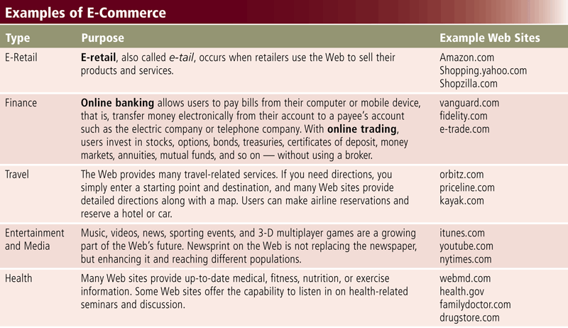
E-Commerce
Page 747
Figure 14-25

Slide 40
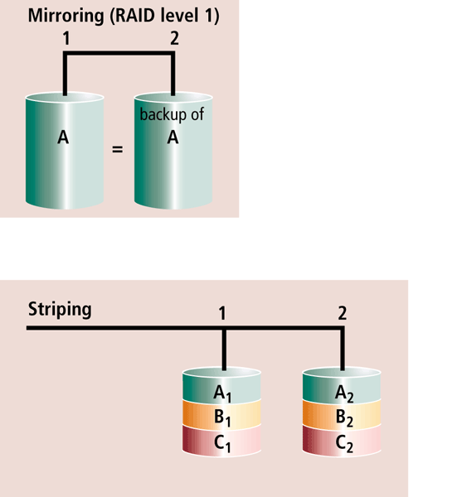
Enterprise Hardware
Enterprise hardware allows large organizations to manage and store information and data using devices geared for:
  Heavy use
  Maximum availability
  Maximum efficiency
RAID duplicates data and
implements duplication
in different ways
Pages 748 – 749
Figure 14-27

Slide 41
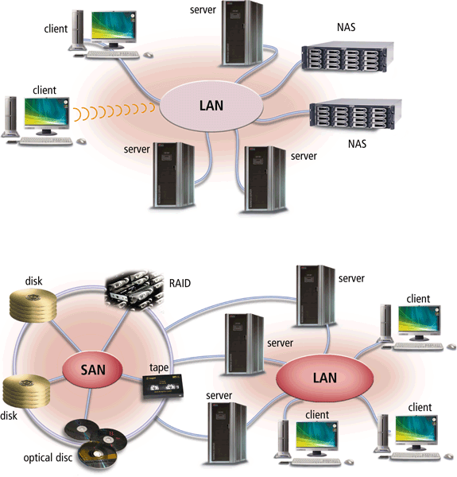
Enterprise Hardware
Network attached storage (NAS) is a server that provides storage to users and information systems attached to the network
Page 749
Figure 14-28a

Slide 42
Enterprise Hardware
A storage area network (SAN) is a high-speed network that provides storage to other servers to which it is attached
Click to view Web Link,
click Chapter 14, Click Web
Link from left navigation,
then click NAS and SAN
below Chapter 14
Pages 749 - 750
Figure 14-28b

Slide 43
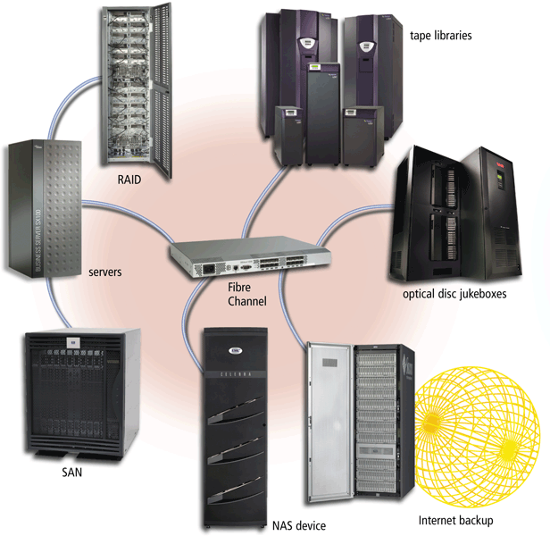
Enterprise Hardware
An enterprise storage system is a strategy that focuses on the availability, protection, organization, and backup of storage in a company
Goal is to consolidate storage
Page 750
Figure 14-29

Slide 44
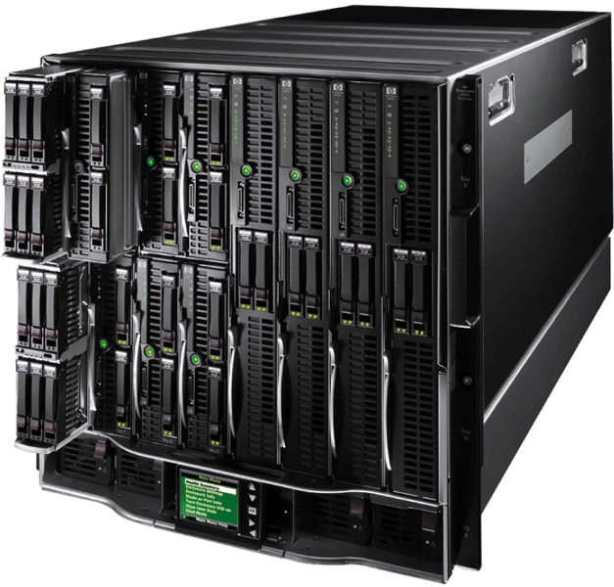
Enterprise Hardware
A blade server packs a complete computer server on a single card (called a blade) rather than a system unit
The individual blades insert in a blade server chassis
Click to view Web Link,
click Chapter 14, Click Web
Link from left navigation,
then click Blade Servers
below Chapter 14
Page 751
Figure 14-30

Slide 45
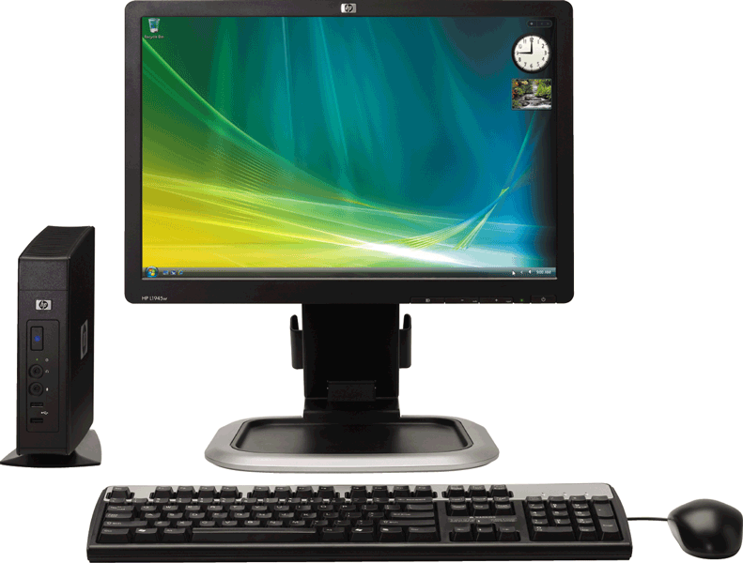
Enterprise Hardware
A thin client is a small terminal-like computer that mostly relies on a server for data storage and processing
The processing for a thin client usually is done on a server
Page 752
Figure 14-31

Slide 46
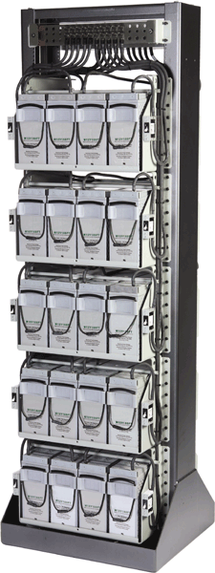
High Availability, Scalability, and Interoperability
A high-availability system continues running and performing tasks for at least 99 percent of the time
  May include hot-swapping
  and redundant components
    When a component fails, another
    component takes over and the
    system continues to function
Pages 752 – 753
Figure 14-32

Slide 47
High Availability, Scalability, and Interoperability
Scalability is a measure of how well computer hardware, software, or an information system can grow to meet increasing performance demands
Interoperability is the ability for an information system to share information with other information systems within an enterprise
Page 753

Slide 48
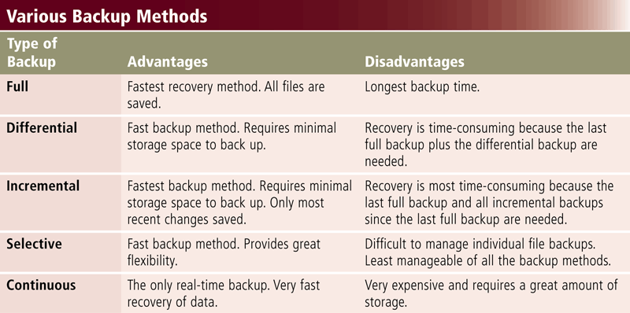
Backup Procedures
Page 754
Figure 14-33

Slide 49
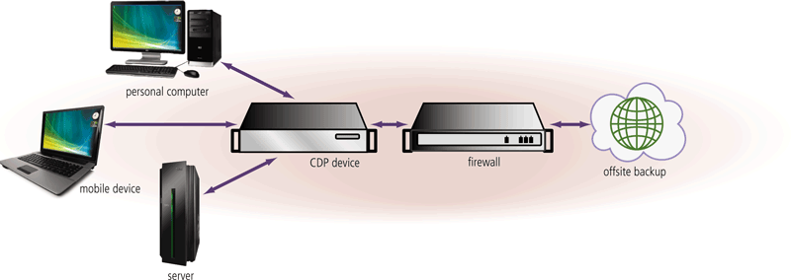
Backup Procedures
Continuous data protection provides automatic data backup whenever data is changed in an enterprise
Pages 754 – 755
Figure 14-34

Slide 50
Backup Procedures
A disaster recovery plan is a written plan describing the steps a company would take to restore computer operations in the event of a disaster
Contains four major components
Emergency plan
Backup plan
Recovery plan
Test plan
Click to view Web Link,
click Chapter 14, Click Web
Link from left navigation,
then click Disaster Recovery Plan
below Chapter 14
Pages 755 - 756

Slide 51
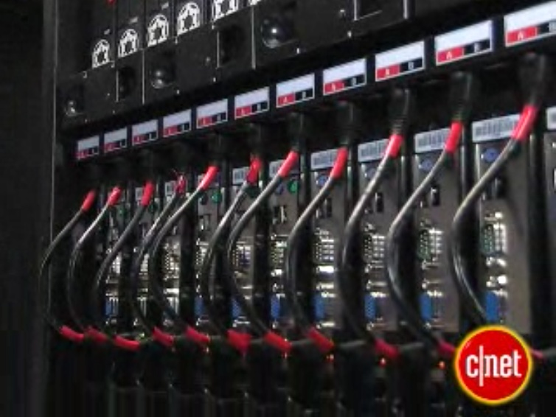
Video: A Tour of Lucasfilm Data Center
CLICK TO START

Slide 52
Summary
Special computing requirements present in an enterprise-sized organization
Various types of users within an organization
Large information systems
Benefits of virtualization and cloud computing
Requirements for enterprise hardware
Backup procedures present in a large organization
Page 757

Slide 53
Chapter 14 Complete

