Slide 2
Objectives Overview
Differentiate between machine and assembly languages
Identify and discuss the purpose of procedural programming languages, and describe the features of C and COBOL
Identify and discuss the characteristics of these object-oriented programming languages and program development tools
Identify the uses of other programming languages and program development tools
Describe various ways to develop Web pages
See Page 663
for Detailed Objectives

Slide 3
Objectives Overview
Identify the uses of popular multimedia authoring programs
List the six steps in the program development life cycle
Explain the basic control structures and design tools used in designing solutions to programming problems
Differentiate between structured design and object-oriented design
See Page 663
for Detailed Objectives

Slide 4

Computer Programs and Programming Languages
A computer program is a series of instructions that directs a computer to perform tasks
  Created by a programmer using a programming language
Pages 664 – 665
Figure 13-1

Slide 5
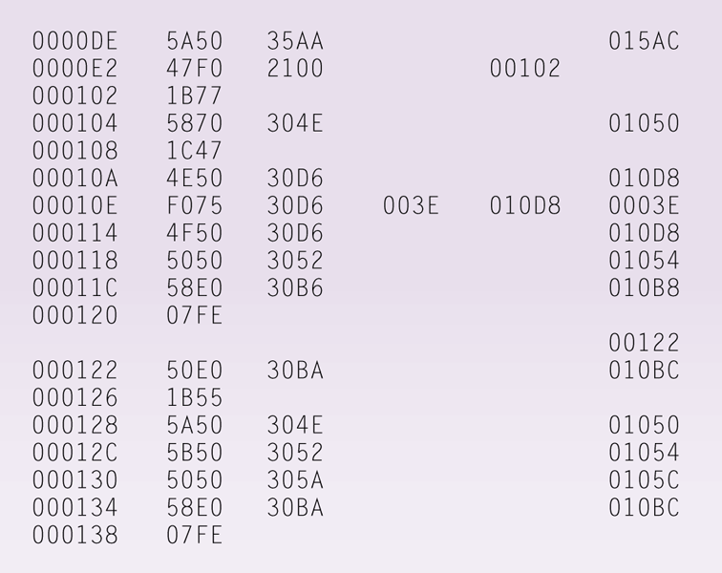
Low-Level Languages
Machine language is the first generation of programming languages
Only language the computer directly recognizes
Page 665
Figure 13-2

Slide 6
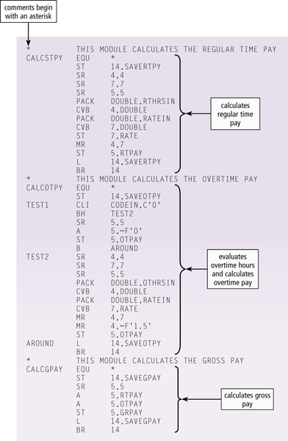
Low-Level Languages
Assembly language is the second generation of programming languages
Programmer writes instructions using symbolic instruction codes
A source program contains the code to be converted to machine language
Pages 665 – 666
Figure 13-3

Slide 7
Procedural Languages
In a procedural language, the programmer writes instructions that tell the computer what to accomplish and how to do it
  Third-generation language (3GL)
A compiler translates an entire program before executing it
An interpreter converts and executes one code statement at a time
Pages 666 - 667

Slide 8
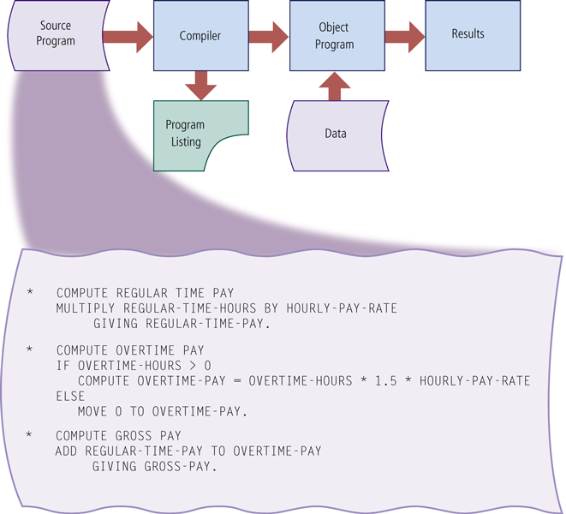
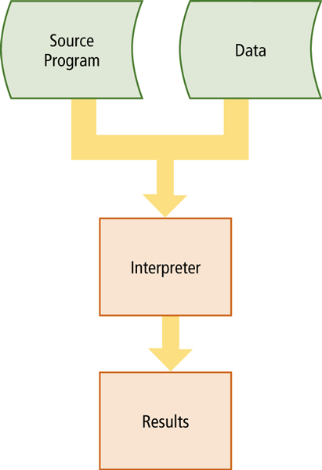
Procedural Languages
Page 667
Figures 13-4 – 13-5

Slide 9
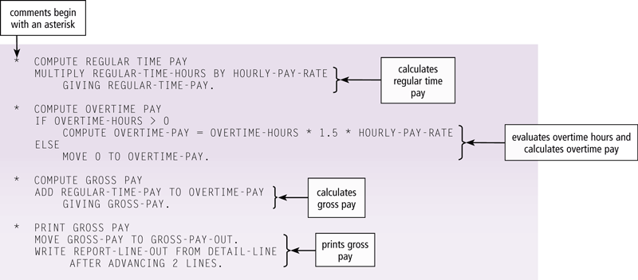
Procedural Languages
COBOL (COmmon Business-Oriented Language) is designed for business applications, but easy to read because of the English-like statements
Pages 668 – 669
Figure 13-7

Slide 10
Object-Oriented Programming Languages and Program Development Tools
An object-oriented programming (OOP) language allows programmers the ability to reuse and modify existing objects
Other advantages include:
Objects can be reused
Programmers create applications faster
Work well in a RAD environment
Most program development tools are IDEs
Page 669

Slide 11
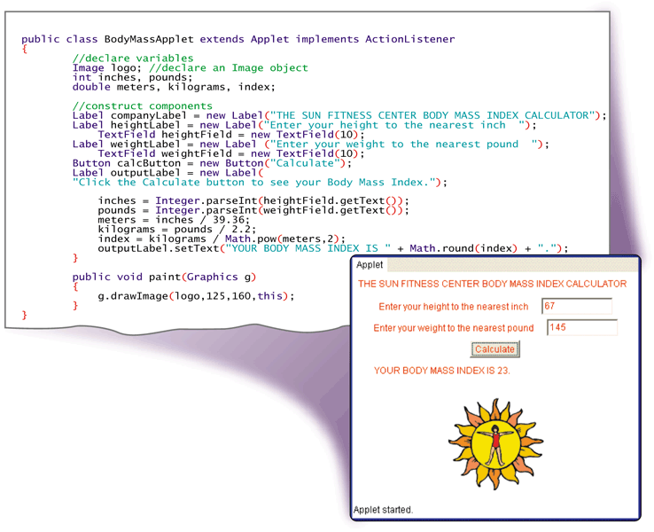
Object-Oriented Programming Languages and Program Development Tools
Java is an object-oriented programming language developed by Sun Microsystems
The Just-in-time (JIT) compiler to convert the bytecode into machine-dependent code
Click to view Web Link,
click Chapter 13, Click
Web Link from left
navigation, then click
Java Platforms
below Chapter 13
Page 670
Figure 13-8

Slide 12
Object-Oriented Programming Languages and Program Development Tools
The Microsoft .NET Framework allows almost any type of program to run on the Internet or an internal business network, as well as computers and mobile devices
Features include:
CLR (Common Language Runtime)
Classes
Page 670

Slide 13
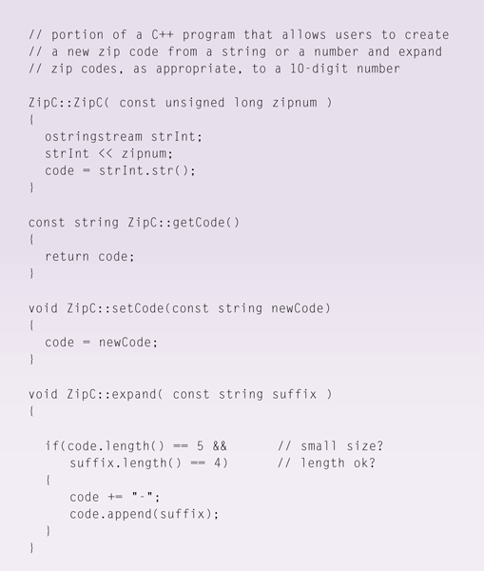
Object-Oriented Programming Languages and Program Development Tools
C++ is an extension of the C programming language
  Additional features for working with objects, classes, events, and other object-oriented concepts
C# is based on C++ and was developed by Microsoft
Page 671
Figure 13-9

Slide 14
Object-Oriented Programming Languages and Program Development Tools
Visual Studio is Microsoft’s suite of program development tools
Visual Basic is based on the BASIC programming language
Visual C++ is based on C++
Visual C# combines the programming elements of C++ with an easier, rapid-development environment
Pages 671 - 673

Slide 15
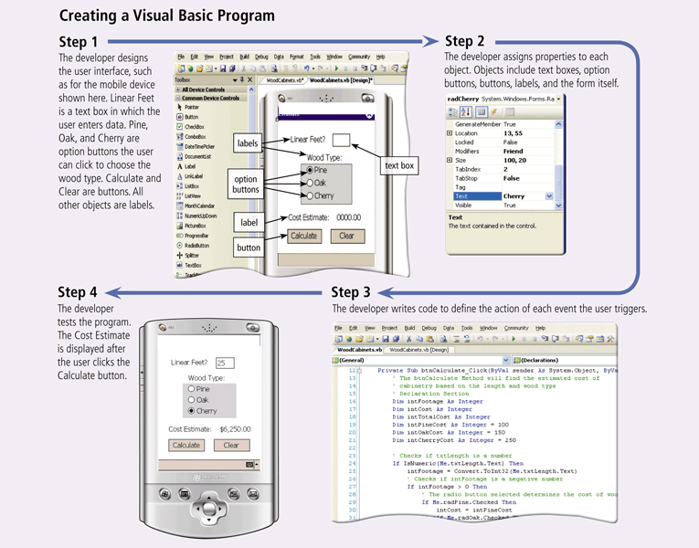
Object-Oriented Programming Languages and Program Development Tools
Click to view Web Link,
click Chapter 13, Click
Web Link from left
navigation, then click
Visual Studio Tools for Office
below Chapter 13
Pages 671 - 672

Slide 16
Object-Oriented Programming Languages and Program Development Tools
A visual programming language is a language that uses a visual or graphical interface for creating all source code
Borland’s Delphi is a powerful program development tool that is ideal for building large-scale enterprise and Web applications in a RAD environment
Page 673

Slide 17
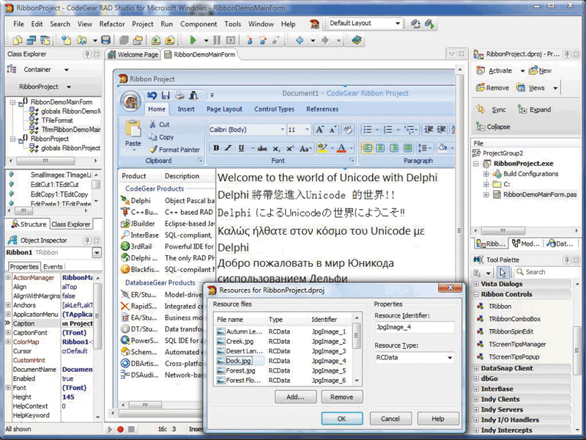
Object-Oriented Programming Languages and Program Development Tools
Page 673
Figure 13-11

Slide 18
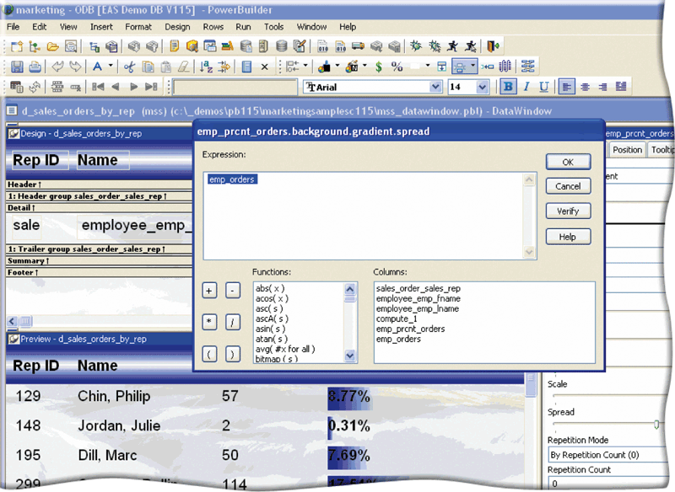
Object-Oriented Programming Languages and Program Development Tools
PowerBuilder is a powerful program development RAD tool
Best suited for Web-based, .NET, and large-scale enterprise object-oriented applications
Page 674
Figure 13-12

Slide 19
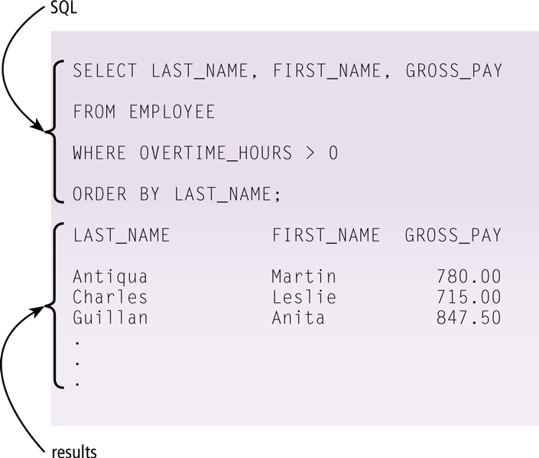
Other Programming Languages and Development Tools
A 4GL (fourth-generation language) is a nonprocedural language that enables users and programmers to access data in a database
  One popular 4GL is SQL
Page 674
Figure 13-13

Slide 20
Other Programming Languages and Development Tools
Classic programming languages include:
Ada
ALGOL
APL
BASIC
Forth
FORTRAN
HyperTalk
LISP
Logo
Modula-2
Pascal
PILOT
PL/1
Prolog
RPG
Smalltalk
Page 675
Figure 13-14

Slide 21
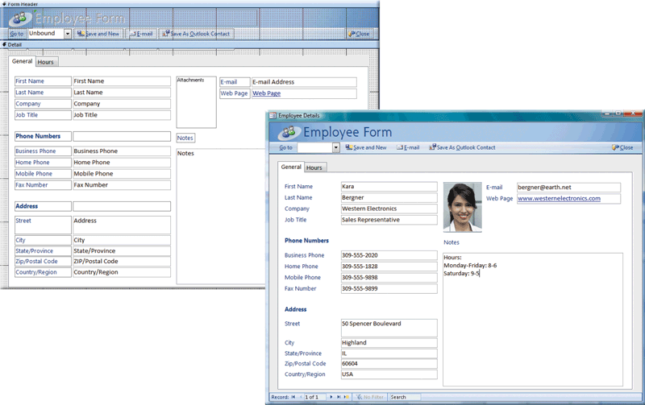
Other Programming Languages and Development Tools
An application generator is a program that creates source code or machine code from a specification of the required functionality
  Often bundled as part of a DBMS
Page 676
Figure 13-15

Slide 22
Other Programming Languages and Development Tools
A macro is a series of statements that instructs an application how to complete a task
You usually create the macro in one of two ways:
  Record the macro with a macro recorder
  Write the macro
Click to view Web Link,
click Chapter 13, Click
Web Link from left
navigation, then click
Macros below Chapter 13
Pages 676 - 677

Slide 23
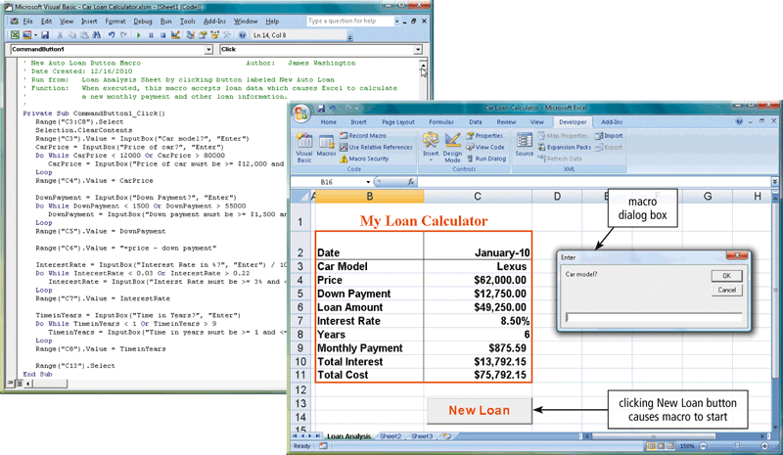
Other Programming Languages and Development Tools
Page 677
Figure 13-16

Slide 24
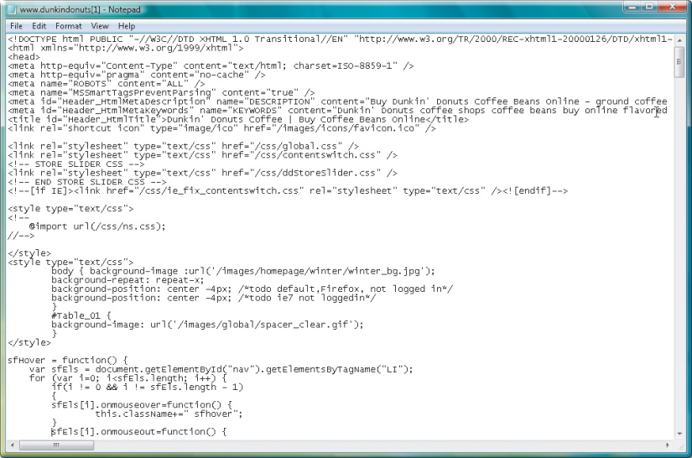
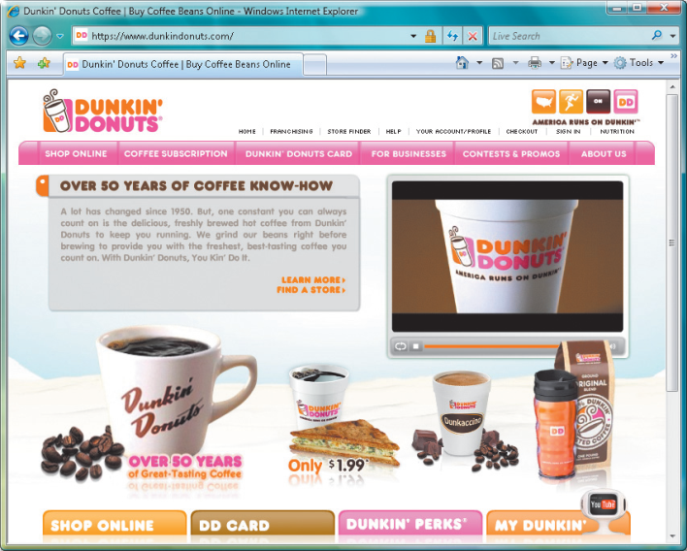
Web Page Development
HTML is a special formatting language that programmers use to format documents for display on the Web
XHTML is a markup language that allows Web sites to be displayed more easily on mobile devices
Page 678
Figure 13-17

Slide 25
Web Page Development
XML allows Web developers to create customized tags and use predefined tags to display content appropriately on various devices
  WML is a subset of XML and is used to design pages for microbrowsers
Two applications of XML are RSS 2.0 and ATOM
Click to view Web Link,
click Chapter 13, Click
Web Link from left
navigation, then click
XML below Chapter 13
Page 679

Slide 26
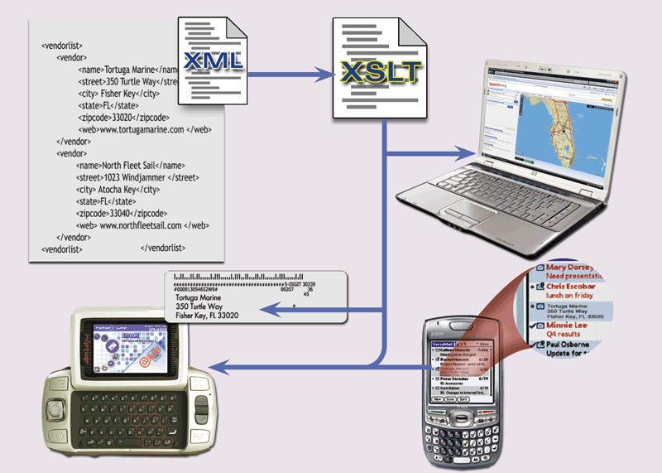
Web Page Development
Page 679
Figure 13-18

Slide 27
Web Page Development
Web browsers can execute short programs to add interactive elements to Web pages
To send and receive information between your computer and a Web server, these programs use the CGI (common gateway interface)
Scripts
Applets
Servlets
ActiveX controls
Page 680

Slide 28
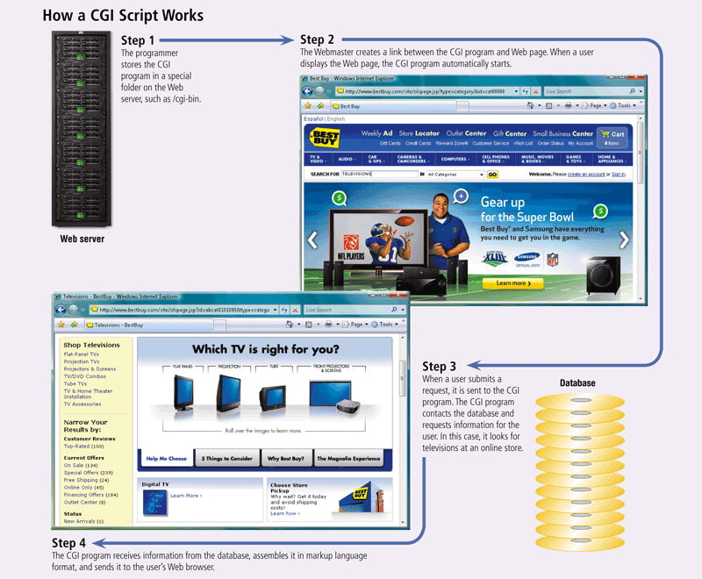
Web Page Development
Page 681
Figure 13-19

Slide 29
Web Page Development
Programmers write scripts, applets, servlets, or ActiveX controls using a variety of languages
JavaScript
Perl
PHP
Rexx
Tcl
VBScript
Click to view Web Link,
click Chapter 13, Click
Web Link from left
navigation, then click
PHP below Chapter 13
Pages 682 - 683

Slide 30
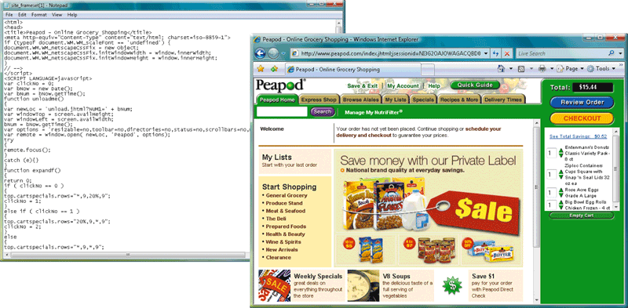
Web Page Development
Page 682
Figure 13-20

Slide 31
Web Page Development
Dynamic HTML (DHTML) allows Web developers to include more graphical interest and interactivity
Cascading style sheets (CSS) contain the formats for how a particular object should be displayed
Ruby on Rails (RoR) provides technologies for developing object-oriented, database-driven Web sites
Click to view Web Link,
click Chapter 13, Click
Web Link from left
navigation, then click
Cascading Style Sheets
below Chapter 13
Page 683

Slide 32
Web Page Development
Web 2.0 allows Web sites to provide a means for users to:
Share personal information
Allow users to modify Web site content
Have application software built into the site
Page 684

Slide 33
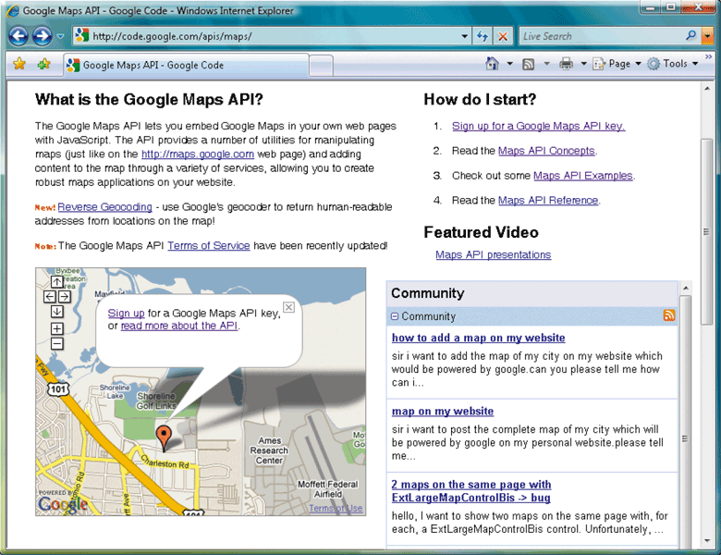
Web Page Development
Most Web 2.0 sites use APIs
  An API enables programmers to interact with an environment such as a Web site or operating system
Click to view Web Link,
click Chapter 13, Click
Web Link from left
navigation, then click
APIs below Chapter 13
Page 684
Figure 13-21

Slide 34
Web Page Development
Web page authoring software can create sophisticated Web pages that include images, video, audio, animation, and other effects
Dreamweaver
Expression Web
Flash
SharePoint Designer
Page 685

Slide 35
Multimedia Program Development
Multimedia authoring software allows programmers to combine text, graphics, animation, audio, and video in an interactive presentation
ToolBook
Director
Page 685

Slide 36
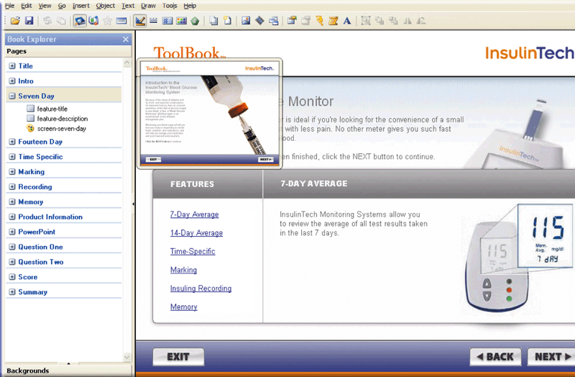
Multimedia Program Development
Page 685
Figure 13-22

Slide 37
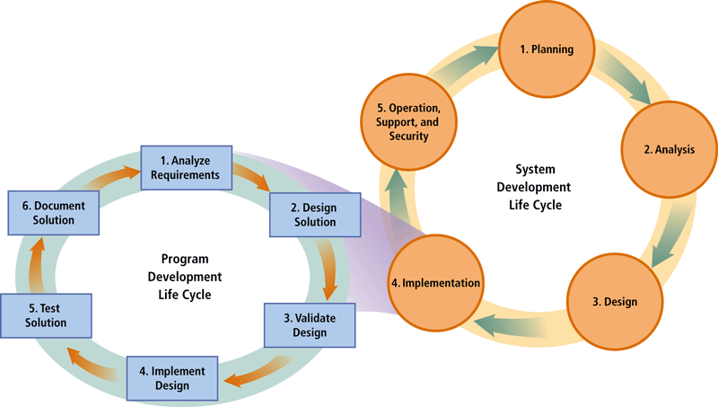
Program Development
Program development consists of a series of steps programmers use to build computer programs
Page 686
Figure 13-23

Slide 38
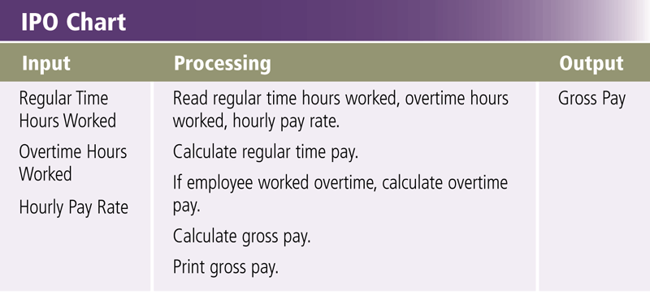
Step 1 – Analyze Requirements
To initiate program development, programmer:
  Reviews the requirements
  Meets with the systems analyst and users
  Identifies input, processing, and output
    IPO chart
Page 687
Figure 13-24

Slide 39
Step 2 – Design Solution
Design a solution algorithm
In structured design, the programmer typically begins with a general design and moves toward a more detailed design
Programmers use a hierarchy chart to show program modules graphically
Page 688

Slide 40
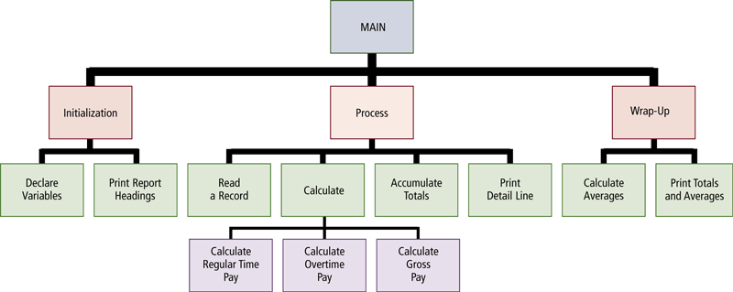
Step 2 – Design Solution
Page 688
Figure 13-25

Slide 41
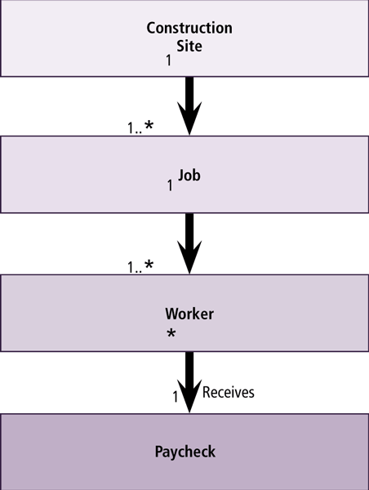
Step 2 – Design Solution
With object-oriented (OO) design, the programmer packages the data and the program into a single object
  Encapsulation
Click to view Web Link,
click Chapter 13, Click
Web Link from left
navigation, then click
Object-Oriented Design
below Chapter 13
Page 689
Figure 13-26

Slide 42
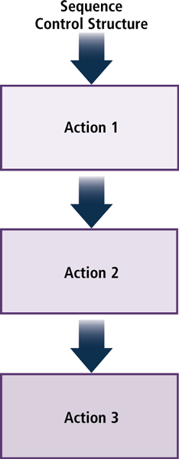
Step 2 – Design Solution
The sequence control structure shows one or more actions following each other in order
Page 689
Figure 13-27

Slide 43
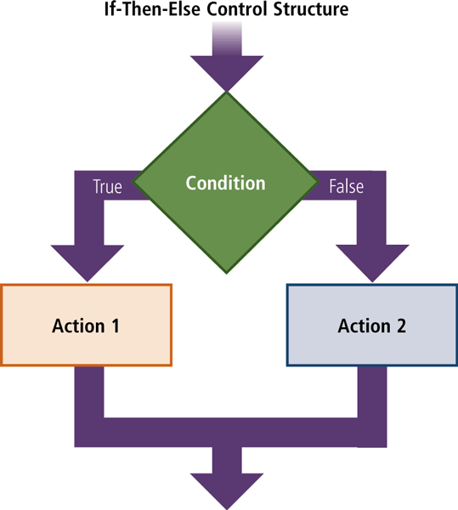
Step 2 – Design Solution
The selection control structure tells the program which action to take, based on a certain condition
  If-then-else
  Case
Page 689
Figure 13-28

Slide 44
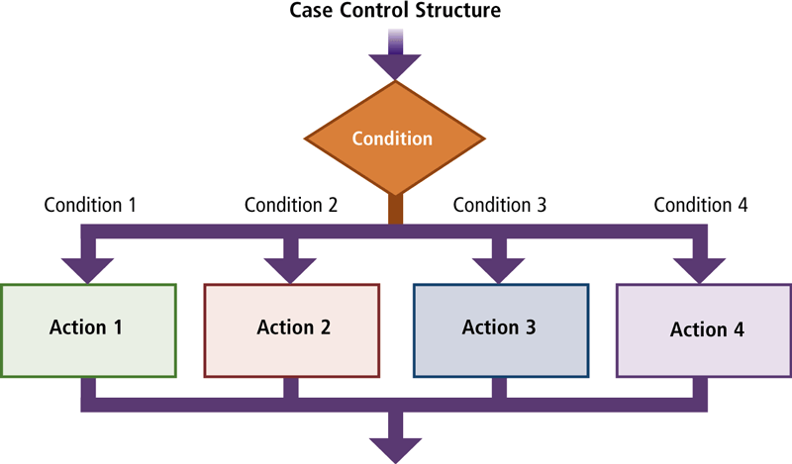
Step 2 – Design Solution
Page 690
Figure 13-29

Slide 45
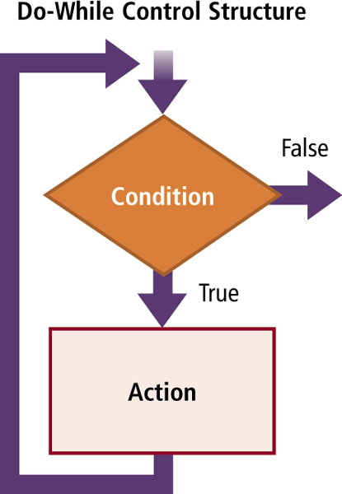
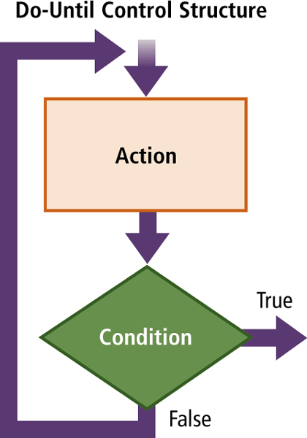
Step 2 – Design Solution
The repetition control structure enables a program to perform one or more actions repeatedly as long as a certain condition is met
Page 690
Figures 13-30 – 13-31

Slide 46
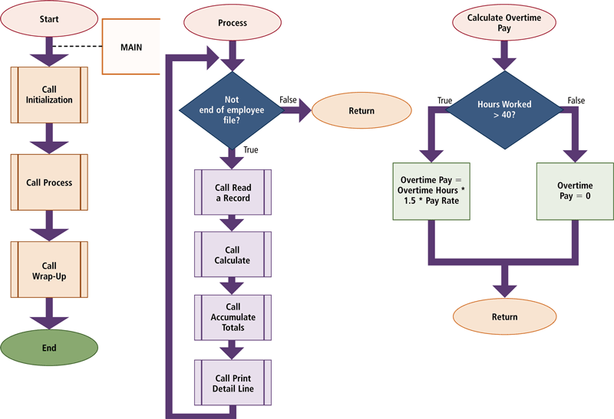
Step 2 – Design Solution
A program flowchart graphically shows the logic in a solution algorithm
Page 691
Figure 13-33

Slide 47
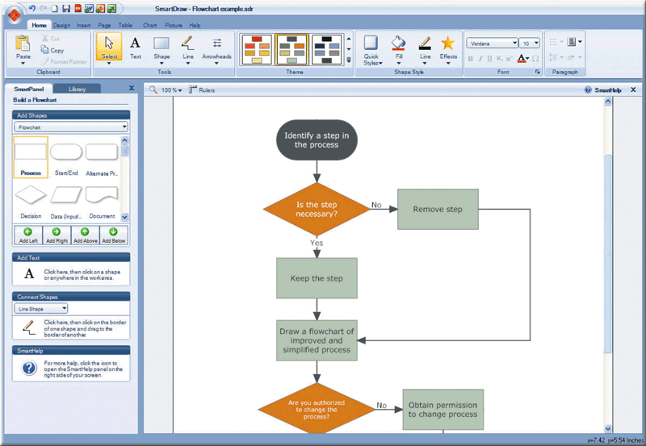
Step 2 – Design Solution
Flowcharting software makes it easy to modify and update flowcharts
  SmartDraw
  Visio
Click to view Web Link,
click Chapter 13, Click
Web Link from left
navigation, then click
Flowcharting Software
below Chapter 13
Page 692
Figure 13-34

Slide 48
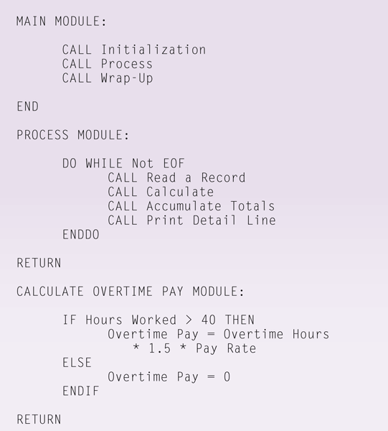
Step 2 – Design Solution
Pseudocode uses a condensed form of English to convey program logic
Page 692
Figure 13-35

Slide 49
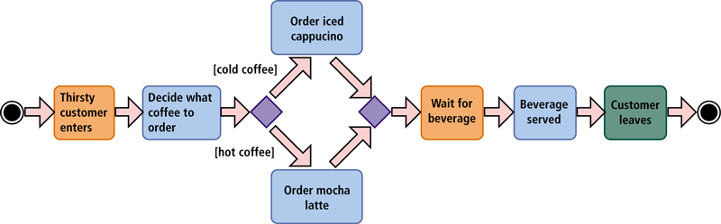
Step 2 – Design Solution
UML (Unified Modeling Language) has been adopted as a standard notation for object modeling and development
Page 693
Figure 13-37

Slide 50
Step 3 – Validate Design
Check for logic errors using test data
Develop various sets of test data
Determine the expected result
Step through the algorithm
Compare the results
Repeat steps for each set of test data
Page 694

Slide 51
Step 4 – Implement Design
Implementation of the design includes using a program development tool that assists the programmer by:
  Generating or providing some or all code
  Writing the code that translates the design into a computer program
  Creating the user interface
Extreme programming is a strategy where programmers immediately begin coding and testing solutions as soon as requirements are defined
Pages 694 - 695

Slide 52
Step 5 – Test Solution
The goal of program testing is to ensure the program runs correctly and is error free
Errors include syntax errors and logic errors
Debugging the program involves removing the bugs
A beta is a program that has most or all of its features and functionality implemented
Click to view Web Link,
click Chapter 13, Click
Web Link from left
navigation, then click
Beta Testers
below Chapter 13
Pages 695 - 696

Slide 53
Step 6 – Document Solution
In documenting the solution, the programmer performs two activities:
Review the program code
Review all the documentation
Page 696

Slide 54
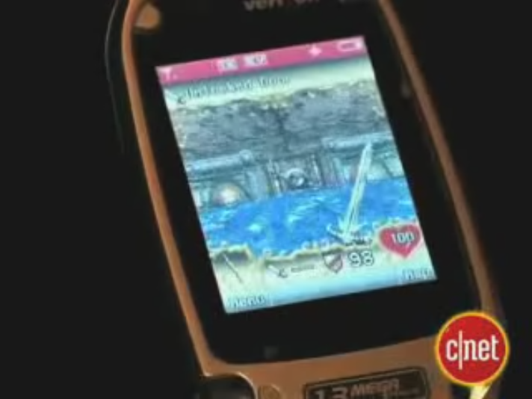
Video: Electronic Arts Going Mobile
CLICK TO START

Slide 55
Summary
Various programming languages used to create computer programs
A variety of Web development and multimedia development tools
Steps in the program development life cycle and tools used to make this process efficient
Page 705

Slide 56
Chapter 13 Complete

