Slide 2
Objectives Overview
Define system development and list the system development phases
Identify the guidelines for system development
Discuss the importance of project management, feasibility assessment, documentation, and data and information gathering techniques
Explain the activities performed in the planning phase
Discuss the purpose of the activities performed in the analysis phase
Describe the various tools used in process modeling
See Page 619
for Detailed Objectives

Slide 3
Objectives Overview
Describe the various tools used in object modeling
Explain the activities performed in the design phase
Recognize the develop programs activity is part of system development
Discuss the activities performed in the implementation phase
Discuss the purpose of the activities performed in the operation, support, and security phase
See Page 619
for Detailed Objectives

Slide 4
What is System Development?
System development is a set of activities used to build an information system
A system is a set of components that interact to achieve a common goal
An information system (IS) is a collection of hardware, software, data, people, and procedures that work together to produce quality information
System development activities are grouped into phases, and is called the system development life cycle (SDLC)
Page 620

Slide 5
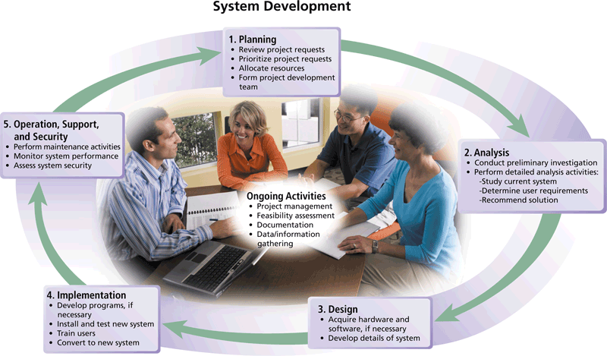
What is System Development?
Pages 620 – 621
Figure 12-1

Slide 6
What is System Development?
System development should follow three general guidelines:
Group activities or tasks into phases
Involve users
Define standards
Page 621

Slide 7
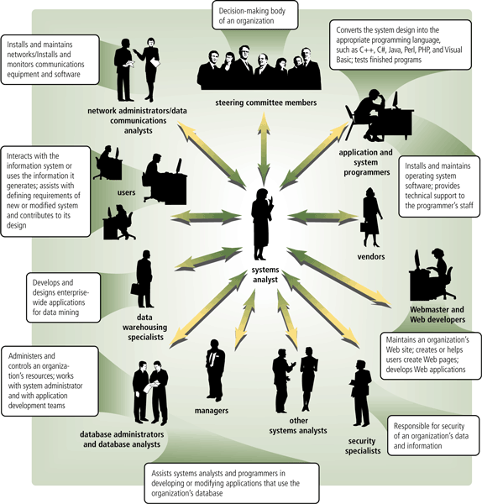
What is System Development?
System development should involve representatives from each department in which the proposed system will be used
Page 622
Figure 12-2

Slide 8
What is System Development?
Project management is the process of planning, scheduling, and then controlling the activities during system development
To plan and schedule a project efficiently, the project leader identifies:
Project scope
Required activities
Time estimates for each activity
Cost estimates for each activity
Order of activities
Activities that can take place at the same time
Page 623

Slide 9
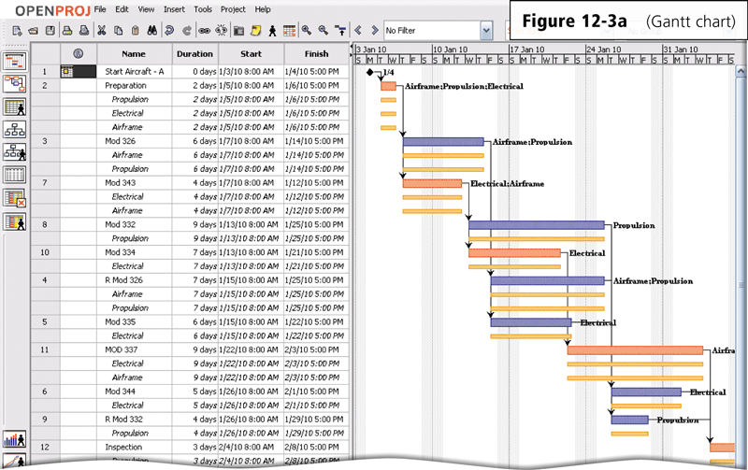
What is System Development?
A popular tool used to plan and schedule the time relationships among project activities is a Gantt chart
Click to view Web Link,
click Chapter 12, Click Web
Link from left navigation,
then click Gantt Charts below Chapter 12
Page 623
Figure 12-3a

Slide 10
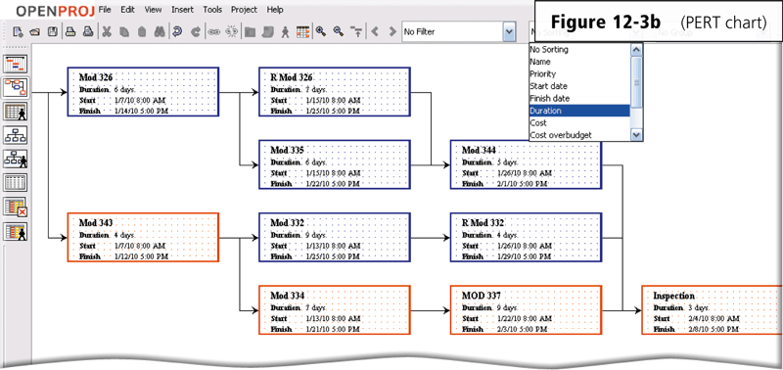
What is System Development?
A PERT chart also can be used for planning and scheduling time
Click to view Web Link,
click Chapter 12, Click Web
Link from left navigation,
then click PERT Charts below Chapter 12
Page 624
Figure 12-3b

Slide 11
What is System Development?
Feasibility is a measure of how suitable the development of a system will be to the organization
Operational feasibility
Schedule feasibility
Technical feasibility
Economic feasibility
Pages 624 - 625

Slide 12
What is System Development?
Documentation is the collection and summarization of data and information
  A project notebook contains all documentation for a single project
Users and IT professionals refer to existing documentation when working with and modifying current systems
Page 625

Slide 13

What is System Development?
During system development, members of the project team gather data and information using several techniques
Review documentation
Observe
Survey
Interview
JAD Sessions
Research
Pages 625 – 626
Figure 12-4

Slide 14
Who Initiates a System
Development Project?
A user may request a new or modified system
Organizations may want to improve hardware, software, or other technology
Situations beyond an organization’s control might require a change
Management might mandate a change
A user may request a new or modified information system using a request for system services or a project request
Page 626

Slide 15

Who Initiates a System
Development Project?
Page 627
Figure 12-5

Slide 16
Planning Phase
The planning phase for a project begins when the steering committee receives a project request
Four major activities are performed:
Review and approve the project requests
Prioritize the project requests
Allocate resources
Form a project development team
Page 628

Slide 17
Analysis Phase
The analysis phase consists of two major activities:
Conduct a preliminary investigation
Perform detailed analysis
Determines and defines the exact nature of the problem or improvement
Interview the user who submitted the request
Study how the current system works
Determine the users’ wants, needs, and requirements
Recommend a solution
Pages 629 - 631

Slide 18
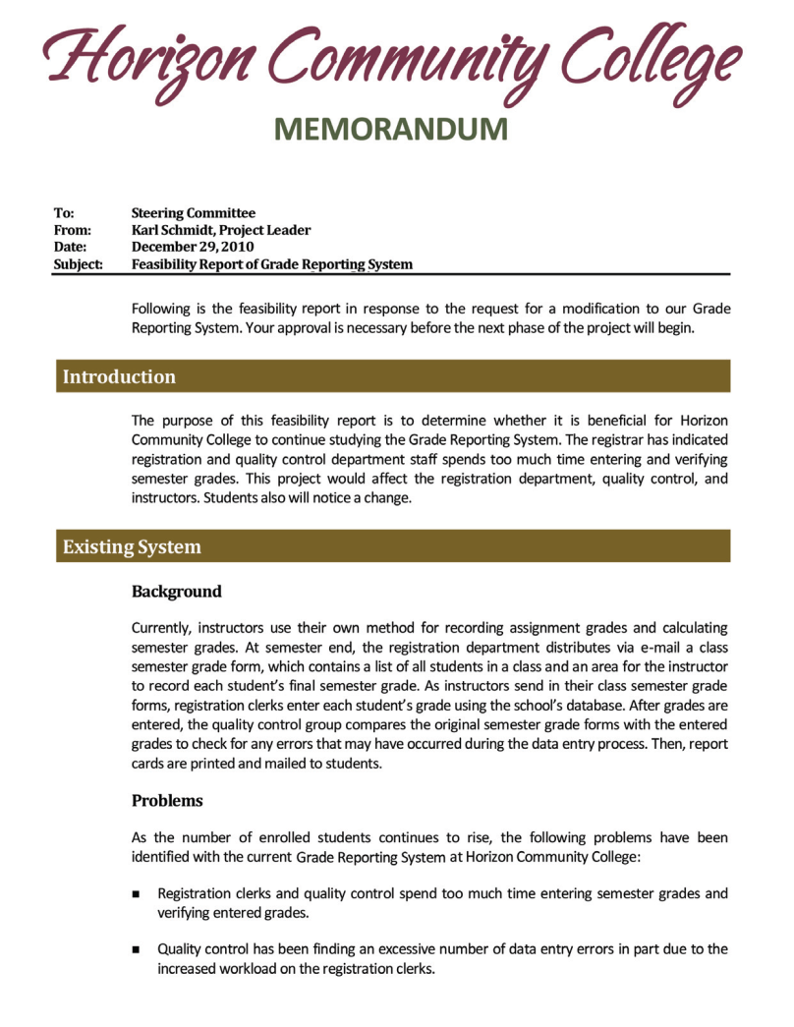

Analysis Phase
Click to view Web Link,
click Chapter 12, Click Web
Link from left navigation,
then click Feasibility Study below Chapter 12
Pages 629 – 630
Figure 12-6

Slide 19
Analysis Phase
Process modeling (structured analysis and design) is an analysis and design technique that describes processes that transform inputs into outputs
Entity-relationship diagrams
Data flow diagrams
Project dictionary
Click to view Web Link,
click Chapter 12, Click Web
Link from left navigation,
then click Process Modeling below Chapter 12
Page 631

Slide 20
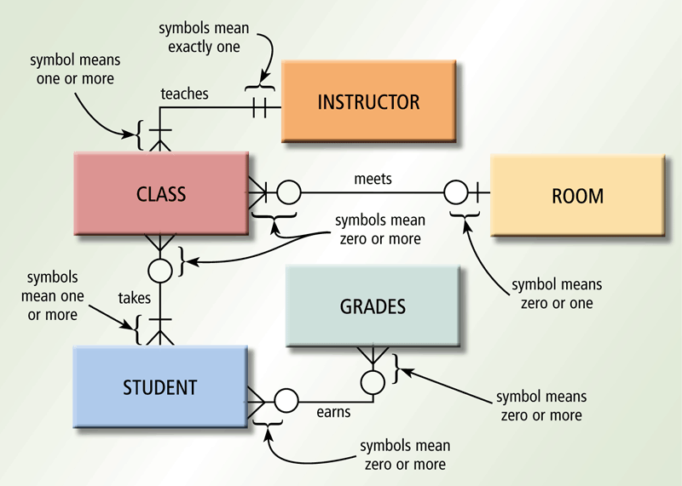
Analysis Phase
An entity-relationship diagram (ERD) is a tool that graphically shows the connections among entities in a system
Entities are objects in the system that have data
Page 632
Figure 12-7

Slide 21
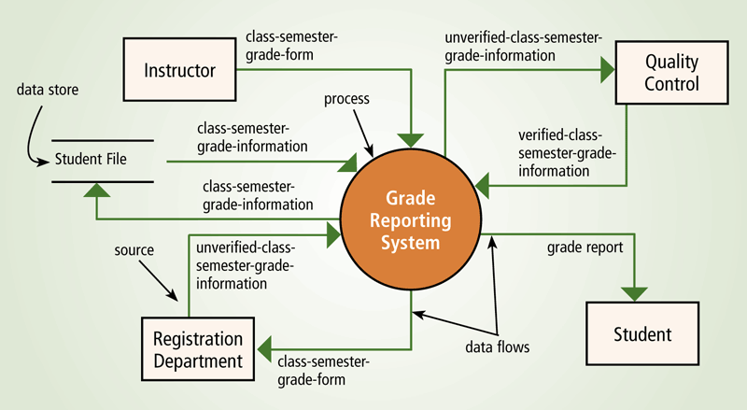
Analysis Phase
A data flow diagram (DFD) is a tool that graphically shows the flow of data in a system
  Data flows
  Processes
  Data stores
  Sources
Page 632
Figure 12-8

Slide 22
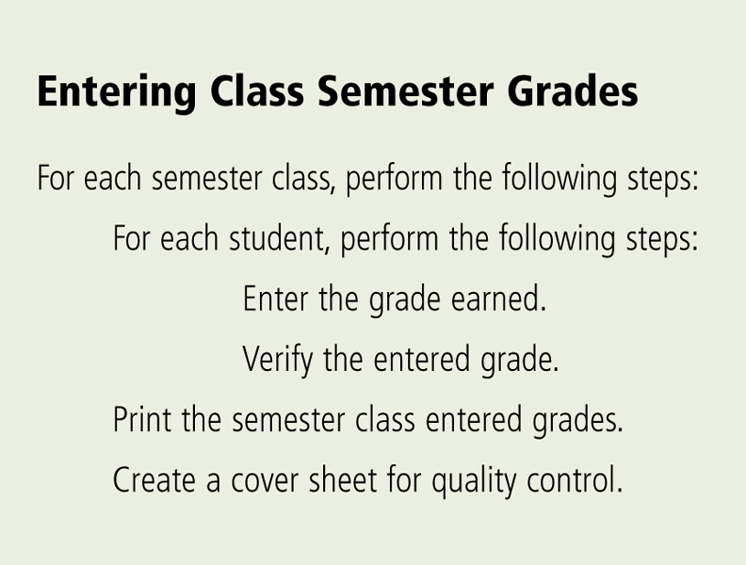
Analysis Phase
The project dictionary contains all the documentation and deliverables of a project
Structured English is a
style of writing that
describes the steps in
a process
Page 633
Figure 12-9

Slide 23
Analysis Phase
A decision table is a table that lists a variety of conditions and the actions that correspond to each condition
A decision tree also shows conditions and actions, but it shows them graphically
Page 633

Slide 24
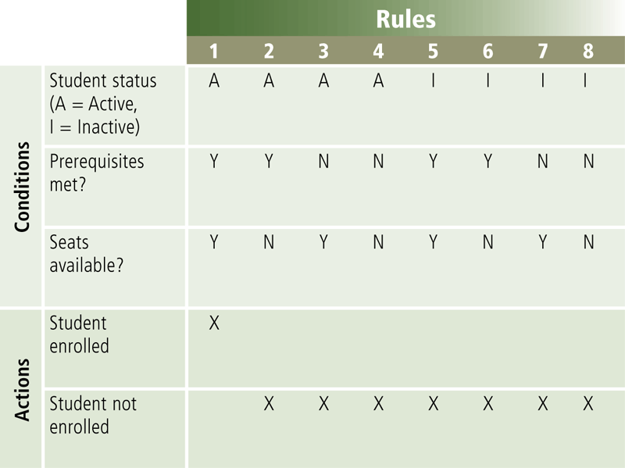
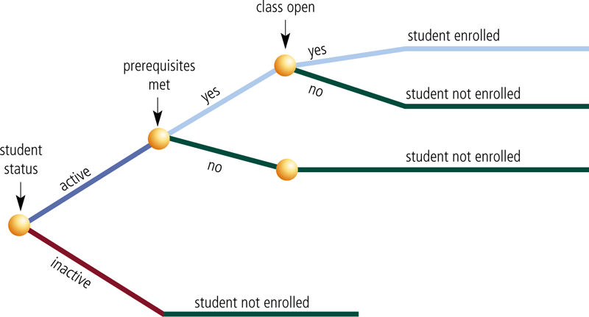
Analysis Phase
Decision table
Decision tree
Page 633
Figures 12-10 – 12-11

Slide 25
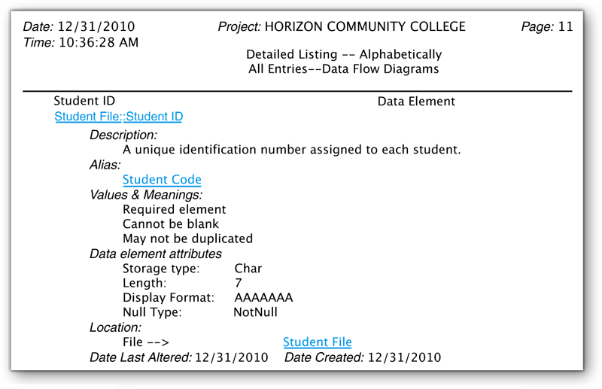
Analysis Phase
The data dictionary stores the data item’s name, description, and other details about each data item
Page 634
Figure 12-12

Slide 26
Analysis Phase
Object modeling combines the data with the processes that act on that data into a single unit, called an object
UML (Unified Modeling Language) has been adopted as a standard notation for object modeling and development
  UML includes 13 different diagrams
  Two diagrams include:
Use case diagram
Class diagram
Click to view Web Link,
click Chapter 12, Click Web
Link from left navigation,
then click UML
below Chapter 12
Page 634

Slide 27
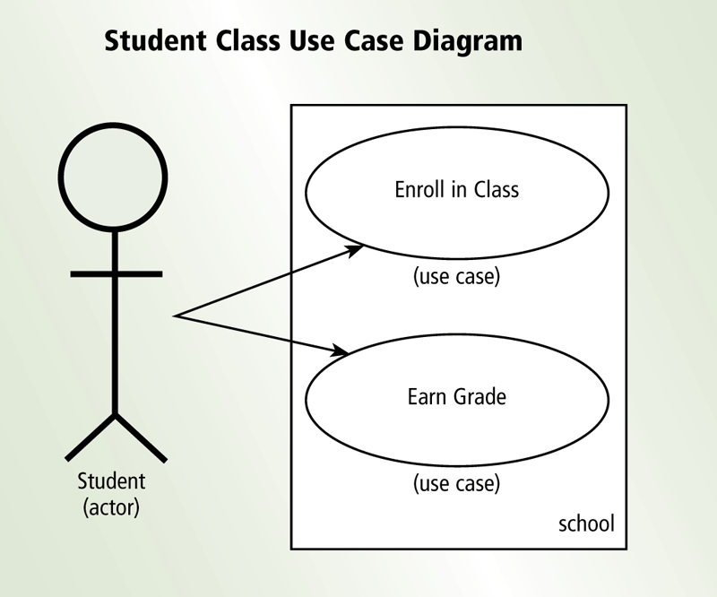
Analysis Phase
A use case diagram graphically shows how actors (users) interact with the information system
Diagrams are considered easy to understand
Page 634
Figure 12-13

Slide 28
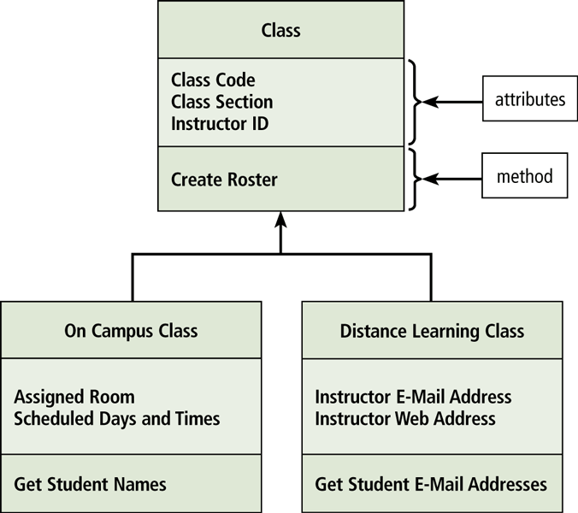
Analysis Phase
A class diagram graphically shows classes and subclasses in a system
Each class can have one or more subclasses
Subclasses use inheritance to inherit methods and attributes of higher levels
Page 635
Figure 12-14

Slide 29
Analysis Phase
The system proposal assesses the feasibility of each alternative solution
The steering committee discusses the system proposal and decides which alternative to pursue
Packaged software
Custom software
Outsourcing
Click to view Web Link,
click Chapter 12, Click Web
Link from left navigation,
then click Vertical Market Software below Chapter 12
Pages 635 - 636

Slide 30
Design Phase
The design phase consists of two major activities
Acquire hardware and software
Develop all of the details of the new or modified information system
Page 638

Slide 31
Design Phase
To acquire the necessary hardware and software:
Identify technical specifications
Solicit vendor proposals
Test and evaluate vendor proposals
Make a decision
Use research techniques such as e-zines
RFQ, RFP, or RFI is sent to potential vendors or VARs
Various techniques are used to determine the best proposal
Systems analyst makes recommendation to steering committee
Click to view Web Link,
click Chapter 12, Click Web
Link from left navigation,
then click E-Zines below Chapter 12
Pages 638 - 640

Slide 32
Design Phase
The next step is to develop detailed design specifications
  Sometimes called a physical design
Database design
Input and output design
Program design
Page 640

Slide 33
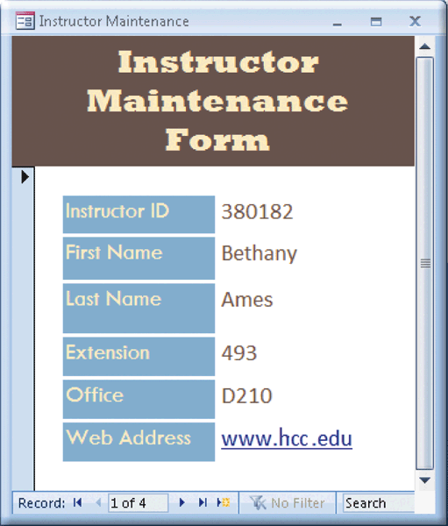
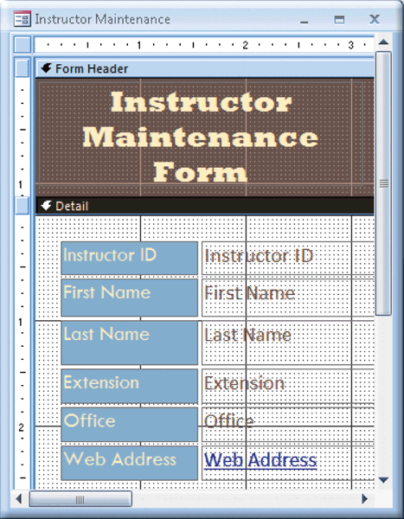
Design Phase
Systems analysts typically develop two types of designs for each input and output
Mockup
Layout chart
Page 641
Figures 12-18 – 12-19

Slide 34
Design Phase
A prototype (proof of concept) is a working model of the proposed system
  Prototypes have inadequate or missing documentation
  Users tend to embrace the prototype as a final system
  Should not eliminate or replace activities
Pages 641 - 642

Slide 35
Design Phase
Computer-aided software engineering (CASE) tools are designed to support one or more activities of system development
CASE tools sometimes contain the following tools:
Project repository
Graphics
Prototyping
Quality assurance
Code generator
Housekeeping
Click to view Web Link,
click Chapter 12, Click Web
Link from left navigation,
then click CASE Tools
below Chapter 12
Page 642

Slide 36
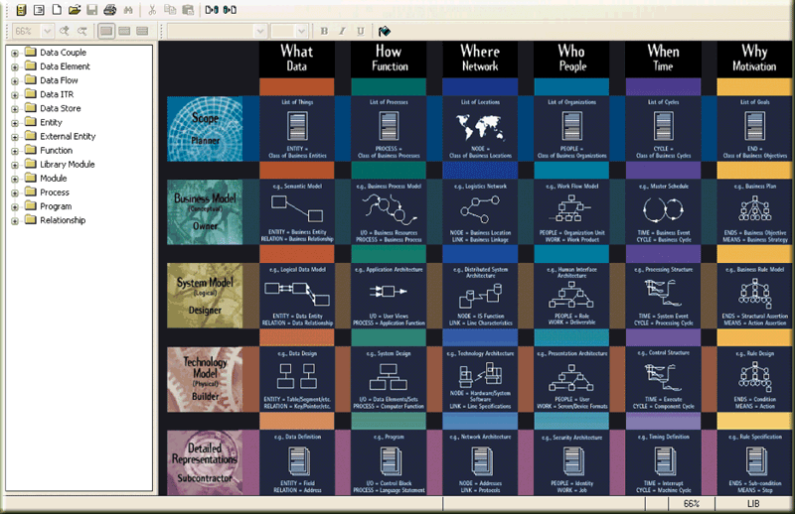
Design Phase
Page 642
Figure 12-20

Slide 37
Design Phase
Many people should review the detailed design specifications
An inspection is a formal review of any system development deliverable
  A team examines the deliverables to identify errors
Page 642

Slide 38
Implementation Phase
The purpose of the implementation phase is to construct the new or modified system and then deliver it
Develop programs
Install and test the new system
Train users
Convert to the new system
Page 643

Slide 39
Implementation Phase
The program development life cycle follows these steps:
Analyze the requirements
Design the solution
Validate the design
Implement the design
Test the solution
Document the solution
1
2
3
4
5
6
Page 643

Slide 40
Implementation Phase
Various tests should be performed on the new system
Unit test
Verifies that each individual program or object works by itself
Systems test
Verifies that all programs in an application work together properly
Integration test
Verifies that an application works with other applications
Acceptance test
Checks the new system to ensure that it works with actual data
Page 644

Slide 41

Implementation Phase
Training involves showing users exactly how they will use the new hardware and software in the system
  One-on-one sessions
  Classroom-style lectures
  Web-based training
Page 644
Figure 12-21

Slide 42
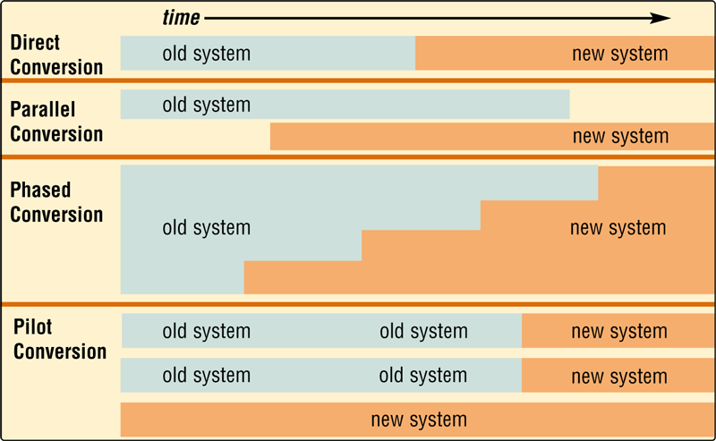
Implementation Phase
One or more of four conversion strategies can be used to change from the old system to the new system
Pages 644 – 645
Figure 12-22

Slide 43
Operation, Support, and Security Phase
The purpose of the operation, support, and security phase is to provide ongoing assistance for an information system and its users after the system is implemented
Perform maintenance activities
Monitor system performance
Assess system security
Click to view Web Link,
click Chapter 12, Click Web
Link from left navigation,
then click Chief Security Officer below Chapter 12
Page 645

Slide 44
Operation, Support, and Security Phase
A computer security plan should do the following:
Identify all information assets of an organization
Identify all security risks that may cause an information asset loss
For each risk, identify the safeguards that exist to detect, prevent, and recover from a loss
Page 646

Slide 45
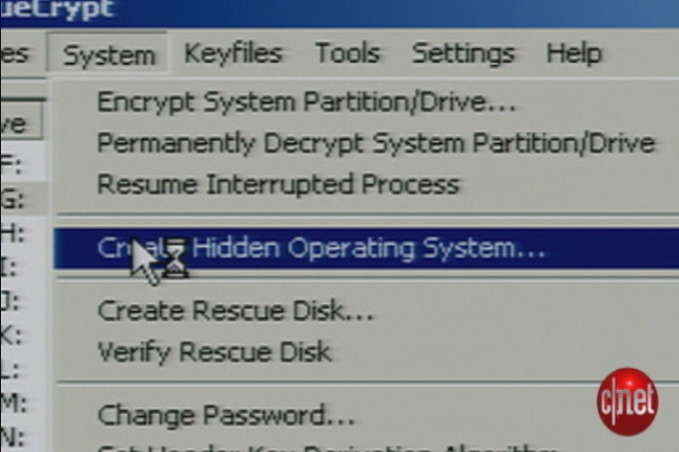
Video: Create a Hidden Operating System
CLICK TO START

Slide 46
Summary
System development phases
Guidelines for system development
Activities that occur during system development
Activities performed during each system development phase
Page 647

Slide 47
Chapter 12 Complete

