Slide 2
Objectives Overview
Discuss the purpose of the components required for successful communications and identify various sending and receiving devices
Describe the uses of computer communications
Differentiate between client/server and peer-to-peer networks, and describe how a P2P network works
Differentiate among a star network, bus network, and ring network
Describe the various network communications standards
List advantages of using a network, and differentiate among LANs, MANs, and WANs
See Page 459
for Detailed Objectives

Slide 3
Objectives Overview
Explain the purpose of communications software
Describe various types of lines for communications over the telephone network
Describe various physical and wireless transmission media
Describe commonly used communications devices
Discuss different ways to set up a home network
See Page 459
for Detailed Objectives

Slide 4
Communications
Computer communications describes a process in which two or more computers or devices transfer data, instructions, and information
Sending device
Communications channel
Receiving device
Page 460

Slide 5
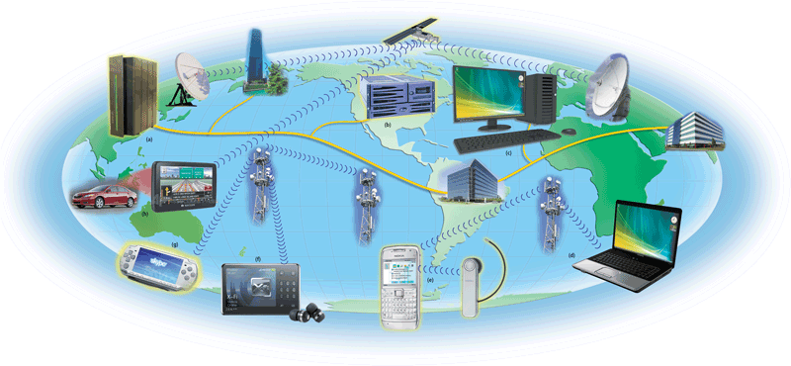
Communications
Pages 460 – 461
Figure 9-1

Slide 6
Uses of Computer Communications
Blogs
Chat rooms
E-mail
Fax
FTP
Instant messaging
Internet
Newsgroups
RSS
Video conferencing
VoIP
Web
Web 2.0
Web folders
Wikis
Click to view Web Link,
click Chapter 9, Click Web
Link from left navigation,
then click Wikis
below Chapter 9
Page 462

Slide 7
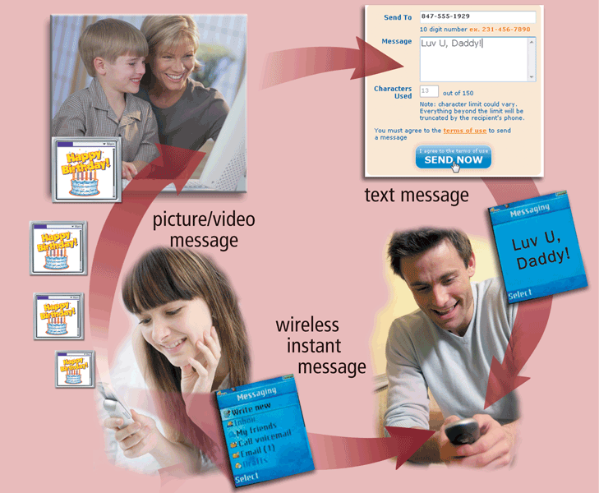
Uses of Computer Communications
Users can send and receive wireless messages using wireless messaging services
Pages 462 – 463
Figure 9-3

Slide 8
Uses of Computer Communications
Text messaging allows users to send and receive short text messages on a phone or other mobile device or computer
Picture messaging allows users to send pictures and sound files
Video messaging allows users to send short video clips
Wireless instant messaging allows wireless users to exchange real-time messages with one or more other users
Click to view Web Link,
click Chapter 9, Click Web
Link from left navigation,
then click Video Messaging
below Chapter 9
Pages 463 - 464

Slide 9
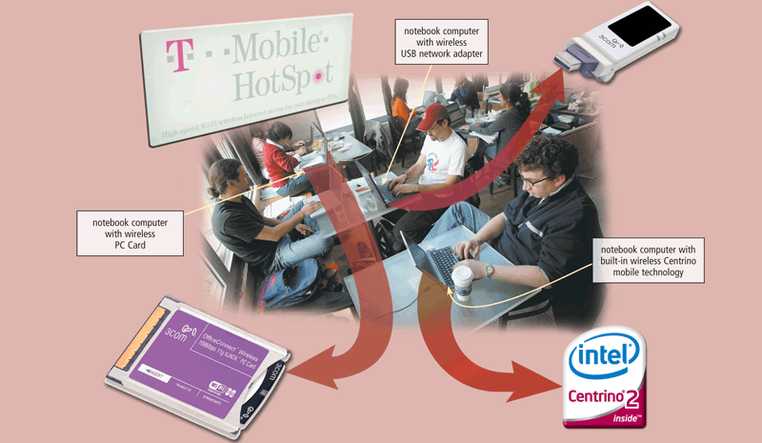
Uses of Computer Communications
Wireless Internet access points allow people to connect wirelessly to the Internet from home, work, school, and in many public locations
Pages 464 – 465
Figure 9-4

Slide 10
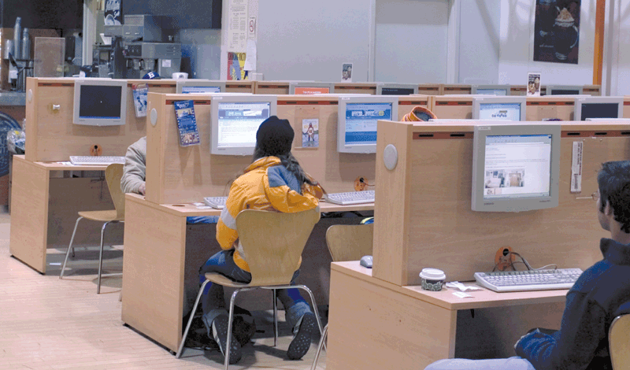
Uses of Computer Communications
A cybercafé is a coffeehouse, restaurant, or other location that provides personal computers with Internet access to its customers
Page 466
Figure 9-5

Slide 11
Uses of Computer Communications
A global positioning system (GPS) is a navigation system that consists of one or more earth-based receivers that accept and analyze signals sent by satellites in order to determine the GPS receiver’s geographic location
GPS receivers are:
Built into many mobile devices
Available as a handheld device
Available with new vehicles
Click to view Web Link,
click Chapter 9, Click Web
Link from left navigation,
then click GPS
below Chapter 9
Page 466

Slide 12
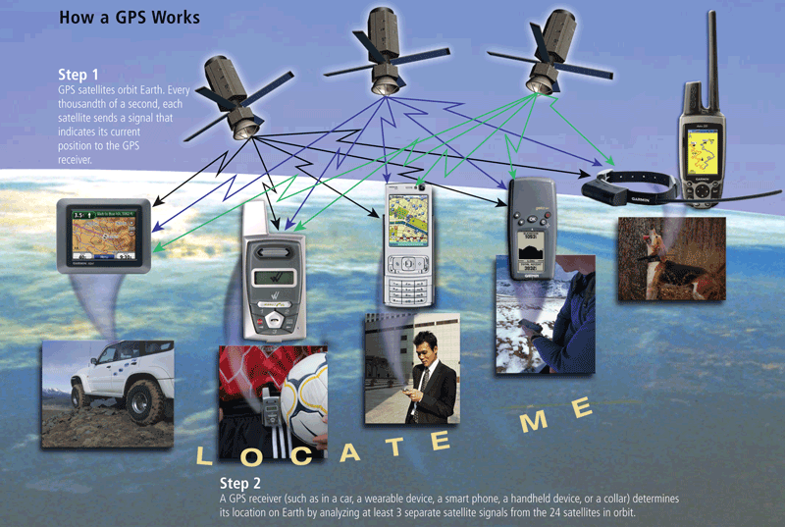
Uses of Computer Communications
Page 467
Figure 9-6

Slide 13
Uses of Computer Communications
Groupware
Helps groups of people work together on projects and share information over a network
Component of workgroup computing
Major feature is group scheduling
Voice mail
Allows someone to leave a voice message for one or more people
Computer in voice mail system converts an analog voice message into digital form
A voice mailbox is a storage location on a hard disk in the voice mail system
Page 467

Slide 14
Uses of Computer Communications
Collaboration software includes tools that enable users to share documents via online meetings and communicate with other connected users
Online meetings
Web conferences
Document management systems
Click to view Web Link,
click Chapter 9, Click Web
Link from left navigation,
then click Microsoft Groove
below Chapter 9
Page 468

Slide 15
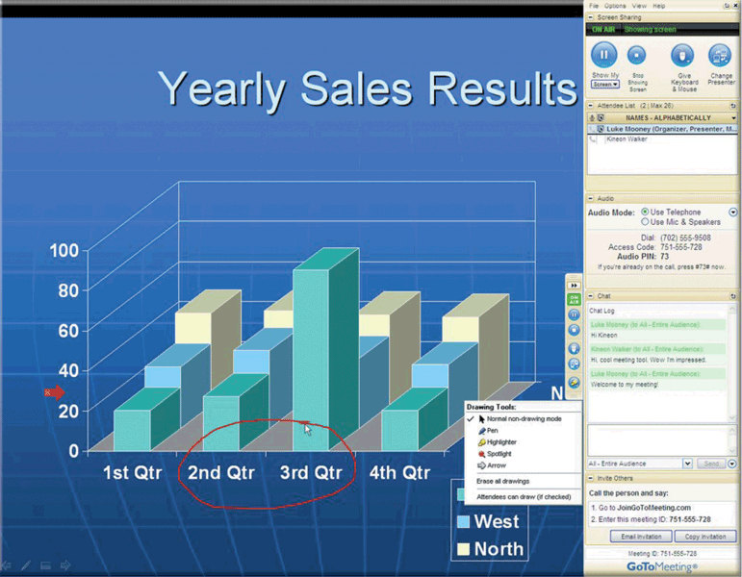
Uses of Computer Communications
Page 468
Figure 9-7

Slide 16
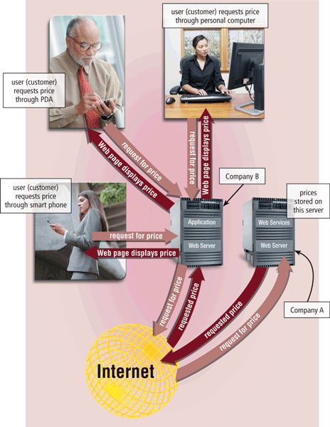
Uses of Computer Communications
Web services enable programmers to create applications that communicate with other remote computers over the Internet or on an internal business network
A mashup is a Web application that combines services from two or more sources
Page 469
Figure 9-8

Slide 17
Networks
A network is a collection of computers and devices connected together via communications devices and transmission media
Advantages of a network include:
Facilitating communications
Sharing hardware
Sharing data and information
Sharing software
Transferring funds
Pages 470 - 471

Slide 18
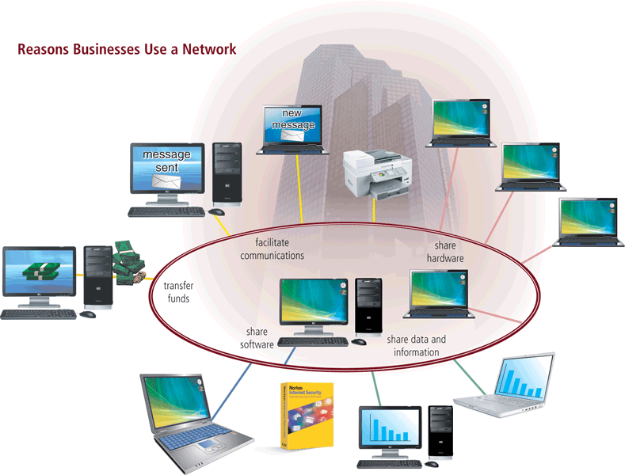
Networks
Page 470
Figure 9-9

Slide 19
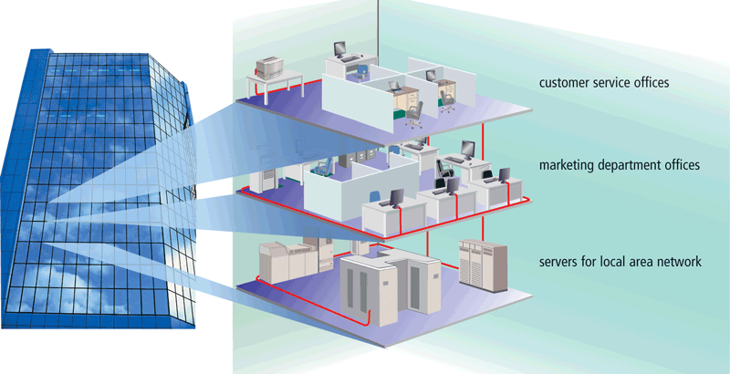
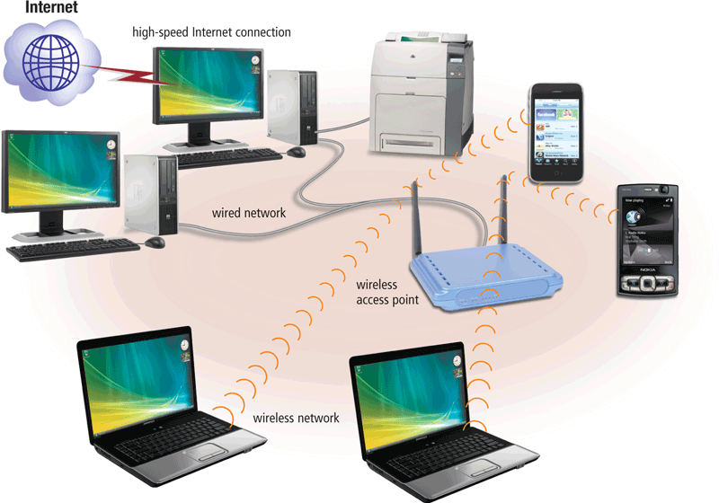
Networks
A local area network (LAN) is a network that connects computers and devices in a limited geographical area
A wireless LAN (WLAN) is a LAN that uses no physical wires
Page 472
Figures 9-10 – 9-11

Slide 20
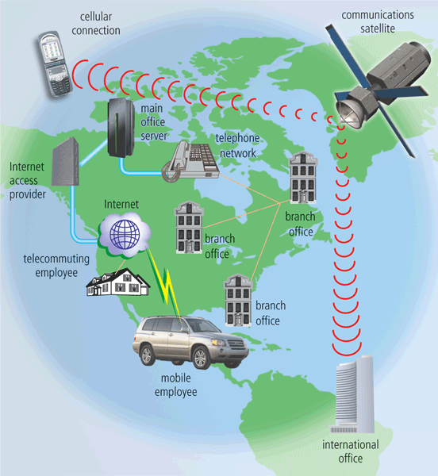
Networks
A metropolitan area network (MAN) connects LANs in a metropolitan area
A wide area network (WAN)
is a network that covers a
large geographical area
Page 473
Figure 9-12

Slide 21
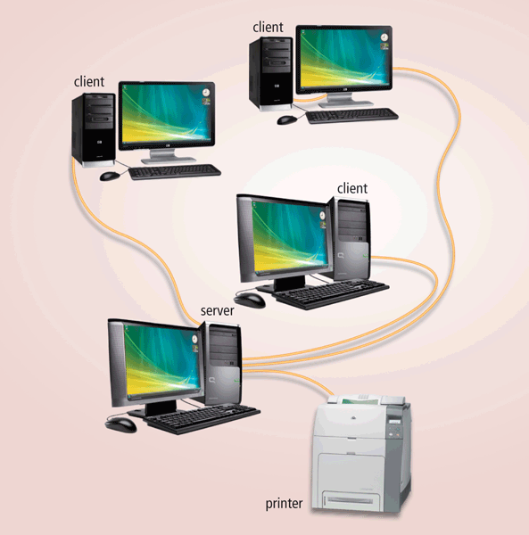
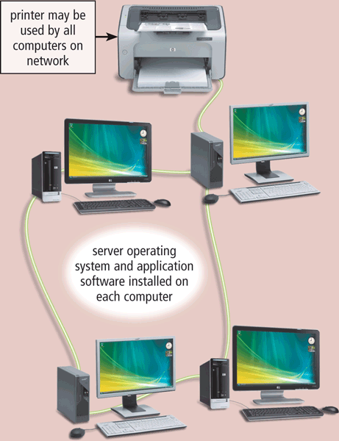
Networks
The design of computers, devices, and media on a network is sometimes called the network architecture
Client/server network
Peer-to-peer network
Pages 473 – 474
Figures 9-13 – 9-14

Slide 22
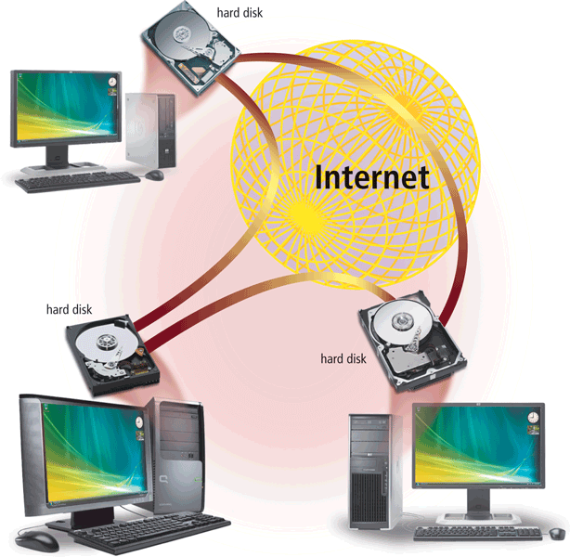
Networks
P2P describes an Internet network on which users access each other’s hard disks and exchange files directly over the Internet
Click to view Web Link,
click Chapter 9, Click Web
Link from left navigation,
then click P2P
below Chapter 9
Page 475
Figure 9-15

Slide 23
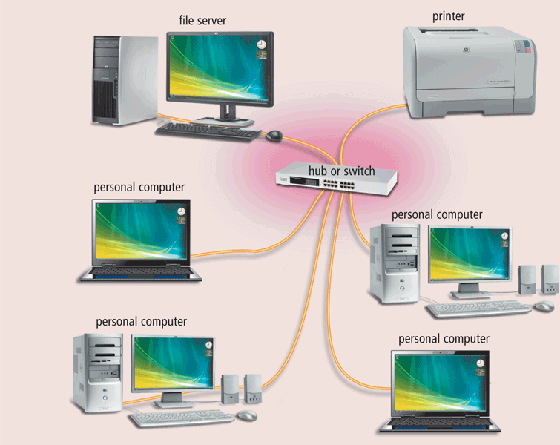
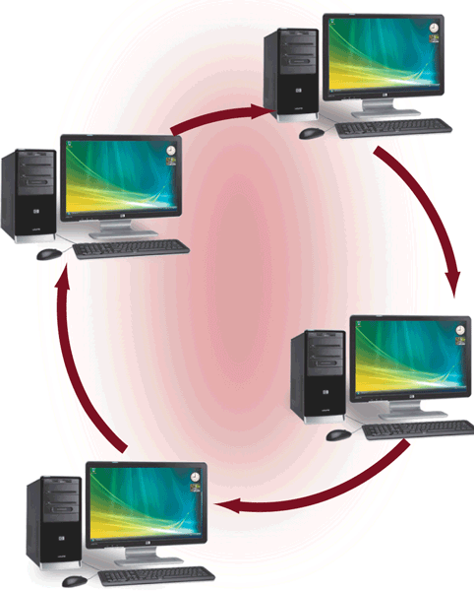
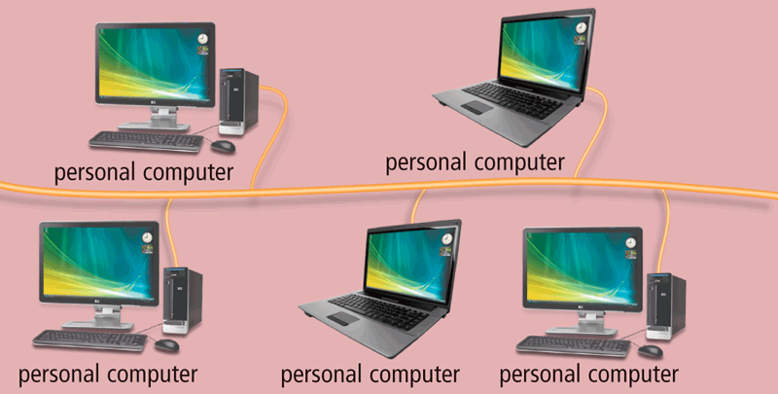
Networks
A network topology refers to the layout of the computers and devices in a communications network
Star network
Bus network
Ring network
Pages 475 – 477
Figures 9-16 – 9-18

Slide 24
Networks
An intranet is an internal network that uses Internet technologies
An extranet allows customers or suppliers to access part of its intranet
Page 477

Slide 25
Network Communications Standards
Ethernet
Token ring
TCP/IP
Wi-Fi
Bluetooth
UWB
IrDA
RFID
WiMAX
WAP
Page 477

Slide 26
Network Communications Standards
Ethernet is a network standard that specifies no computer controls when data can be transmitted
The token ring standard specifies that computers and devices on the network share or pass a special signal (token)
TCP/IP is a network standard that defines how messages are routed from one end of a network to another
Click to view Web Link,
click Chapter 9, Click Web
Link from left navigation,
then click Ethernet
below Chapter 9
Page 478

Slide 27
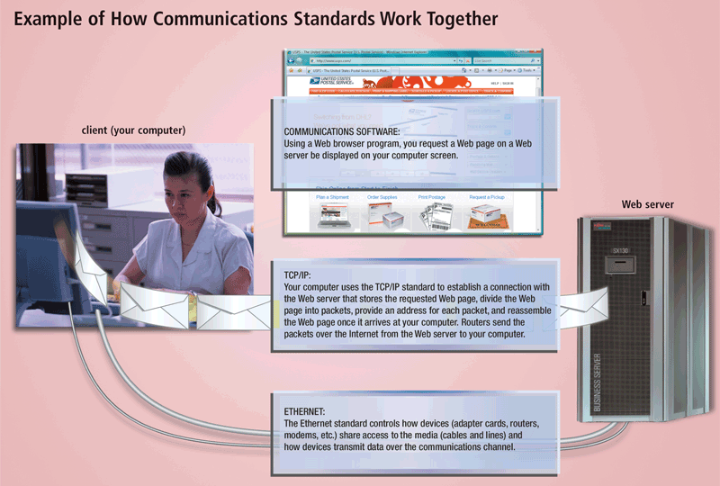
Network Communications Standards
Page 479
Figure 9-19

Slide 28
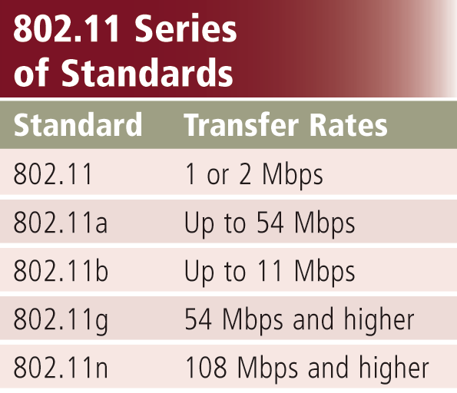
Network Communications Standards
Wi-Fi identifies any network based on the 802.11 standard that facilitates wireless communication
Sometimes referred to as wireless Ethernet
Page 479
Figure 9-20

Slide 29
Network Communications Standards
Bluetooth defines how two Bluetooth devices use short-range radio waves to transmit data
UWB (ultra-wideband) specifies how two UWB devices use short-range radio waves to communicate at high speeds
IrDA transmits data wirelessly via infrared (IR) light waves
RFID uses radio signals to communicate with a tag placed in or attached to an object, animal, or person
Click to view Web Link,
click Chapter 9, Click Web
Link from left navigation,
then click RFID
below Chapter 9
Pages 480 - 481

Slide 30
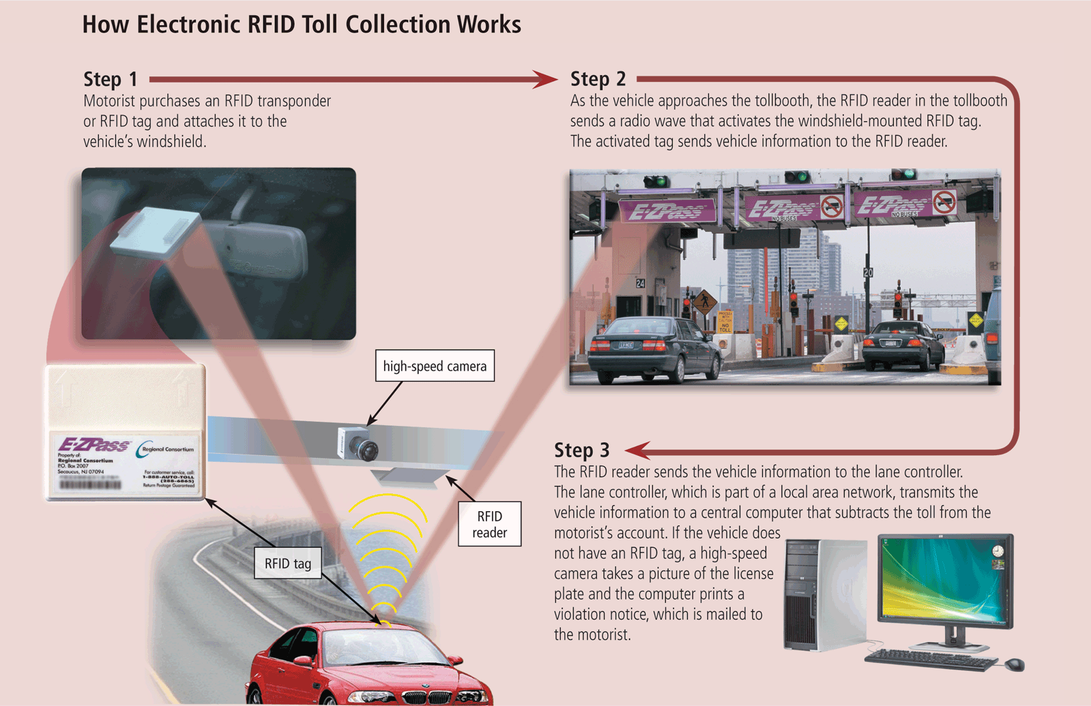
Network Communications Standards
Page 481
Figure 9-21

Slide 31
Network Communications Standards
WiMAX (802.16)
Developed by IEEE
Towers can cover a 30-mile radius
Two types are fixed wireless and mobile wireless
Provides wireless broadband Internet access
Wireless Application Protocol (WAP)
Specifies how some mobile devices can display the content of Internet services
Web
E-mail
Chat rooms
Uses a client/server network
Page 482

Slide 32
Communications Software
Communications software consists of programs that:
Help users establish a connection to another computer or network
Manage the transmission of data, instructions, and information
Provide an interface for users to communicate with one another
Page 482

Slide 33
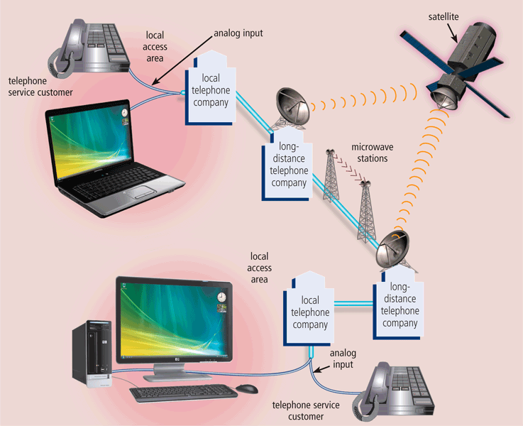
Communications Over the Telephone Network
The public switched telephone network (PSTN) is the worldwide telephone system
Pages 482 – 483
Figure 9-23

Slide 34
Communications Over the Telephone Network
Dial-up lines
Dedicated line
ISDN line
DSL
FTTP
T-carrier line
ATM
Click to view Web Link,
click Chapter 9, Click Web
Link from left navigation,
then click DSL
below Chapter 9
Pages 483 - 485

Slide 35
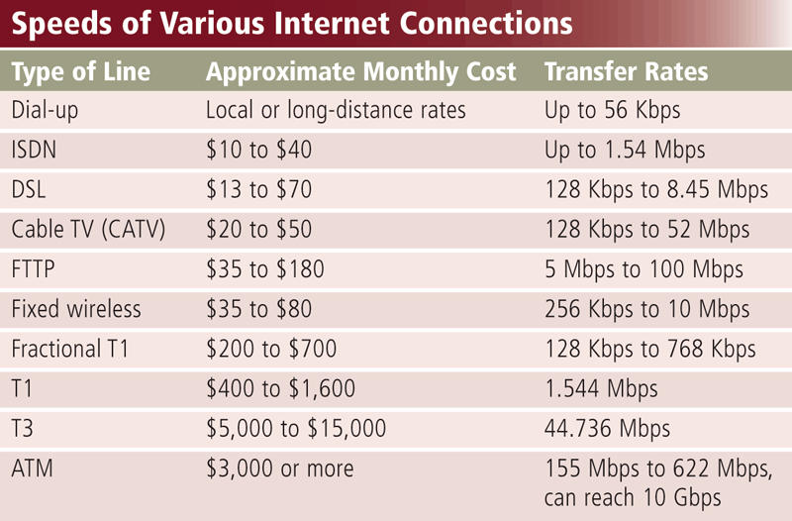
Communications Over the Telephone Network
Page 483
Figure 9-24

Slide 36
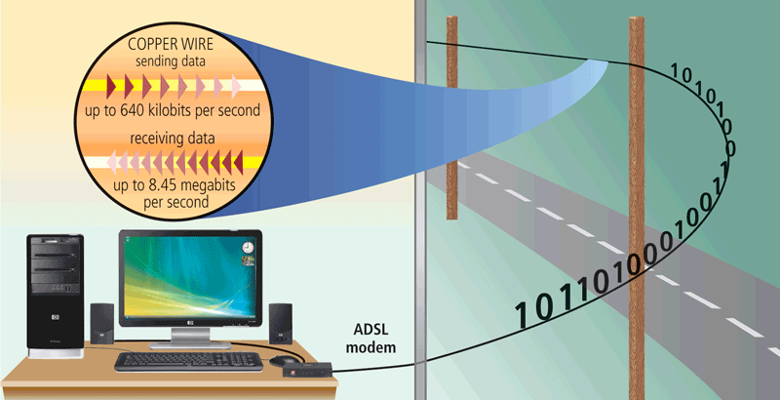
Communications Over the Telephone Network
ADSL connections transmit data downstream at a much faster rate than upstream
Page 484
Figure 9-25

Slide 37
Communications Devices
A communications device is any type of hardware capable of transmitting data, instructions, and information between a sending device and a receiving device
A dial-up modem converts signals between analog and digital
Page 485

Slide 38
Communications Devices
A digital modem sends and receives data and information to and from a digital line
DSL modem
Cable modem
Click to view Web Link,
click Chapter 9, Click Web
Link from left navigation,
then click Cable Modems
below Chapter 9
Page 486

Slide 39
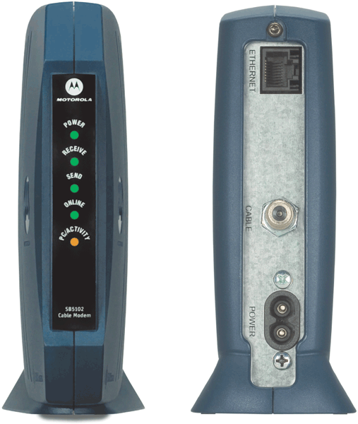
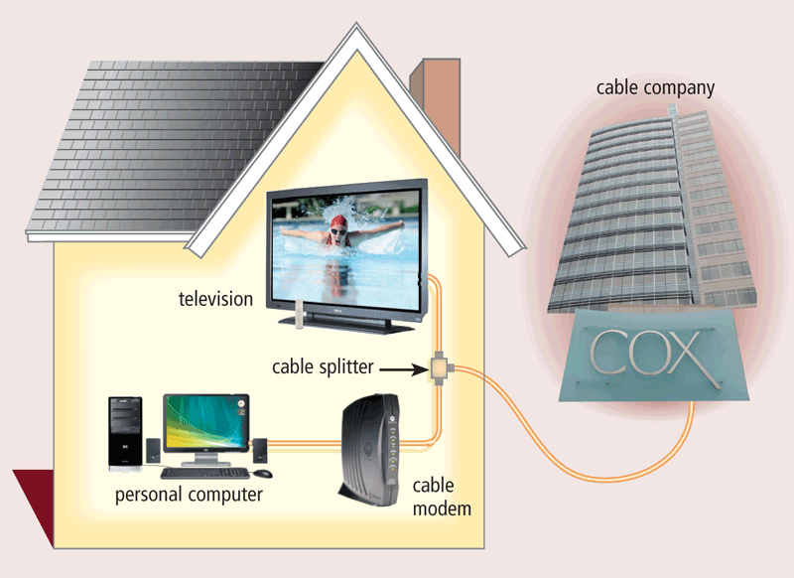
Communications Devices
Page 486
Figures 9-26 – 9-27

Slide 40
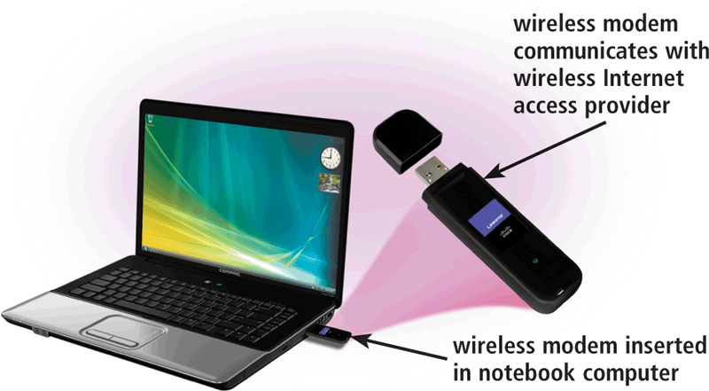
Communications Devices
A wireless modem uses the cell phone network to connect to the Internet wirelessly from a notebook computer, a smart phone, or other mobile device
Page 487
Figure 9-28

Slide 41
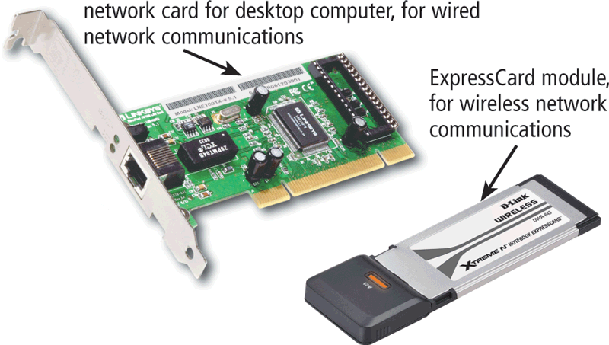
Communications Devices
A network card enables a computer or device to access a network
Available in a variety of styles
Wireless network cards often have an antenna
Page 487
Figure 9-29

Slide 42

Communications Devices
A wireless access point is a central communications device that allows computers and devices to transfer data wirelessly among themselves or to a wired network
Page 487
Figure 9-30

Slide 43
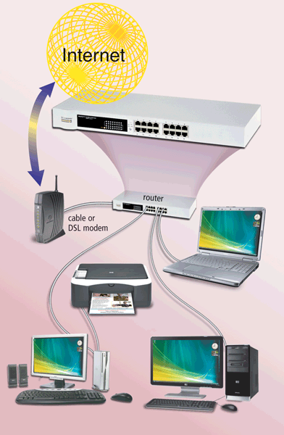
Communications Devices
A router connects multiple computers or other routers together and transmits data to its correct destination on a network
Many are protected by a hardware firewall
Click to view Web Link,
click Chapter 9, Click Web
Link from left navigation,
then click Wireless Routers
below Chapter 9
Page 488
Figure 9-31

Slide 44
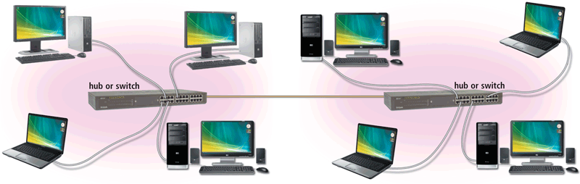
Communications Devices
A hub or switch connects several devices in a network together
Pages 488 – 489
Figure 9-32

Slide 45
Home Networks
Home networks provide computers with the following capabilities:
Connect to the Internet at the same time
Share a single high-speed Internet connection
Access files and programs on other computers
Share peripherals
Play multiplayer games
Connect game consoles to the Internet
Subscribe to and use VoIP
Click to view Web Link,
click Chapter 9, Click Web
Link from left navigation,
then click Home Networks
below Chapter 9
Page 489

Slide 46
Home Networks
Types of wired home networks:
Ethernet
Powerline cable
Phoneline
Page 489

Slide 47
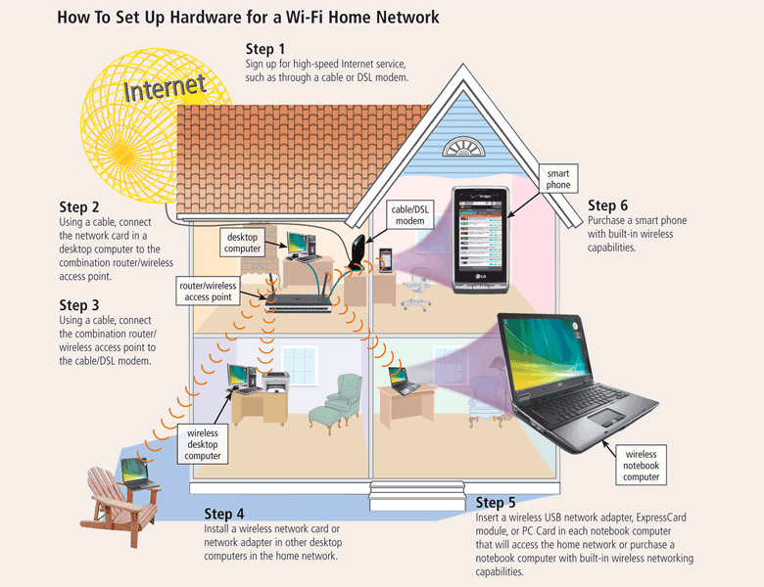
Home Networks
Page 490
Figure 9-33

Slide 48
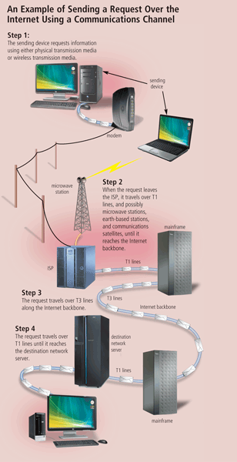
Communications Channel
The amount of data that can travel over a communications channel sometimes is called the bandwidth
Latency is the time it takes a signal to travel from one location to another on a network
Transmission media carries one or more signals
Broadband media transmit multiple signals simultaneously
Page 491
Figure 9-34

Slide 49
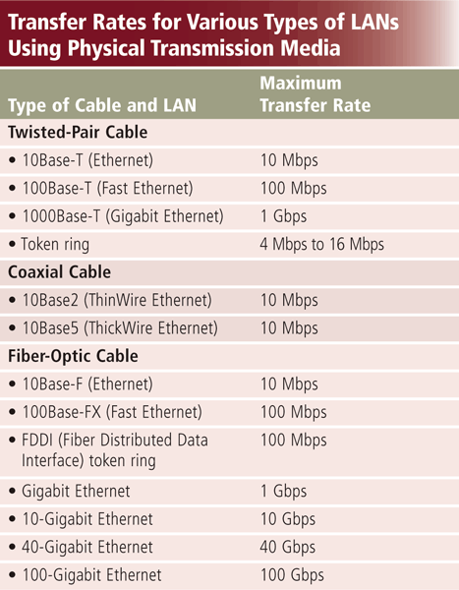
Physical Transmission Media
Page 492
Figure 9-35

Slide 50
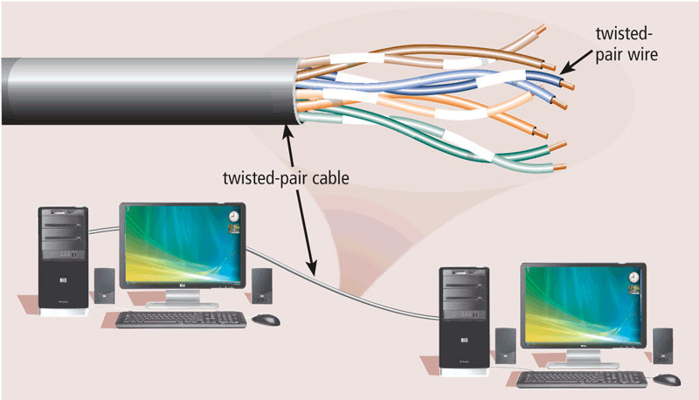
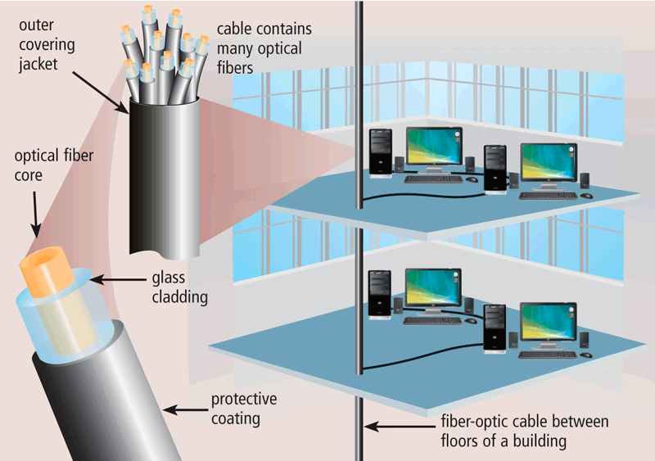
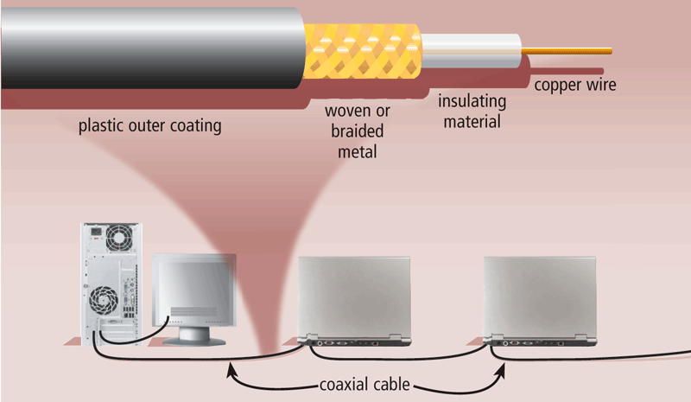
Physical Transmission Media
Twisted-pair cable
Fiber-optic cable
Coaxial cable
Page 493
Figures 9-36 – 9-38

Slide 51
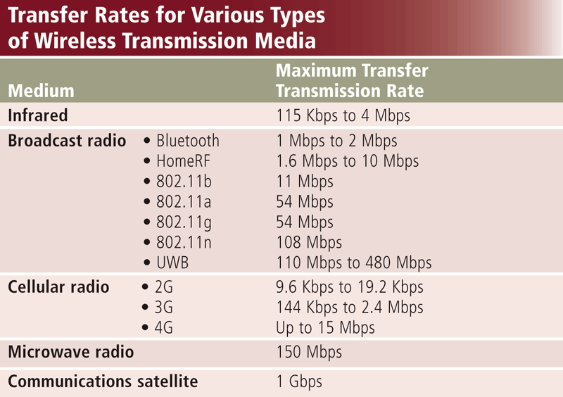
Wireless Transmission Media
Page 494
Figure 9-39

Slide 52
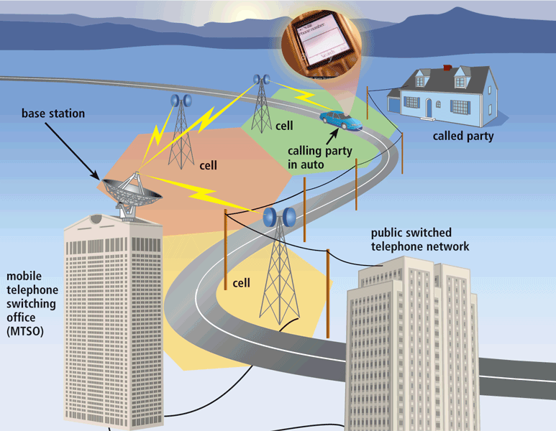
Wireless Transmission Media
Cellular radio is a form of broadcast radio that is used widely for mobile communications
Click to view Web Link,
click Chapter 9, Click Web
Link from left navigation,
then click Mobile TV
below Chapter 9
Page 495
Figure 9-40

Slide 53
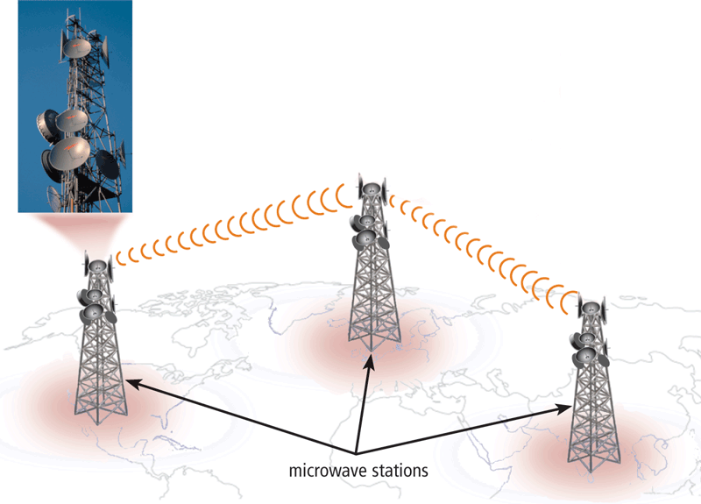
Wireless Transmission Media
Microwaves are radio waves that provide a high-speed signal transmission
Page 496
Figure 9-41

Slide 54
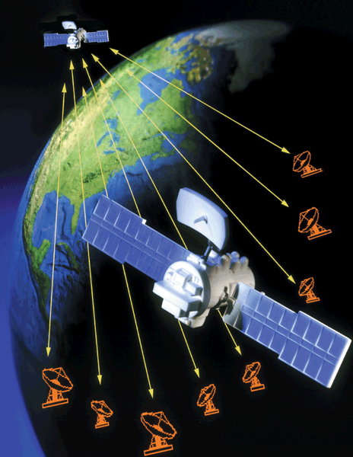
Wireless Transmission Media
A communications satellite is a space station that receives microwave signals from an earth-based station, amplifies it, and broadcasts the signal over a wide area
Page 496
Figure 9-42

Slide 55
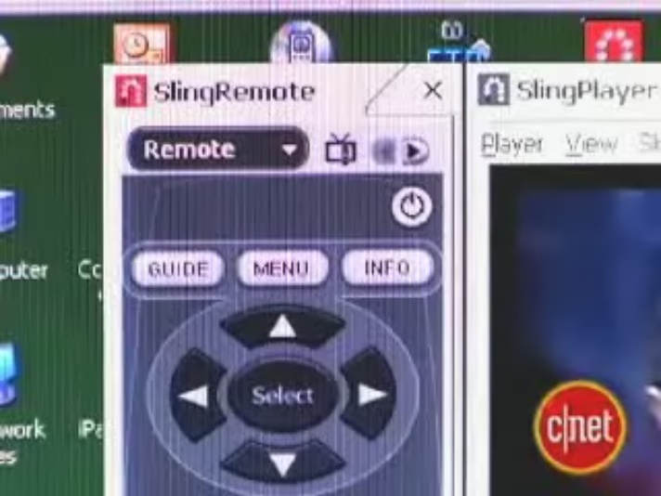
Video: Got Your Video Right Here
CLICK TO START

Slide 56
Summary
Overview of communications terminology and applications
How to join computers into a network
Various communications devices, media, and procedures
Page 497

Slide 57
Chapter 9 Complete

