Slide 2
Objectives Overview
Define input and differentiate among a program, command, and user response
Identify the keys and buttons commonly found on desktop computer keyboards, and describe how keyboards for mobile computers and devices differ from desktop computer keyboards
Describe different mouse types and explain how to use a mouse
Describe various types of touch screens and explain how a touch-sensitive pad works
Describe various types of pen input, and identify other types of input for smart phones
Summarize the purpose of various game controllers
See Page 257
for Detailed Objectives

Slide 3
Objectives Overview
Explain how resolution affects the quality of a picture captured on a digital camera
Describe the uses of voice recognition, Web cams, and video conferencing
Discuss how various scanners and reading devices work
Summarize the various biometric devices
Discuss how POS terminals, automated teller machines, and DVD kiosks work
Identify alternative input devices for physically challenged users
See Page 257
for Detailed Objectives

Slide 4
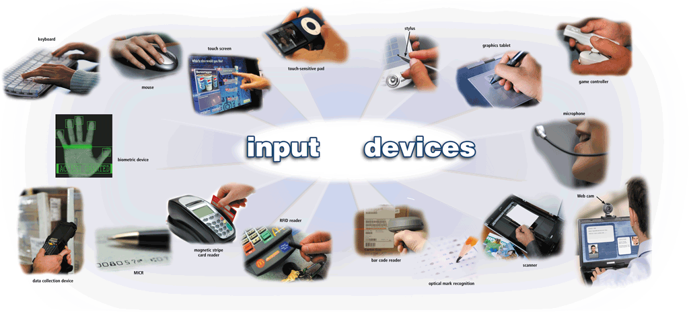
What Is Input?
Input is any data and instructions entered into the memory of a computer
Pages 258 – 259
Figure 5-1

Slide 5
What Is Input?
Instructions can be entered into the computer in the form of programs, commands, and user responses
A program is a series of related instructions that tells a computer what tasks to perform and how to perform them
Programs respond to commands that a user issues
A user response is an instruction a user issues by replying to a question displayed by a program
Pages 258 - 259

Slide 6
What Are Input Devices
An input device is any hardware component that allows users to enter data and instructions into a computer
Page 260

Slide 7
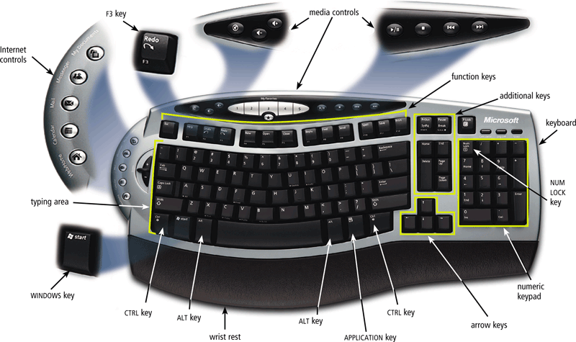
The Keyboard
A keyboard is an input device that contains keys users press to enter data and instructions into a computer
Page 560
Figure 5-2

Slide 8
The Keyboard
Most desktop computer keyboards have…
Between 101 and 105 keys
A numeric keypad on the right side of the keyboard
Function keys, CTRL keys, ALT keys, and arrow keys
WINDOWS key
Toggle keys
APPLICATION key
Pages 260 - 261

Slide 9
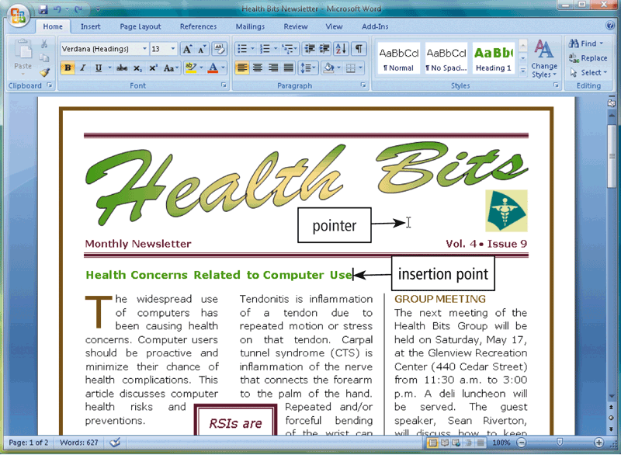
The Keyboard
The insertion point, also known as the cursor, is a symbol on the screen that indicates where the next character you type will appear
Page 261
Figure 5-3

Slide 10
The Keyboard
Wired Keyboards
USB port
Keyboard port
Wireless Keyboards
Bluetooth
IrDA
Page 262

Slide 11
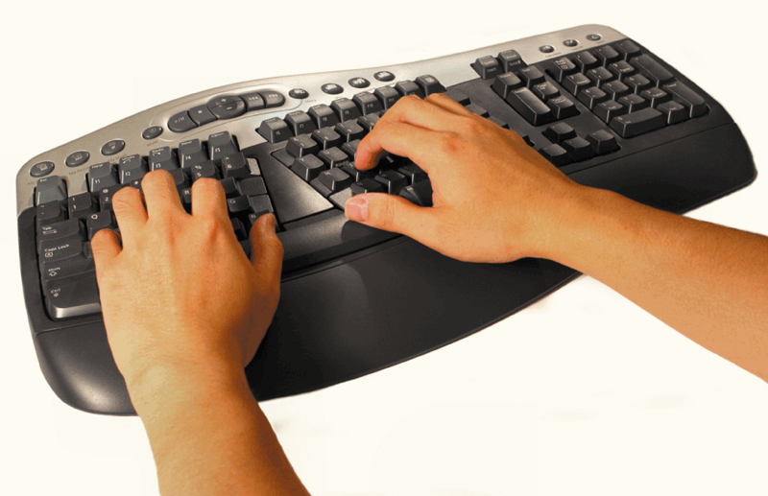
The Keyboard
An ergonomic keyboard has a design that reduces the chance of wrist and hand injuries
Ergonomics incorporates comfort, efficiency, and safety into the design of the workplace
Click to view Web Link,
click Chapter 5, Click Web
Link from left navigation,
then click Ergonomics
below Chapter 5
Page 262
Figure 5-4

Slide 12
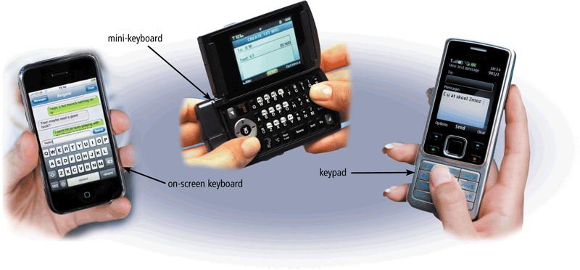
The Keyboard
Keyboards on mobile devices typically are smaller and/or have fewer keys
Some phones have predictive text input, which saves time when entering text using the phone’s keypad
Pages 262 – 263
Figure 5-5

Slide 13
Pointing Devices
A pointing device is an input device that allows a user to control a pointer on the screen
A pointer is a small symbol on the screen whose location and shape change as a user moves a pointing device
Page 263

Slide 14
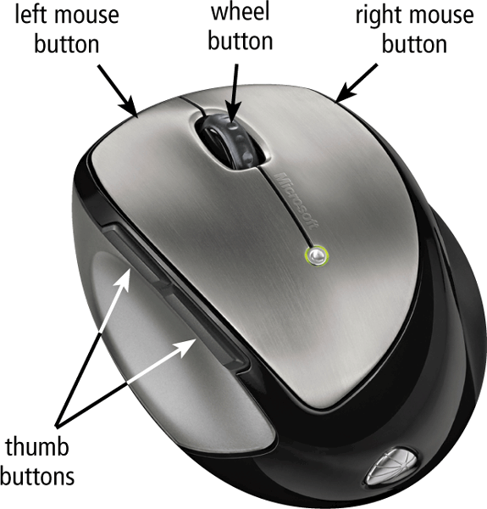
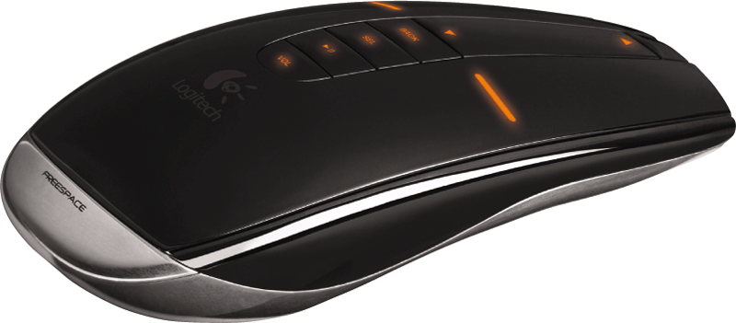
Mouse
A mouse is a pointing device that fits under the palm of your hand comfortably
  Most widely used pointing device on desktop computers
A mouse can be wired or wireless
Pages 263 – 264
Figures 5-6 and 5-7

Slide 15
Mouse
Mouse operations
Point
Click
Right-click
Double-click
Triple-click
Drag
Right-drag
Rotate wheel
Free-spin wheel
Press wheel
Tilt wheel
Press thumb button
Page 264
Figure 5-8

Slide 16
Other Pointing Devices
Trackball
A trackball is a stationary pointing device with a ball on its top or side
Touchpad
A touchpad is a small, flat, rectangular pointing device that is sensitive to pressure and motion
Pointing Stick
A pointing stick is a pressure-sensitive pointing device shaped like a pencil eraser that is positioned between keys on a keyboard
Pages 265 – 266
Figures 5-9 – 5-11

Slide 17
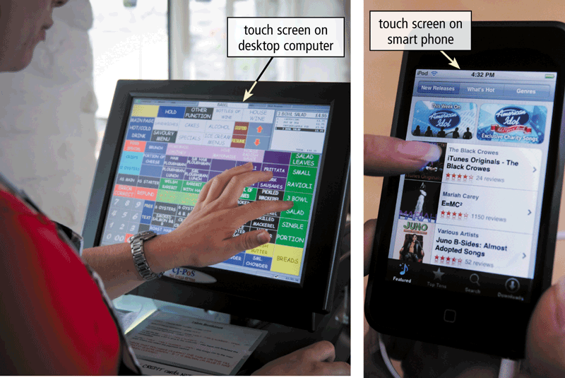
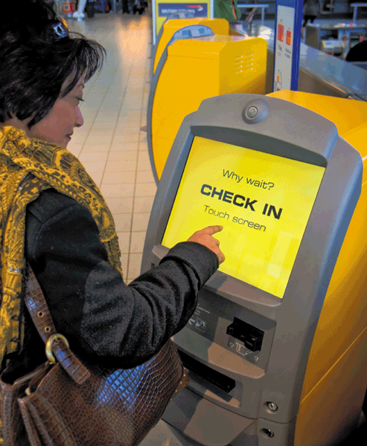
Touch Screens and Touch-Sensitive Pads
A touch screen is a touch-sensitive display device
Click to view Web Link,
click Chapter 5, Click Web
Link from left navigation,
then click Multi-Touch Screens
below Chapter 5
Page 266
Figures 5-12 – 5-13

Slide 18
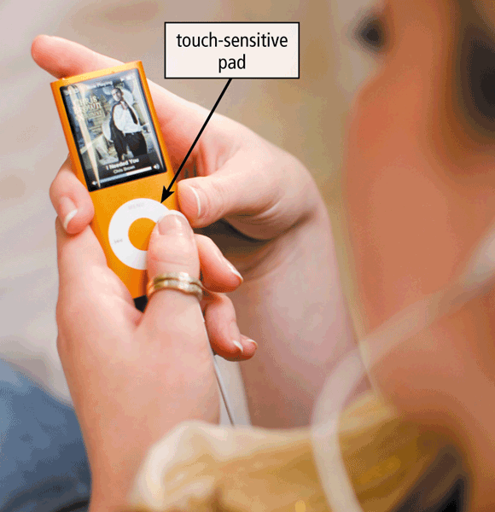
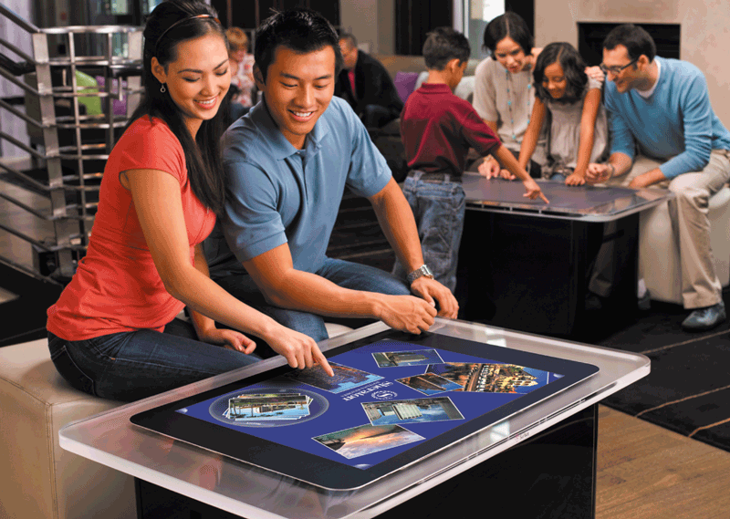
Touch Screens and Touch-Sensitive Pads
Microsoft Surface
Touch-sensitive pads
Page 267
Figures 5-14 – 5-15

Slide 19
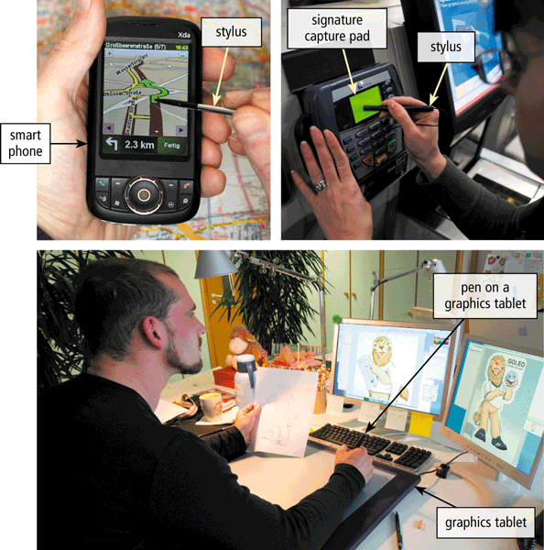
Pen Input
With pen input, you touch a stylus or digital pen on a flat surface to write, draw, or make selections
Click to view Web Link,
click Chapter 5, Click Web
Link from left navigation,
then click Signature Capture Pads below Chapter 5
Page 268
Figure 5-16

Slide 20
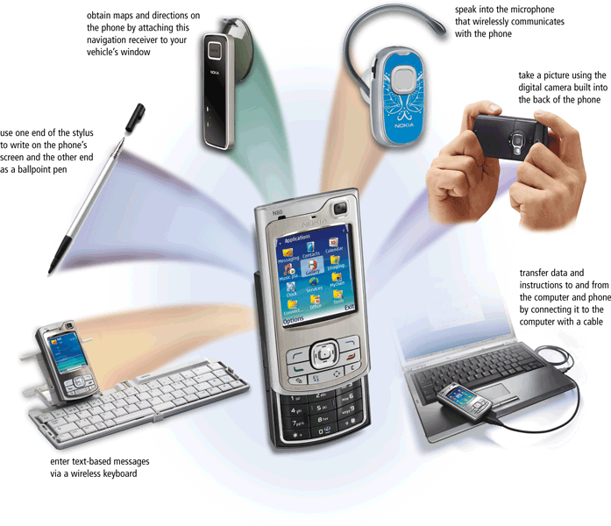
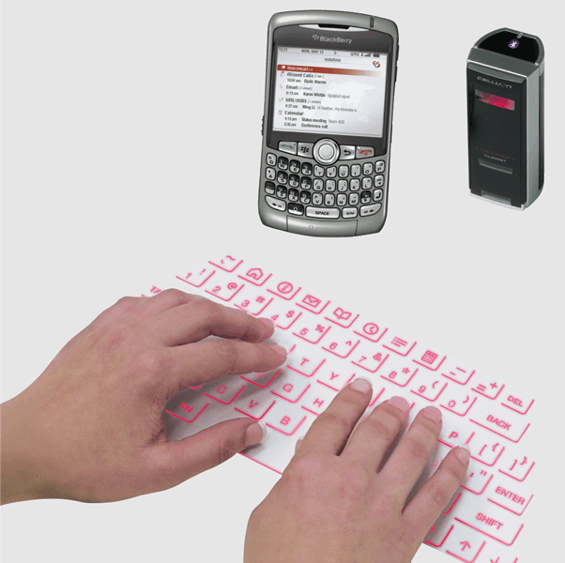
Other Input for Smart Phones
Page 269
Figures 5-17 – 5-18

Slide 21
Game Controllers
Video games and computer games use a game controller as the input device that directs movements and actions of on-screen objects
Gamepads
Joysticks and Wheels
Light guns
Dance pads
Motion-sensing controllers
Click to view Web Link,
click Chapter 5, Click Web
Link from left navigation,
then click Wii Remote
below Chapter 5
Page 270

Slide 22
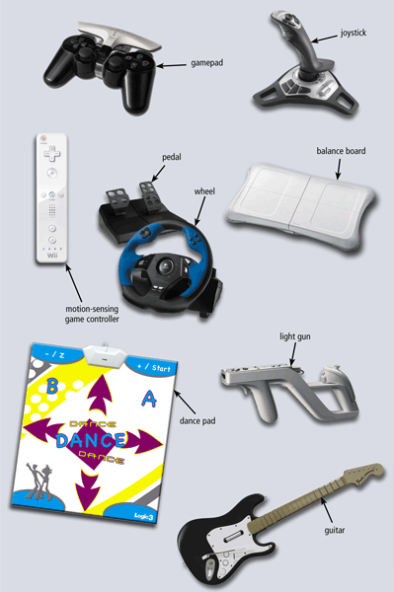
Game Controllers
Page 270
Figure 5-19

Slide 23
Digital Cameras
A digital camera is a mobile device that allows users to take pictures and store them digitally
Studio cameras
Field cameras
Point-and-shoot camera
Page 272

Slide 24
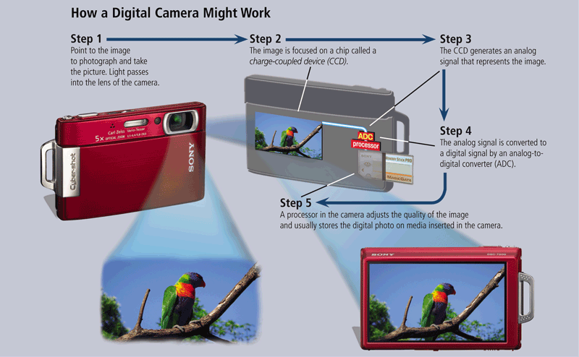
Digital Cameras
Page 272
Figure 5-20

Slide 25
Digital Cameras
Two factors affect the quality of digital camera photos:
Resolution
Resolution is the number of horizontal and vertical pictures in a display device
Number of bits stored in each pixel
Each pixel consists of one or more bits of data
A pixel is the smallest element in an electronic display
The more bits used to represent a pixel, the more colors and shades of gray that can be represented
Page 273

Slide 26

Voice Input
Voice input is the process of entering input by speaking into a microphone
Voice recognition is the computer’s capability of distinguishing spoken words
Page 274
Figure 5-22

Slide 27
Voice Input
Audio input is the process of entering any sound into the computer
Speech
Music
Sound Effects
Page 274

Slide 28
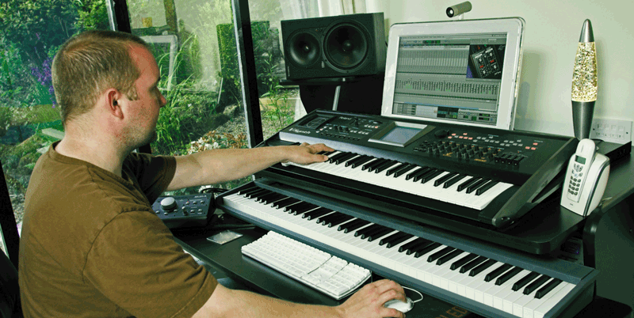
Voice Input
Music production software allows users to record, compose, mix, and edit music and sounds
Page 274
Figure 5-23

Slide 29
Video Input
Video input is the process of capturing full-motion images and storing them on a computer’s storage medium
Record video on a digital video (DV) camera or use a video capture card to convert analog signals to digital
Connect the camera to a port on the system unit
Transfer video and images
Page 275

Slide 30
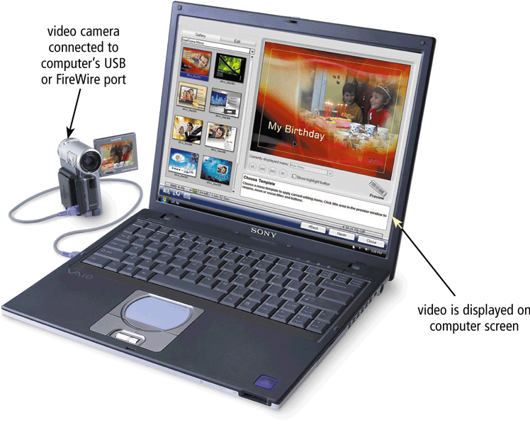
Video Input
Page 275
Figure 5-24

Slide 31
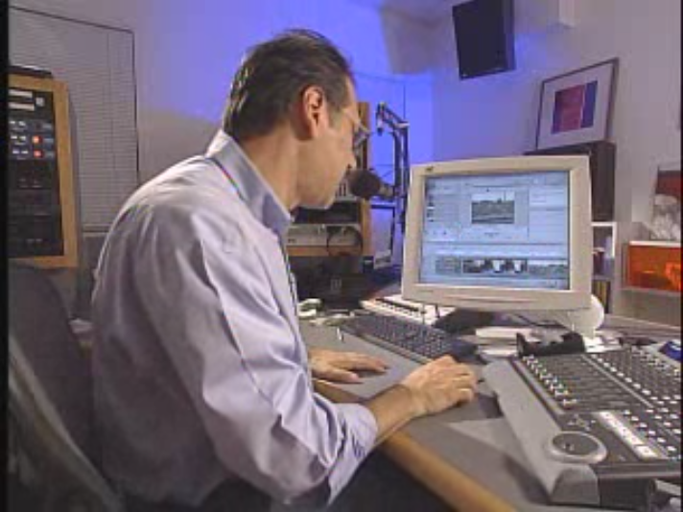
Video: Video Editing on Your Computer
CLICK TO START

Slide 32
Video Input
A Web cam is a type of digital video camera that enables a user to:
Capture video and still images
Send e-mail messages with video attachments
Add live images to instant messages
Broadcast live images over the Internet
Make video telephone calls
Click to view Web Link,
click Chapter 5, Click Web
Link from left navigation,
then click Web Cams
below Chapter 5
Pages 275 - 276

Slide 33
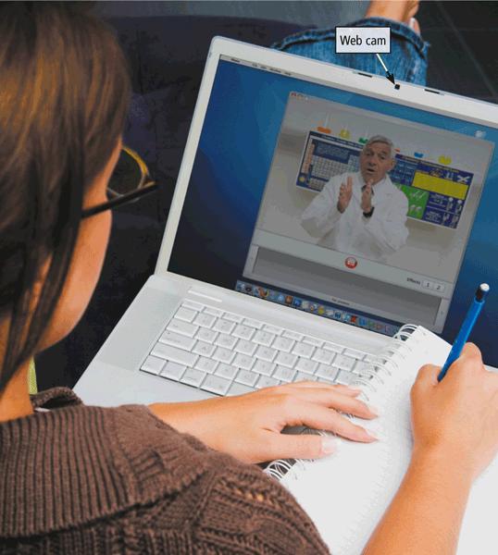
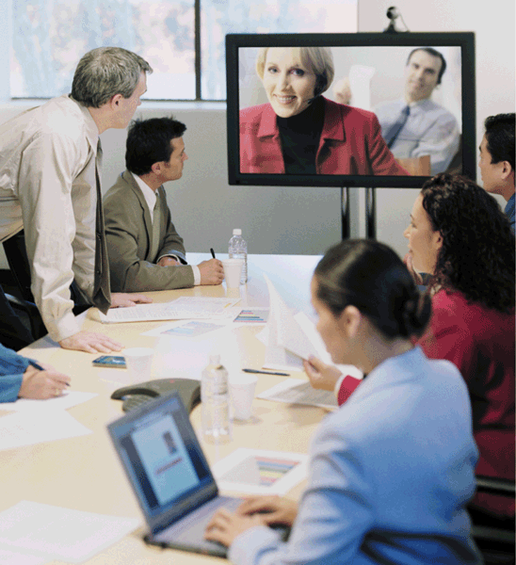
Video Input
A video conference is a meeting between two or more geographically separated people
Pages 276 – 277
Figures 5-25 – 5-26

Slide 34
Scanners and Reading Devices
Flatbed
Pen or Handheld
Sheet-fed
Drum
Page 277
Figure 5-27

Slide 35
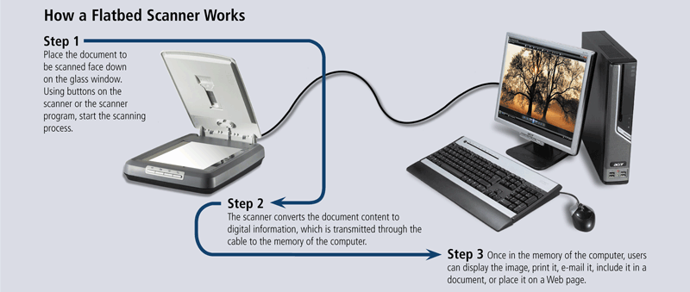
Scanners and Reading Devices
Page 278
Figure 5-28

Slide 36
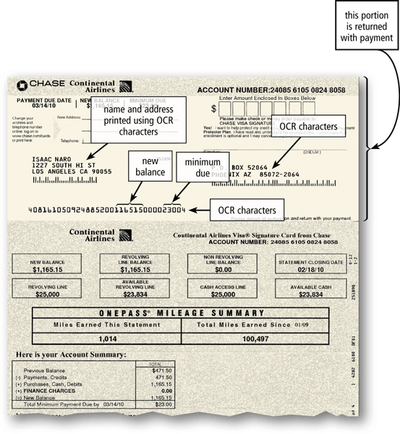
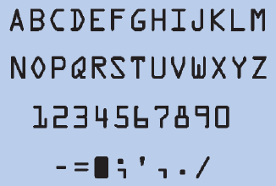
Scanners and Reading Devices
Optical character recognition (OCR) involves reading characters from ordinary documents
A turnaround document is a document you return to the company that creates and sends it
Page 279
Figures 5-29 – 5-30

Slide 37
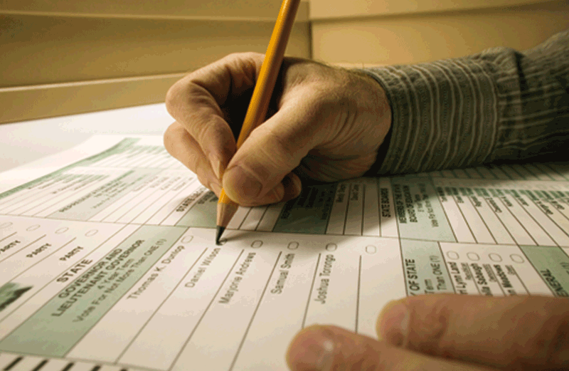
Scanners and Reading Devices
Optical mark recognition (OMR) reads hand-drawn marks such as small circles or rectangles
An OMR device scans the documents and matches the patterns of light
Page 279
Figure 5-31

Slide 38
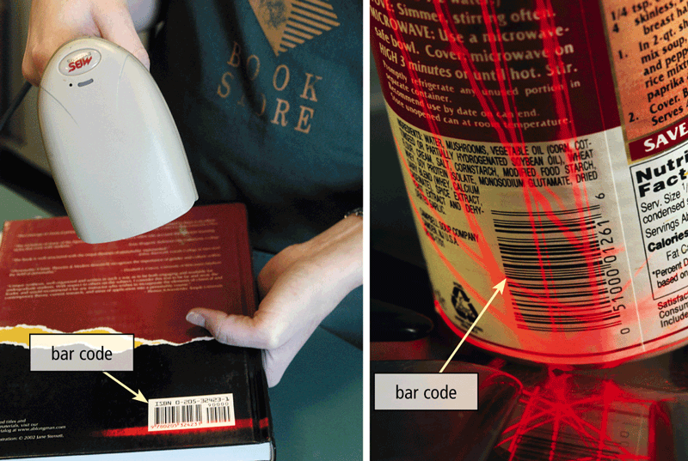
Scanners and Reading Devices
A bar code reader, also called a bar code scanner uses laser beams to read bar codes
Click to view Web Link,
click Chapter 5, Click Web
Link from left navigation,
then click Bar Code Readers
below Chapter 5
Page 280
Figure 5-32

Slide 39
Scanners and Reading Devices
RFID (radio frequency identification) uses radio signals to communicate with a tag placed in or attached to an object
An RFID reader reads information on the tag via radio waves
RFID can track:
Inventory
Location of soldiers
Employee wardrobes
Airline baggage
Gauging tire pressure and temperature
Library books
Prepaid tolls
Page 280

Slide 40
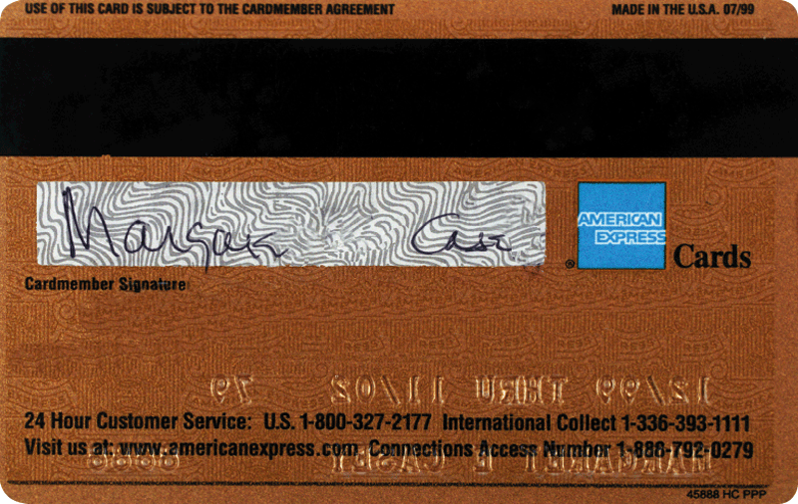
Scanners and Reading Devices
Magnetic stripe card readers read the magnetic stripe on the back of cards such as:
Credit cards
Entertainment cards
Bank cards
Other similar cards
Page 281
Figure 5-34

Slide 41
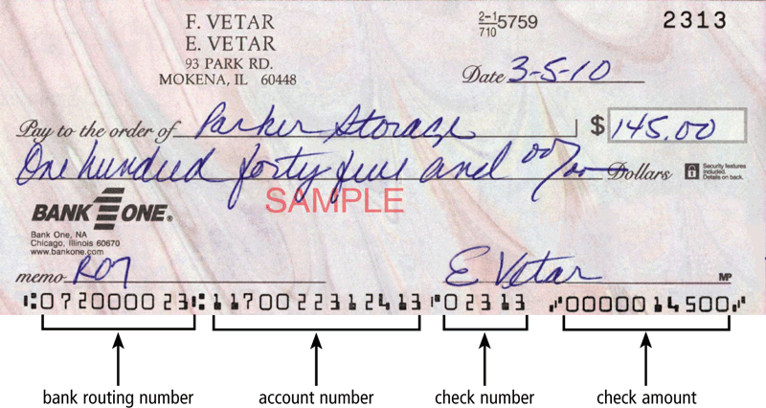
Scanners and Reading Devices
MICR (magnetic ink character recognition) devices read text printed with magnetized ink
An MICR reader converts MICR characters into a form the computer can process
Banking industry uses MICR for check processing
Page 281
Figure 5-35

Slide 42
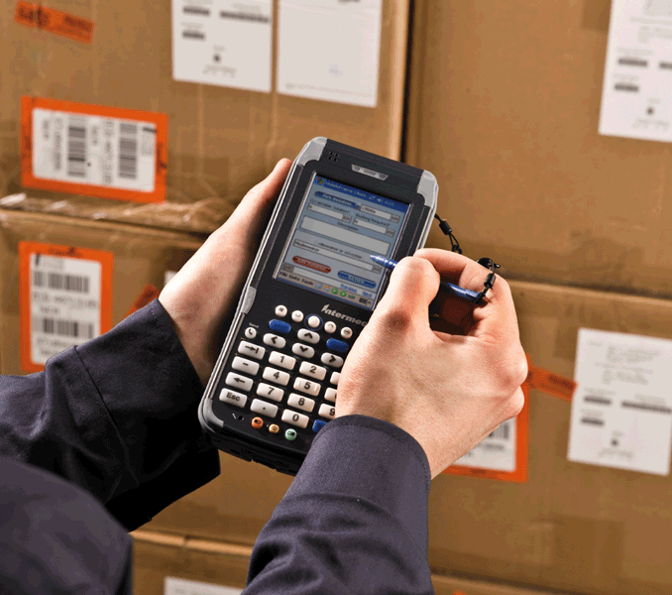
Scanners and Reading Devices
Data collection devices obtain data directly at the location where the transaction or event takes place
Used in:
  Restaurants
  Grocery stores
  Factories
  Warehouses
  The outdoors
Page 282
Figure 5-36

Slide 43
Biometric Input
Biometrics authenticates a person’s identity by verifying a personal characteristic
Fingerprint reader
Face recognition system
Hand geometry system
Voice verification system
Signature verification system
Iris recognition system
Retinal scanners
Pages 282 - 283

Slide 44
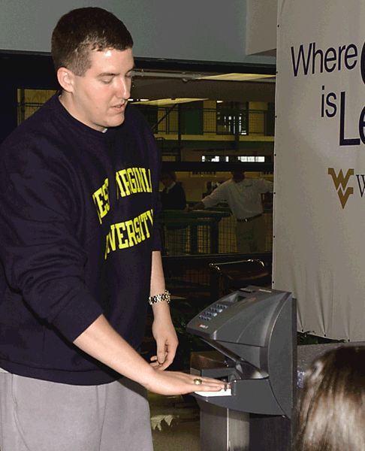
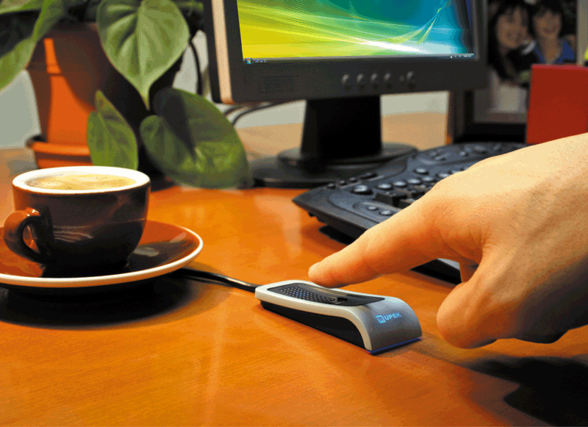
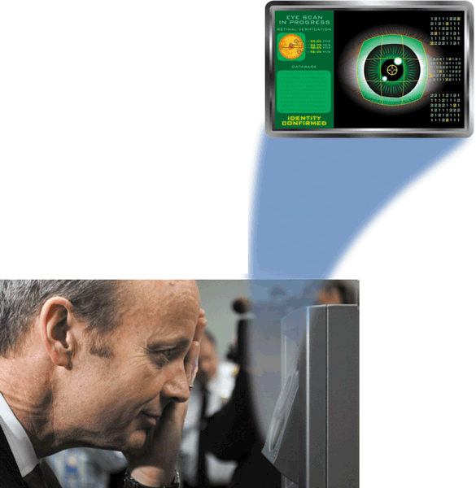
Biometric Input
hand geometry system
iris recognition system
fingerprint reader
Click to view Web Link,
click Chapter 5, Click Web
Link from left navigation,
then click Biometric Input
below Chapter 5
Pages 282 – 283
Figures 5-37 – 5-39

Slide 45
Terminals
A terminal is a computer that allows users to send data to and/or receive information from a host computer
A POS terminal records purchases, processes payment, and updates inventory
An automated teller machine (ATM) allows users to access their bank accounts
A DVD kiosk is a self-service DVD rental machine
Pages 284 – 285
Figures 5-40 – 5-42

Slide 46

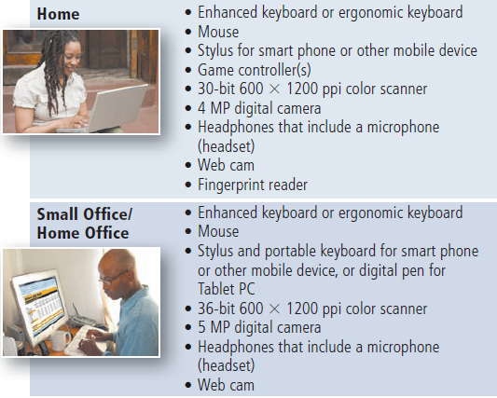
Putting It All Together
Page 285
Figure 5-43

Slide 47
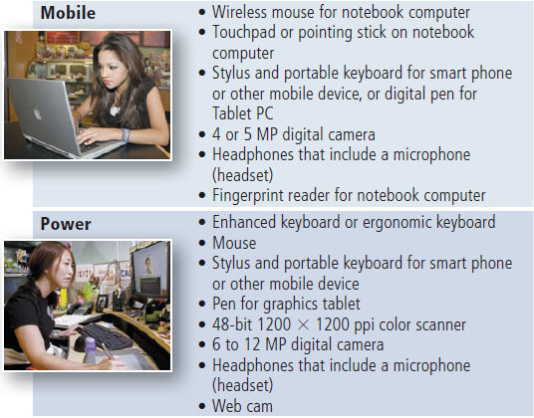
Putting It All Together
Page 285
Figure 5-43

Slide 48
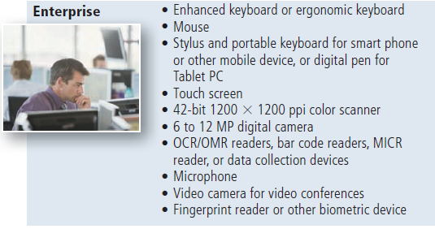
Putting It All Together
Page 285
Figure 5-43

Slide 49
Input Devices for Physically Challenged Users
Several input devices are available to assist physically challenged users:
Keyguard
Keyboards with larger keys
On-screen keyboard
Various pointing devices
Head-mounted pointer
Gesture recognition
Computerized implant devices
Click to view Web Link,
click Chapter 5, Click Web
Link from left navigation,
then click Gesture Recognition
below Chapter 5
Page 286

Slide 50
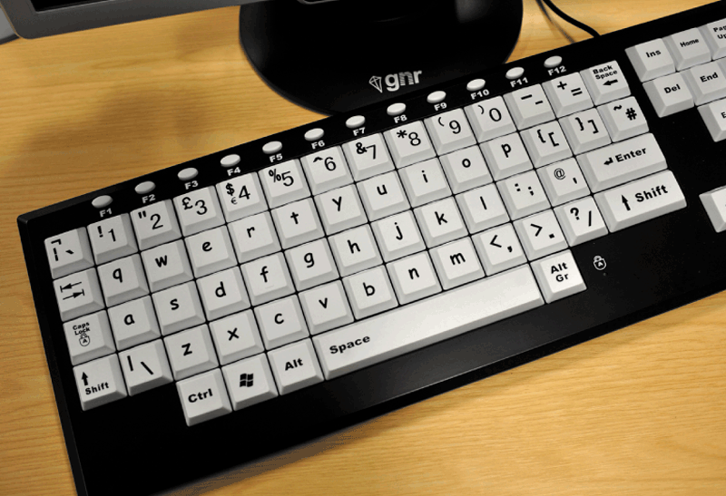
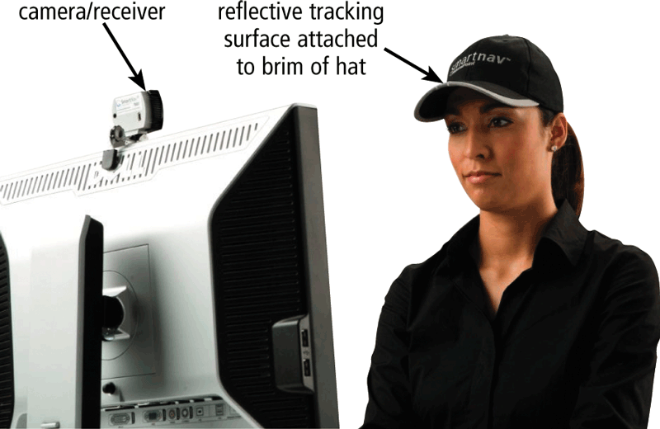
Input Devices for Physically Challenged Users
Keyboard with larger keys
Head-mounted pointer
Page 286
Figures 5-44 – 5-45

Slide 51
Summary
Various techniques of entering input
Several commonly used input devices
Keyboard, mouse, and other pointing devices; touch screens, pen input, other input for smart phones, game controllers, digital cameras, voice input, video input, scanners and reading devices, biometric input, and terminals
Input devices for physically challenged users
Page 287

Slide 52
Chapter 5 Complete

