Slide 2
Objectives Overview
Identify the four categories of application software
Differentiate among the seven forms through which software is available
Explain how the operating system and utility programs work with application software
Describe characteristics of a user interface
Identify the key features of widely used business programs
See Page 141
for Detailed Objectives

Slide 3
Objectives Overview
Identify the key features of widely used graphics and multimedia programs
Identify the key features of widely used home, personal, and educational programs
Discuss the advantages of and ways to access Web applications
Identify the types of application software used in communications
Describe the learning aids available for application software
See Page 141
for Detailed Objectives

Slide 4
Application Software
Application software consists of programs designed to make users more productive and/or assist with personal tasks
To make business activities more efficient
To assist with graphics and multimedia projects
To support home, personal, and educational tasks
To facilitate communications
Page 142

Slide 5
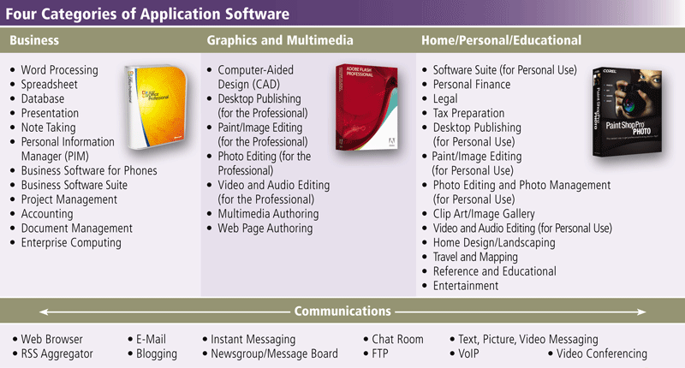
Application Software
Page 142
Figure 3-1

Slide 6
Application Software
Available in a variety of forms:
Packaged software
Custom software
Web application
Open source software
Shareware
Freeware
Public-domain software
Pages 142 – 143

Slide 7
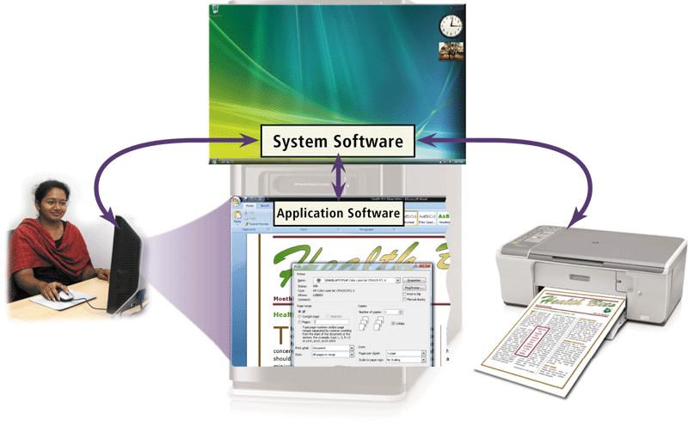
Application Software
System software serves as the interface between the user, the application software, and the computer’s hardware
  Utility programs
Click to view Web Link,
click Chapter 3, Click Web
Link from left navigation,
then click Antivirus Programs
below Chapter 3
Page 143
Figure 3-2

Slide 8
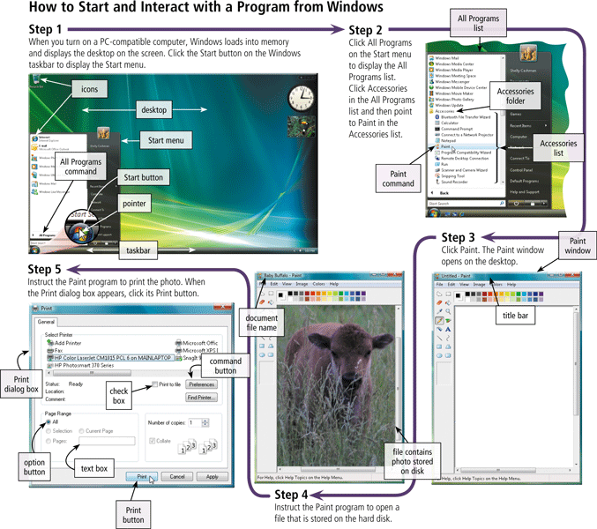
Application Software
Page 145
Figure 3-3

Slide 9
Business Software
Business software is application software that assists people while performing business activities
Word Processing
Spreadsheet
Database
Presentation
Note taking
Personal information manager
Business software for phones
Business software suites
Project management
Accounting
Document management
Enterprise computing software
Page 146

Slide 10
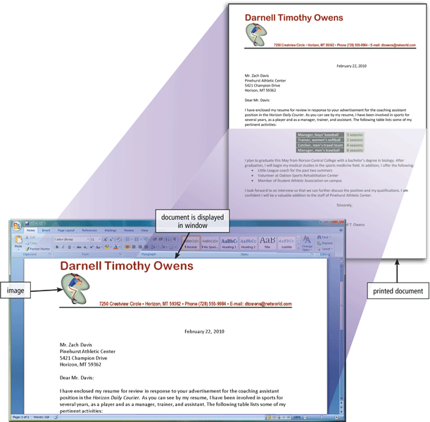
Business Software
Word processing software allows users to create and manipulate documents
Clip art is a collection of electronic drawings, photos, and other images
Page 147
Figure 3-5

Slide 11
Business Software
Additional word processing features include
AutoCorrect
AutoFormat
Collaboration
Columns
Grammar Checker
Ink Input
Macros
Mail Merge
Reading Layout
Research
Search and Replace
Smart Tags
Tables
Templates
Thesaurus
Tracking Changes
Voice Recognition
Web Page Development
Click to view Web Link,
click Chapter 3, Click Web
Link from left navigation,
then click Word Processing Software below Chapter 3
Page 148
Figure 3-6

Slide 12
Business Software
Developing a document
Create a document
Enter text and numbers
Edit a document
Make changes to existing content
Format a document
Change appearance
Insert images
Perform other tasks
Inserting, deleting, cutting, copying, and pasting
Font
Font size
Page 149

Slide 13
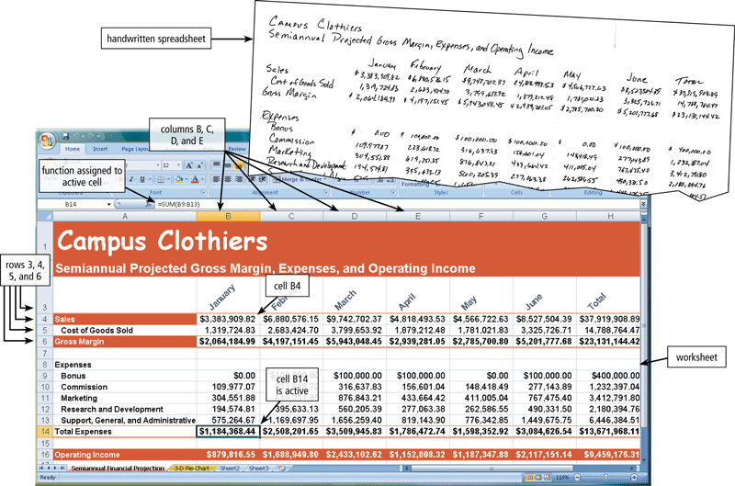
Business Software
Spreadsheet software allows users to organize data in rows and columns and perform calculations
Click to view Web Link,
click Chapter 3, Click Web
Link from left navigation,
then click Spreadsheet Software below Chapter 3
Pages 150 - 151
Figure 3-8

Slide 14
Business Software
A function is a predefined formula that performs common calculations
FV
NPV
PMT
PV
RATE
DATE
NOW
TIME
ABS
INT
LN
LOG
ROUND
SQRT
SUM
AVERAGE
COUNT
MAX
MIN
STDEV
IF
Page 152
Figure 3-9

Slide 15
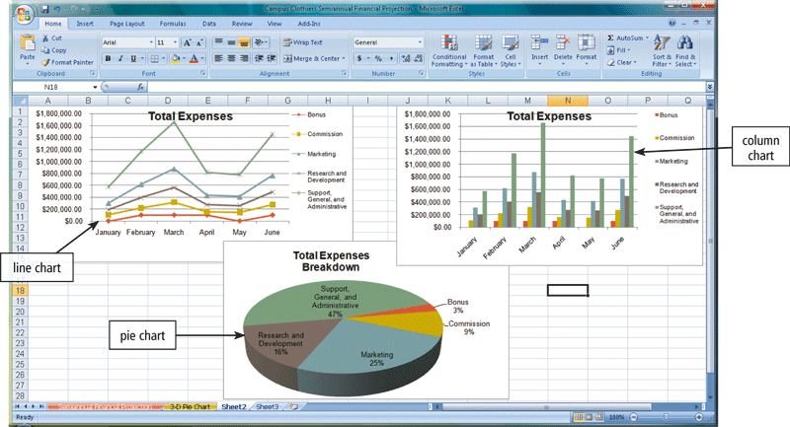
Business Software
Charting depicts data in a spreadsheet in graphical form
Pages 152 – 153
Figure 3-10

Slide 16
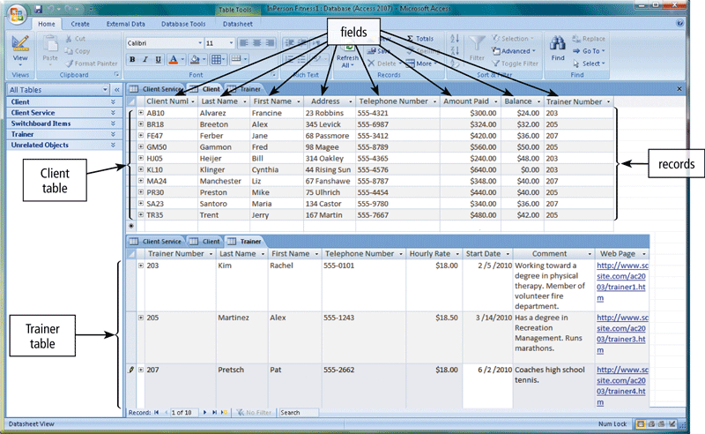
Business Software
A database is a collection of data organized in a manner that allows access, retrieval, and use of that data
  Database software allows users to create, access, and manage a database
Click to view Web Link,
click Chapter 3, Click Web
Link from left navigation,
then click Database
Software below Chapter 3
Page 153
Figure 3-11

Slide 17
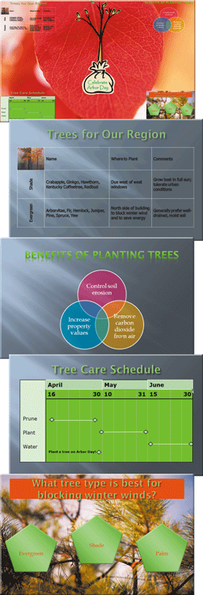
Business Software
Presentation software allows users to create visual aids for presentations to communicate ideas, messages, and other information to a group
Click to view Web Link,
click Chapter 3, Click Web
Link from left navigation,
then click Presentation
Software below Chapter 3
Page 154
Figure 3-12

Slide 18
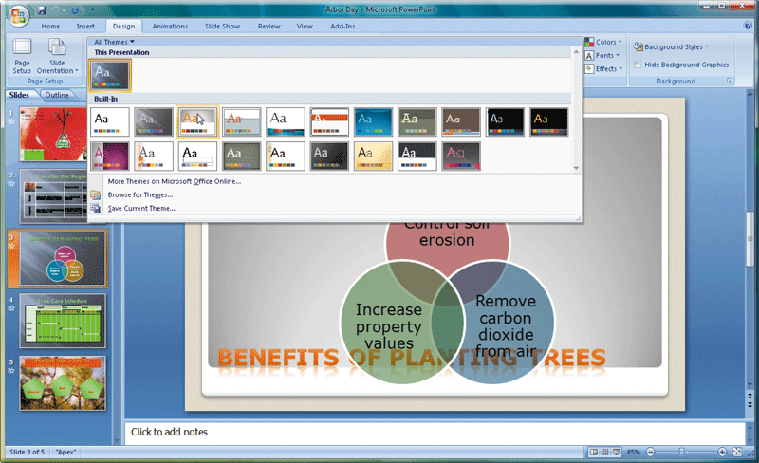
Business Software
Page 155
Figure 3-13

Slide 19
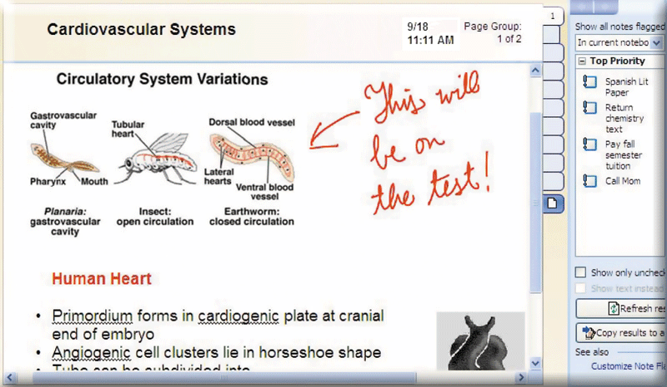
Business Software
Note taking software is application software that enables users to enter typed text, handwritten comments, drawings, or sketches anywhere on a page
Page 156
Figure 3-14

Slide 20
Business Software
A software suite is a collection of individual programs available together as a unit
A personal information manager (PIM) is application software that includes
Appointment calendar
Address book
Notepad
Click to view Web Link,
click Chapter 3, Click Web
Link from left navigation,
then click Microsoft Office below Chapter 3
Page 156

Slide 21
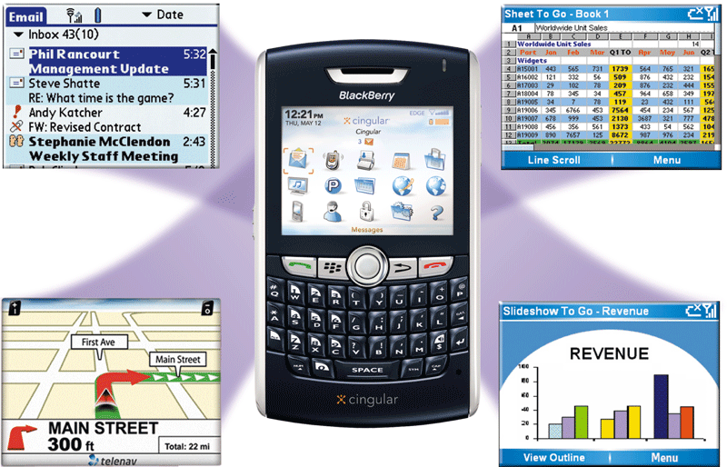
Business Software
Scaled down versions of software are available to work with smart phones and other mobile devices
Pages 156 – 157
Figure 3-15

Slide 22
Business Software
Project management software allows a user to plan, schedule, track, and analyze the events, resources, and costs of a project
Accounting software helps companies record and report their financial transactions
Document management software provides a means for sharing, distributing, and searching through documents by converting them into a format that can be viewed by any user
Pages 157 – 158
Figures 3-16 – 3-18

Slide 23
Business Software
Enterprises typically require special computing solutions for various functional units
Human resources
Accounting
Engineering
Marketing
Sales
Distribution
Customer service
Information technology
Page 159

Slide 24
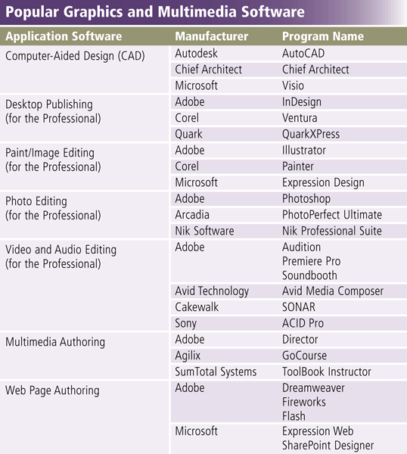
Graphics and Multimedia Software
Page 159
Figure 3-19

Slide 25
Graphics and Multimedia Software
Computer-aided design (CAD) software
Desktop publishing software
Paint/Image editing software
Click to view Web Link,
click Chapter 3, Click Web
Link from left navigation,
then click Graphics Software below Chapter 3
Pages 160 – 161
Figures 3-20 – 3-22

Slide 26
Graphics and Multimedia Software
Professional photo editing software
Video and audio editing software
Multimedia authoring software
Pages 162 – 163
Figures 3-23 – 3-25

Slide 27
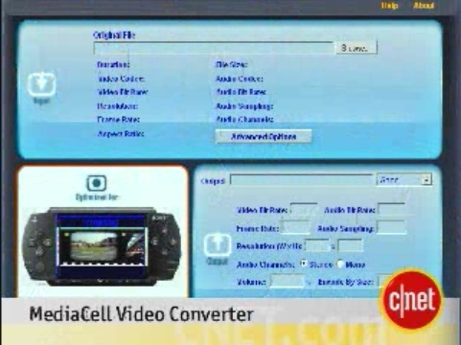
Video: MediaCell Video Converter
CLICK TO START

Slide 28
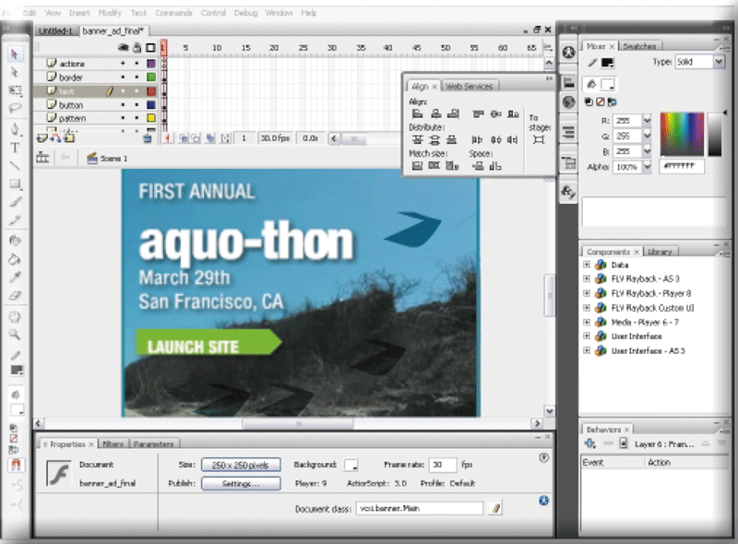
Graphics and Multimedia Software
Web page authoring software helps users of all skill levels create Web pages that include multimedia and interactive content
Click to view Web Link,
click Chapter 3, Click Web
Link from left navigation,
then click Web Page Authoring Software below Chapter 3
Page 164
Figure 3-26

Slide 29
Software for Home, Personal, and Educational Use
Personal finance software
Legal software
Tax preparation software
Click to view Web Link,
click Chapter 3, Click Web
Link from left navigation,
then click Tax Preparation Software below Chapter 3
Pages 166 – 167
Figures 3-28 – 3-30

Slide 30
Software for Home, Personal, and Educational Use
Personal DTP software
Personal paint/image editing software
Personal photo editing software
Click to view Web Link,
click Chapter 3, Click Web
Link from left navigation,
then click Desktop Publishing Software below Chapter 3
Pages 167 – 169
Figures 3-31 – 3-33

Slide 31
Software for Home, Personal, and Educational Use
Clip art/image gallery
Video and audio editing software
Home design/landscaping software
Pages 169 – 170
Figures 3-35 – 3-37

Slide 32
Software for Home, Personal, and Educational Use
Travel and mapping software
Reference software
Educational software
Entertainment software
Click to view Web Link,
click Chapter 3, Click Web
Link from left navigation,
then click Game Software below Chapter 3
Pages 170 – 171
Figures 3-38 – 3-41

Slide 33
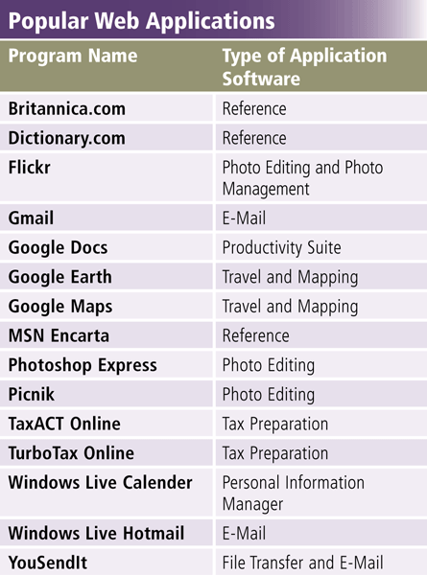
Web Applications
A Web application is a Web site that allows users to access and interact with software from any computer or device that is connected to the Internet
Pages 172 – 173
Figure 3-42

Slide 34
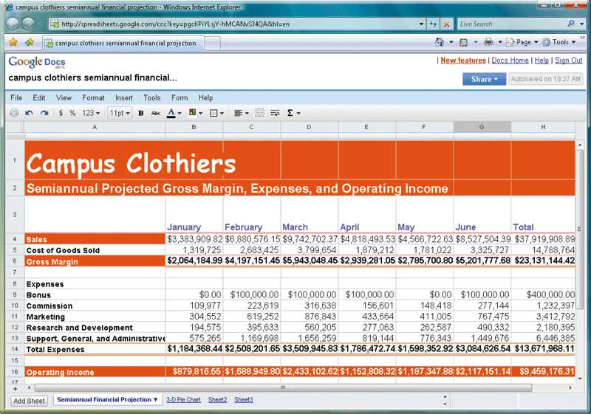
Web Applications
Click to view Web Link,
click Chapter 3, Click Web
Link from left navigation,
then click Google Docs
below Chapter 3
Page 173
Figure 3-43

Slide 35
Application Software for Communications
Web Browser
E-Mail
Instant Messaging
Chat Room
Text, Picture, Video Messaging
RSS Aggregator
Blogging
Newsgroup/Message Board
FTP
Video Conferencing
Page 174
Figure 3-44

Slide 36
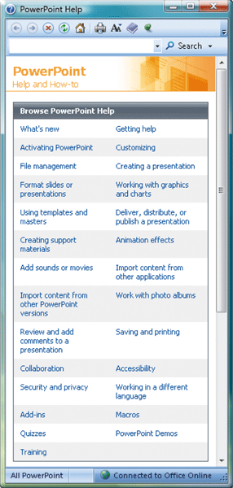
Learning Tools for Application Software
Online Help is the electronic equivalent of a user manual
You can ask a question or access the Help topics in subject or alphabetical order
Page 175
Figure 3-45a

Slide 37
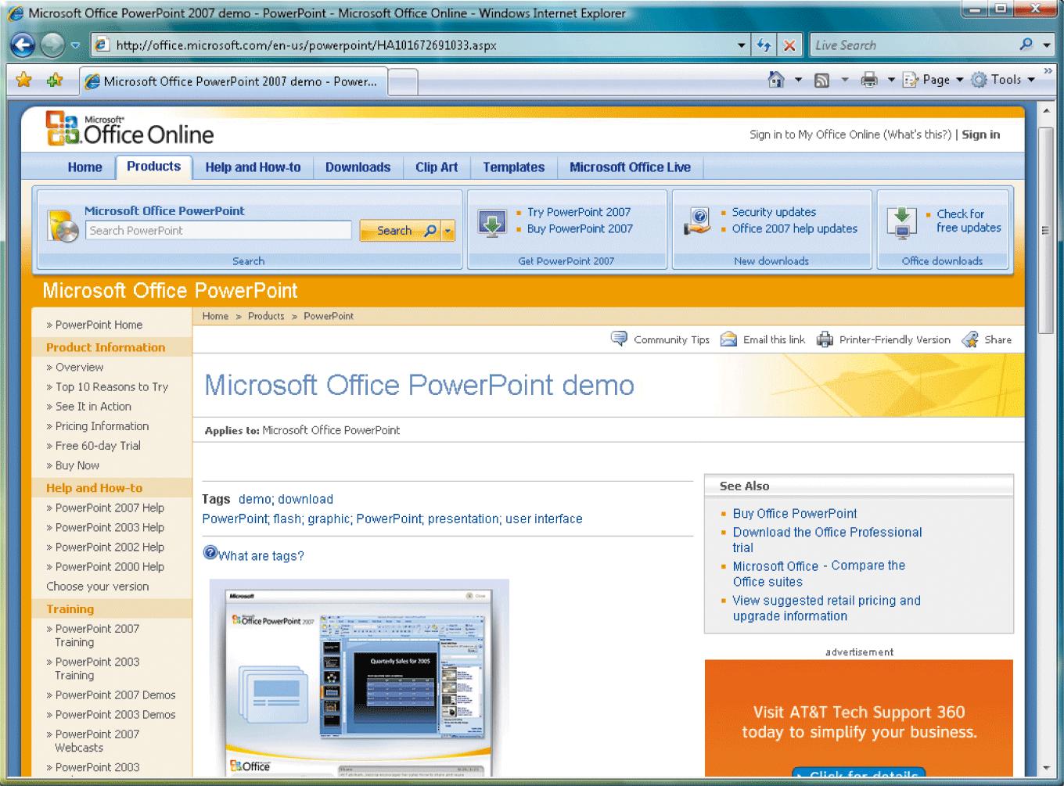
Learning Tools for Application Software
Web-based Help provides updates and more comprehensive resources to respond to technical issues about software
Page 175
Figure 3-45b

Slide 38
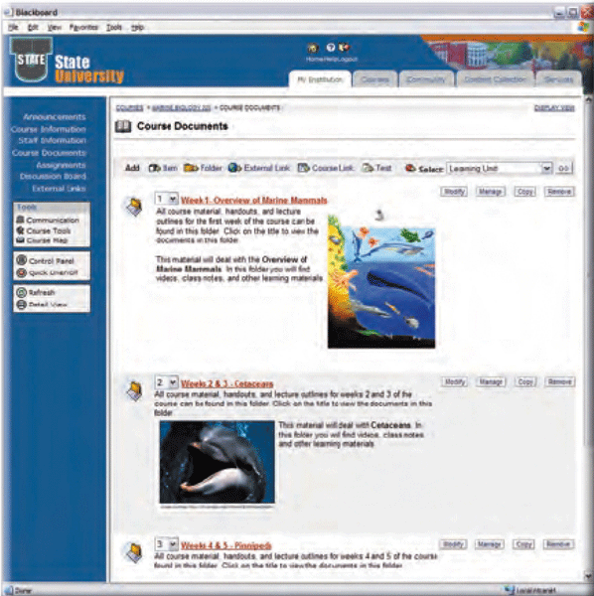
Learning Tools for Application Software
Web-based training is a type of CBT that uses Internet technology and consists of application software on the Web
Distance learning (DL) is the delivery of education at one location while the learning takes place at other locations
Page 176
Figure 3-46

Slide 39
Summary
How to start and interact with application software
Overview of a variety of business software, graphics and multimedia software, and home/personal/educational software
Web applications and application software for communications
Learning tools for application software and Web-based training
Page 177

Slide 40
Chapter 3 Complete

